Slide 1
INSITE GOLD & SWAN SERVER
By: Alex Savoie – NSI Distribution Inc.

Slide 2
Free Application – insite gold
FREE APPLICATION DOWNLOAD
MULTIPLE SITES ON ONE APPLICATION
ALARM CONTROL (ARMING & DISARMING)
PGM CONTROL (ON/OFF CONTROL)
VIDEO CONTROL (PARADOX MOTION CAMERAS)
ACCESS CONTROL FROM APPLICATION (OPENING AND/OR UNLOCKING ACCESS DOORS)
PUSH NOTIFICATIONS (ENABLE/DISABLED)

Slide 3
MULTIPLE SITES SUPPORTED
CONNECT TO MULTIPLE SITES RIGHT FROM YOUR FINGER TIPS

Slide 4
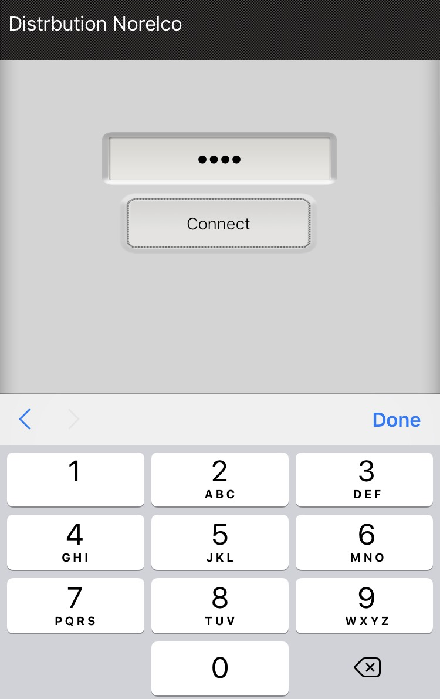
Encrypted AND SECURE
ONCE SITE IS SELECTED CODE MUST BE APPLIED INSTANTLY TO GRANT ACCESS

Slide 5
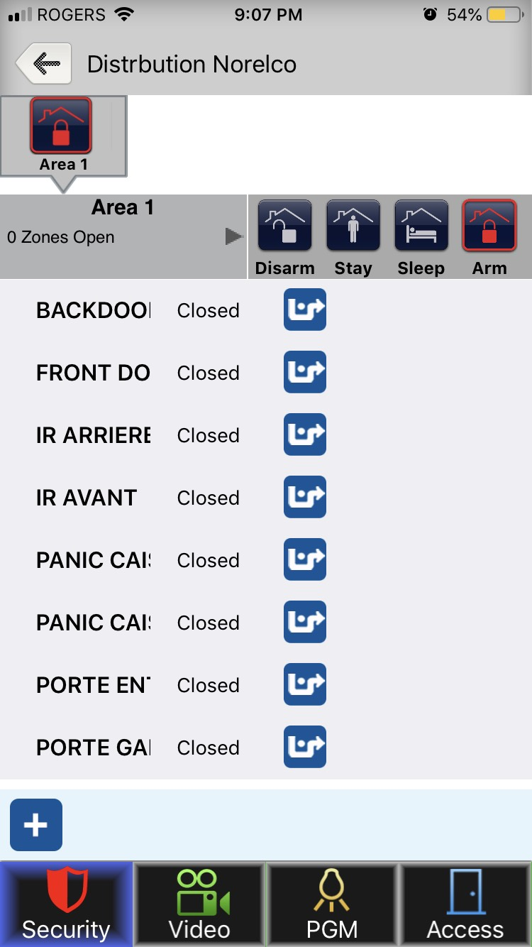
SECURITY CONTROL
PARTITION CONTROL
ARMING/DISARMING
STAY ARM
SLEEP ARM (SP/MG ONLY)
SEE LIVE ZONE STATUS
BYPASS ZONES
BYPASS ALL OPEN ZONES

Slide 6
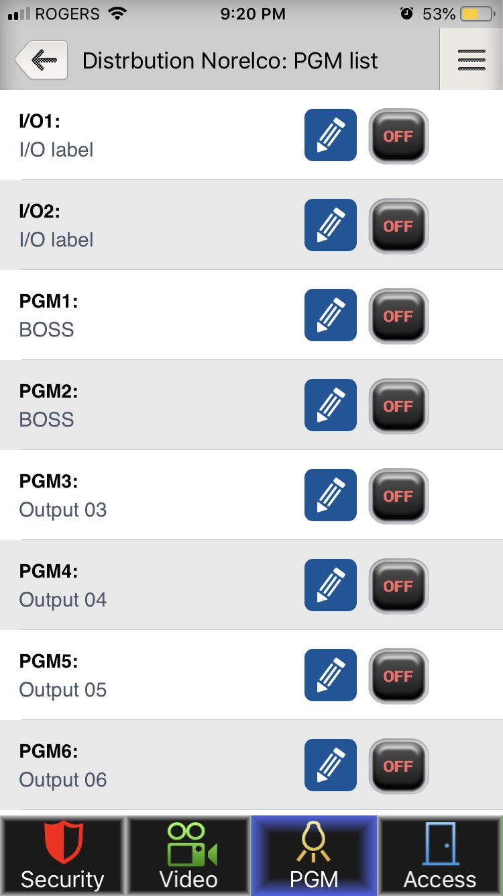
PGM CONTROL
ACTIVATING OR DEACTIVATING LIST OF PGMS
32- PGMS AVAILABLE FROM THE SYSTEM

Slide 7
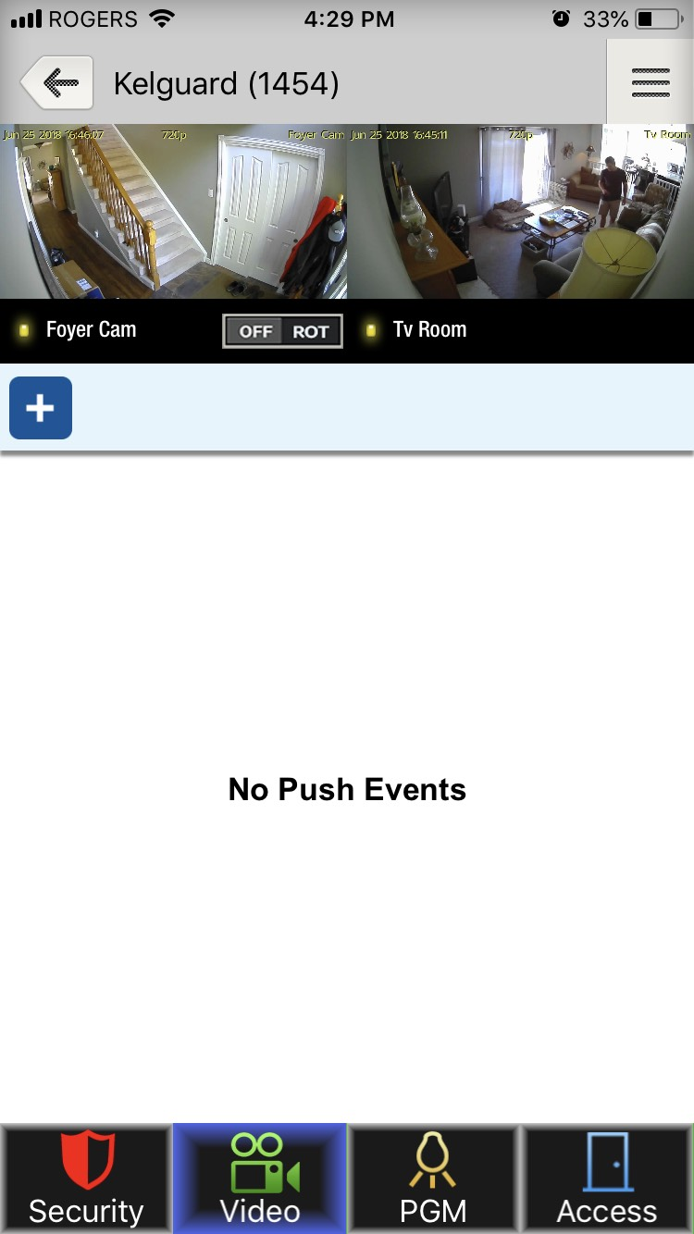
Paradox VIDEO
PARADOX MOTION CAMERAS:
HD78 – INDOOR
WIFI / HARDWIRED
HD88 – OUTDOOR
WIFI / HARDWIRED
VIEW 16-CAMERAS PER SITE
720P HD RESOLUTION
HEAR AUDIO FEEDBACK FROM CAMERA

Slide 8
ACCESS CONTROL
ACCESS 32-DOORS OF ACCESS CONTROL
OPEN A DOOR (EQUIVILANT TO ACCESS GRANTED)
UNLOCK DOOR (LATCH OPEN)
LOCK DOOR (LATCH CLOSED)

Slide 9
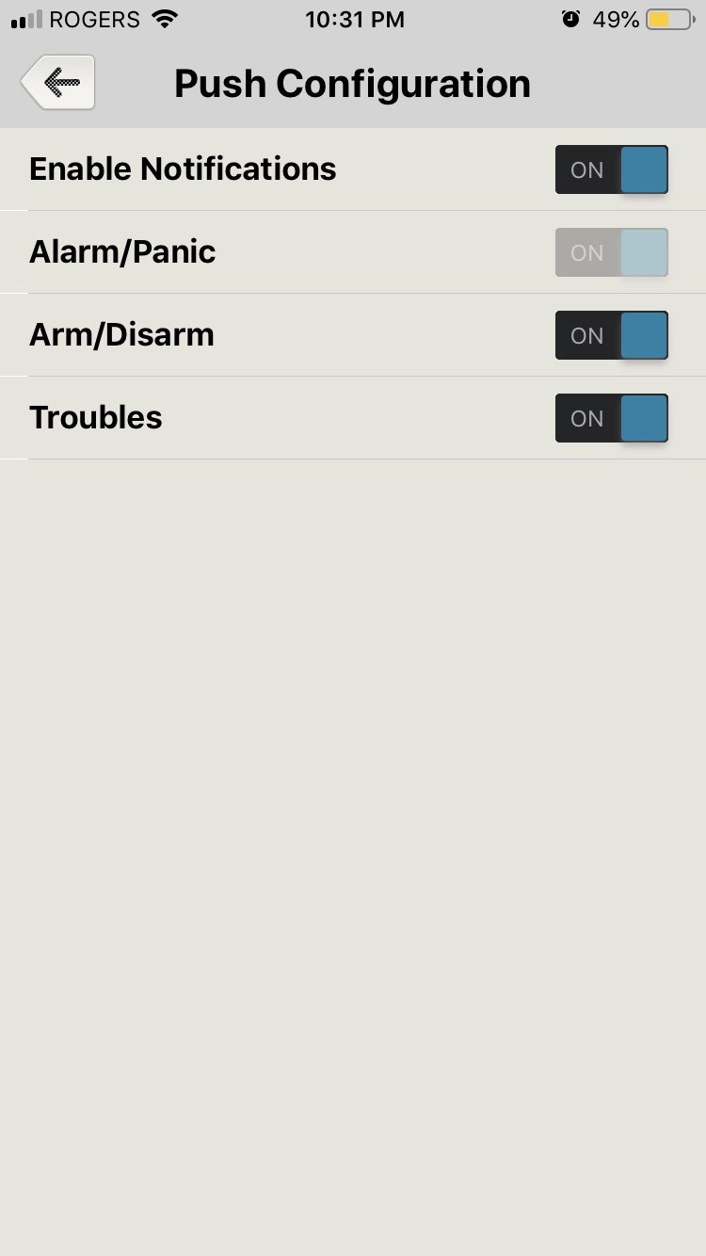
PUSH NOTIFICATIONS
ENABLE ON/OFF CONTROL
ALARM/PANICS – ALWAYS ENABLED
ARM/DISARMING ON/OFF
TROUBLE ON/OFF

Slide 10
QUESTIONS & ANSWERS

Slide 11
THANK YOU & MERCI

