Slide 1


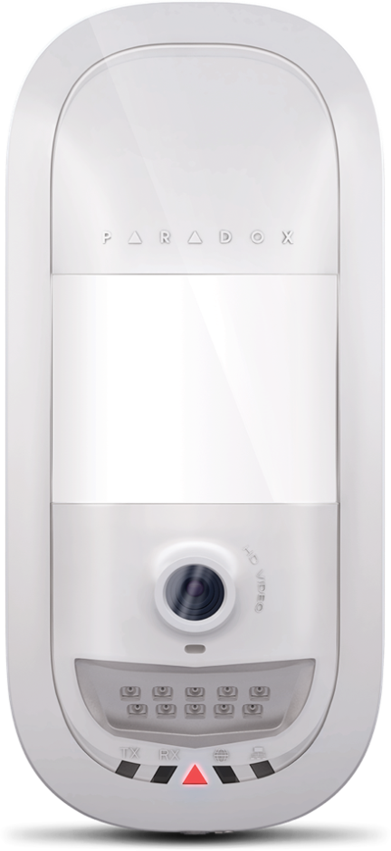
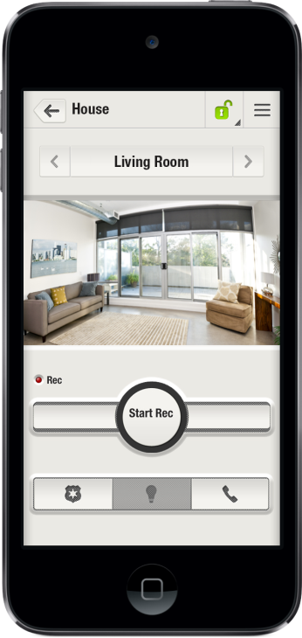
Security designed for your lifestyle
Notes:
Hello everyone and thank you all very much for joining us today. We are very excited to present you with Paradox Insight systems today.

Slide 2
Topics
Paradox Insight Offering
Paradox Insight Tech. Overview
Q&A
Questions & Answers
Notes:
In today’s presentation we would like to give you an overview of Paradox Insight.
We will start by talking about the Insight offering, system highlights and its value to the end-users and the installers.
After that we will look at the core components for the system and key features that differentiate us from our competitors.
If you have any questions you’d like to ask, please send them over during the session using the chat box and at the end we’ll do our best to answer them.

Slide 3
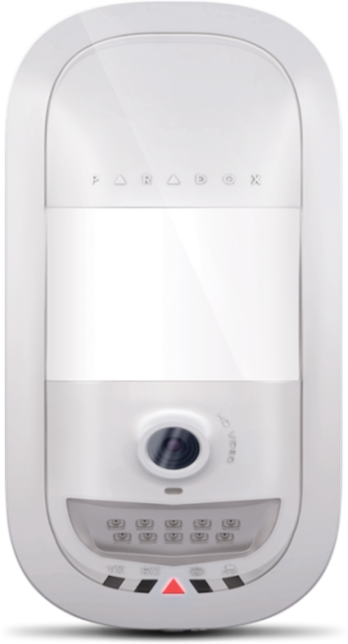
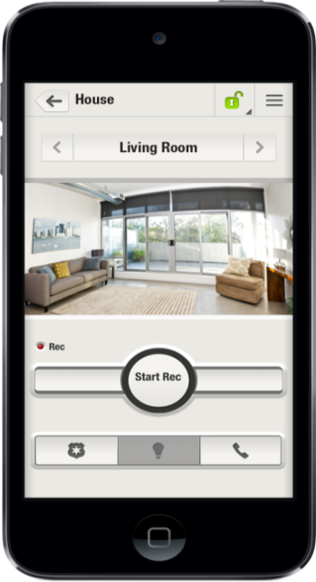
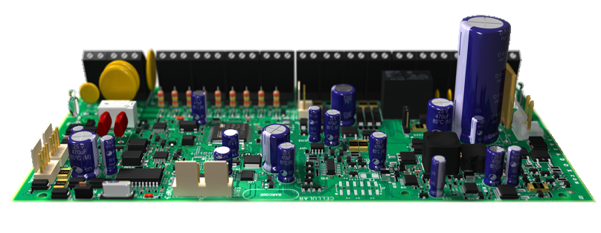
Paradox Insight™ Offering
CE, EN 50131
The 1ST integrated solution of HD video/audio monitoring with superior security capabilities to monitor your home & business anytime from anywhere
EVOHD
HD77 Camera
Insight™ app
Notes:
Paradox Insight is the first and only integrated solution of HD video/audio monitoring with superior security capabilities that allows users to see and hear what is going on and protect their home or business anytime, anywhere right from their smartphone. In a case of a security breach, Paradox Insight provides HD videos with high quality audio of events for visual verification and reporting purposes.
Three core products make up the Paradox Insight™ System
The EVOHD control panel
HD77 HD camera with an integrated PIR detector and microphone (supports 4 x HD77s)
The Paradox Insight™ Mobile App

Slide 4
Paradox Insight™ Highlights
HD video and audio camera (720p) with superior PIR detector
Unlimited viewing/recording of live HD video and audio streaming – anytime, anywhere
Instant video and audio notification with 10FPS JPGs for alarm verification
Free SDK – enables CMS automation software to receive both video and alarm for efficient event reporting
User privacy protection – set of permissions limit non-master users and CMS system access
Secure multiple locations via one app
Self-monitoring application allows immediate access to secure locations from anywhere
Notes:
Few highlights of the system:
- We provide HD video (720p) & audio for event verification including pre-alarm recording – 3 seconds prior to the actual alarm. Using the Paradox Insight app users can view what happened just before the alarm was triggered
- Instant notifications (+ video) of events to permitted recipients (CMS & up to 8 additional users)
-Privacy controls capabilities. Master user can define notification recipients, viewing & recording permissions)
CMS allowed to view live video on alarm only
- APP: System management via app
Watch 4 live HD video & audio quality streams (VOD) with night vision- each site will support 4 cameras
Start Record on Demand (ROD) –will last for two minutes , Record on Trigger (ROT) AND Record on Motion (ROM) – you can review this through the app
Arm, stay & disarm system
Control & manage multiple locations from one app
Record on Trigger (ROT): Recording is done based on alarm received from up to 4 different detection devices (zones), (e.g. opening a door can trigger recording)
Record on Motion (ROM) is triggered if a motion is detected by the HD77 camera. ROM is done when system is armed or disarmed

Slide 5
The Paradox Insight™: The Big Picture
A single CAT5 or higher cable can be used to wire a single HD77 camera.
Notes:
Paradox offers several different supporting products that can be combined with the Paradox Insight solution. The flexibility of the EVOHD panel enables a professional installer to build innovative solutions, geared towards the varying needs and applications of different users. To maximize the capabilities of Paradox Insight, it is logical to expand the system to add additional supporting products such as:
IPRS-7 (CMS software). Easy and intuitive software allows the CMS to remotely connect to customers’ secured locations. An unlimited number of accounts can be registered via IP or SMS. IPRS-7 can display and help the CMS to manage up to 50,000 video and alarm events to achieve an effective response.
TM50. Touchscreen module or standard keypad offers an easy and intuitive interface to manage and control the security system in addition to the Paradox Insight™ mobile app.
IP150. Provides a secure connection to the Internet and allows users to control and monitor the security system via any web browser. IP150 enhances Paradox Insight™ capabilities by sending detailed alarm and event notifications to users via email and send events to the CMS (via IPRS-7).
PCS250/PCS250G . Empowers Paradox Insight™ with the ability to send alarm notifications via SMS/text messages.
Paradox Insight™ is a member of the Paradox EVO family of products and is compatible with all products supported by the EVO192 control panel.
** A single CAT5 or higher cable can be used to wire a single HD77 camera. This cable includes 2 twisted
pairs for the 4-wire combus and 2 twisted pairs for the Ethernet lines. When using this option the cable length is limited
to 50 meters.

Slide 6
HD77 Camera
HD video and audio camera
HD (720p) color video & high quality audio recording
(3 seconds pre-alarm recording)
Superior Quad PIR detector
Illumination IR for clear & concise view of premises
Video Verification of alarm events
  Email (end-user & CMS)
  CMS via IPRS-7 integrated with automation Software
Covering areas up to 12m x 12m (40ft x 40ft)
Onboard 4GB SD card, 3GB available for recording
Notes:
HD77 Camera is a highly reliable HD video (720p) and high-quality audio PIR camera that delivers unlimited live HD video and audio streaming for monitoring and verification of alarm events.
With the HD77, users will get:
24 hour monitoring and alarm verification with infrared night visibility of up to eight meters and full color and black and white (night vision) video recording capabilities.
Live HD video & audio as well as 10 JPEG still images are sent to the monitoring station (via IPRS-7) and to authorized user’s email to help determine the cause for an alarm and an appropriate response. Event reports include HD video at 360p and. And a link to HD streaming video at 720p.
CMS and authorized users can access the camera to watch live events to continue view and dispatch if needed.
Streaming Video on Demand (VOD) functionality using the Paradox InsightTM mobile application or by using the NEware PC application. VOD functionality allows the user to view the scene through the camera without using up memory storage.
Record on Demand (ROD) through the Insight Mobile App with video streaming for up to five minutes.. Recordings are stored on site and can be managed via the mobile application. The HD77 can also be set to record on motion AND record on trigger.
Record on Trigger (ROT): Recording is done based on alarm received from up to 4 different detection devices (zones), (e.g. opening a door can trigger recording)
Record on Motion (ROM) is triggered if a motion is detected by the HD77 camera. ROM is done when system is armed or disarmed
Privacy protected recordings stored on a memory card built into the module that allows audio and video recording initiated by the user or an alarm. Access to VOD and ROD are controlled by the master user.

Slide 7
HD77 Comparison of features
For internal use only
Category | Paradox Insight HD77 | Competitor 1 (Visonic) | Competitor 2 (Essence) | Competitor 3 (RSI) | Competitor 4 (Risco)
Audio | 16KHz/16Bit | Yes | None | None | None
Image Output (on alarm) | Video Stream 640 × 360 HD video: 1280 × 720 10 jpegs per alarm | Motion JPEG QVGA: 320x240 | 1Motion JPEG VGA/QVGA: 640 × 480 | Motion JPEG; snapshot QVGA 320x240 VGA: 640 × 480 | Motion JPEG QVGA: 320x240 VGA: 640 × 480
Video on Demand (VOD) | Unlimited viewing time | Motion jpeg | Motion jpeg (limited time) | Motion jpeg OR Snapshot only for CMS | Motion jpeg
Night Vision | Camera w/ IR illumination | Camera w/ IR illumination | Camera w/ White LED Flash | Near visible IR LEDs | IR LED Flash
Camera Range | 12m (40ft) | 12m (40ft) | 10m (33ft) | 12m (40ft) | 10m (33ft)
Viewing Angle | 100° | 90° | 67° | 110° | 85°
Frame Rate | 10fps | 2fps | 5fps (can go up to 15 fps but Image quality is limited due to low bit RF link – 38kbps) | 5fps | 3-7 configurable
PIR Type | Quad PIR element | Dual PIR element | Dual PIR element | Dual PIR element | Dual PIR element
Notes:
This is a full comparison of features. (need to pick few highlights and talk about them)
- Quad PIR element compare to Dual PIR element
High definition video & Audio
VOD
Frame rates is higher than others
For us it is a real motion files for the others they take snapshots
------------
Paradox: Camera with IR illumination 10m (33ft)
Visonic: Camera with IR illumination - 10m (33ft)
Risco: IR LED Flash -10m (33ft
Essence: . Motion JPEG VGA/QVGA:
640 × 480
2. Up to 15 frames per
alarm
(**Image quality is limited due to low bit RF link – 38kbps, default setting is QVGA and 5 frames per alarm)

Slide 8
EVOHD Control Panel
Robust to support enhanced security capabilities
Chip based 1200 bauds communication line (300 bauds for reporting)
Manage VoIP line and bypass signal distortions
Faster Dialer Communication
Chip based 1200 bauds communication line (300 bauds for reporting)
Manage VoIP line and bypass signal distortions
Faster Dialer Communication
Added Protection to System Integrity
Added Protection to System Integrity
Dedicated input for box tamper switch
Supervised bell output 1A, fuse-less shutdown at 3A
Dedicated input for box tamper switch
Supervised bell output 1A, fuse-less shutdown at 3A
Notes:
EVOHD is a robust control panel with a powerful processor to support the enhanced functionality of the HD77 camera. Its redundant communication method is capable of sending reports to the CMS over IP, GSM, GPRS, landline or any combination. Designed for easy installation and expansion of additional products, the EVOHD can support up to 254 security devices and 192 zones. Its flexible zone assignment allows any detector to be connected or can be assigned to any zone regardless of the physical location of the connection.
----
The only panel that support the HD77 camera
Provide more power to the auxiliary as it provide more power
---
At the core of the Paradox Insight™ solution is the EVOHD professional control panel, designed with a powerful processor enabling it to support
access control, alarms, and video & audio verification functions which includes an advanced PIR (Passive Infra Red) detector with integrated camera (Paradox HD77).
EVOHD is capable of faster processing speeds, programming for tamper reporting, improved zone definitions and PGM configuration changes. It's Digiplex bus system enables plug and play functionality that simplifies installation and upgrade and allows module by module deployment (e.g. zone expansion module, access control, etc.). All bus modules, including motion detectors, can be programmed remotely via a keypad or the Babyware upload/download software.
EVOHD key features:
Zones 192
Partitions 8
Users 999
On-board PGMs* 5
Modules 254
Digital bus
Provides constant power, supervision and two-way communication between the control panel and all its modules
Efficient and effective use of zone deployment
Integrated tamper reporting of EVOHD connected devices without additional wiring
PGM configurations:
3 on-board solid-state PGMs (2, 3, 4) are either inputs or outputs
PGM1 can be used as a 2-wire smoke input
Faster landline communications for software (1200 baud)
Faster battery charging providing up to 1.5A
Power supply features:
2.5A switching power supply
Transformer increased to 75VA
Power consumption of connected modules increased to 2A

Slide 9
EVOHD Control Panel
Robust to support enhanced security capabilities
Power Supply Improvements
New 3.5A internal power supply
Improved auxiliary output (2A)
  Support 4 x HD77
  Shutdown at 2.5A
Fixed Load on DC – no Bus drop on BAT test
1.5A battery charger totally separated and independent of main power supply
  Battery charger much faster – 7AH in 6hr
Support
all EVO192 parameters and more

Slide 10
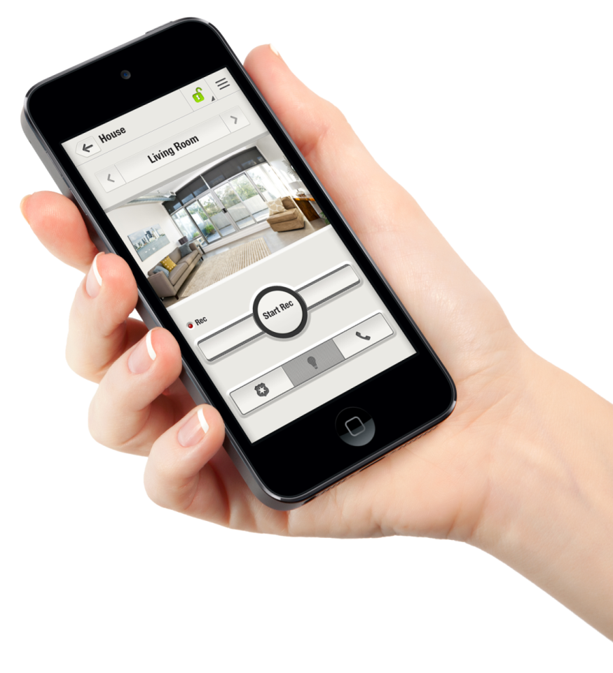
Insight Mobile app
Protect and manage from your smartphone
Manage the entire system from your smartphone
Unlimited live video on demand
Capture and view video clips (ROD)
Email & Camera users management
File management
Panel management
(Status, Arm / Disarm)
Enabled panic triggering
Build a security network of up to 8 people
to receive notifications
Monitor & control multiple locations from one Insight app
View alarms & alarm history
Notes:
Paradox Insight mobile application provides allows instant access to the HD77 to manage multiple secure locations directly from your iPhone (in the future we will support other devices as well) including arming/disarming, recording and watching live videos, and manage user permissions, and media files. With the Insight mobile app, users can:
Watch unlimited live HD streaming videos simultaneously for unlimited time from each secured zone
Access system event logs to quickly verify or monitor the reason for an alarm, enabling instant response
Respond to alarm notifications with options such as contact police, fire, or the Central Monitoring System (CMS) via a panic button or call anyone listed in the mobile phone contacts
** The Panic buttons need to be activated by your installer.
------

Slide 11

Increased Security & Privacy Control
Your security network
One master user
CMS
Up to 8 permitted users to receive alarm notifications
All permitted users can record files
Turn off VOD
View live video anytime, from anywhere
Only master user can write protect, share, or delete the recorded files
Receive alarm notificatons
Restricted to view video (10 sec) + jpegs on alarm only
View live streams (VOD) for 15 minutes after alarm
Up to 8 permitted users to receive alarm notifications
All permitted users can record files
  Recordings are saved on HD77, no external server gets the video recordings
  Only encrypted HD 360p video sent over the web
Notes:
Privacy controls. Set by the master user, privacy is protected by limiting non-master user access. The CMS only receives video in the event of alarm – and for a limited time frame of 15 minutes. Recording only takes place when an alarm is triggered, or when an authorized user implements Record on Demand which is stored within the HD77 device.

Slide 12

Paradox Insight™ System Offering
Manage alarm system (arm/disarm/stay)
Watch unlimited live video
VOD, ROD, ROM, ROT
Manage users & event files (Privacy)
Set VOD LED
  View event reports
View and share recorded
event videos
Video Verification
HD video, high quality audio 720p camera
High reliability Quad PIR, Auto pulse, Auto dual edge, digital detector
Protects areas of 12m x 12m
(40ft x 40ft)
Night visibility for up to
8 m (26ft)
Object identification at 10m (33ft)
Face identification at 4m (13ft)
Mobile Management
Detection
Paradox Insight™
  Multi Site Overview
  HD Video & audio including 360p video of 3 seconds of video preceding the alarm, 10 FPS jpegs
  View live video during event
Notes:
Video verification:
The cause of the alarm is verified both by sight and by sound:
720p high definition recordings
High quality microphone picks up sound
360p video and high quality JPEGs are recorded for IP transmission
3 second pre-alarm recordings (both 720p and 360p) and still pictures
Our camera records in high definition 720p resolution. Because this resolution is too high to transmit by email the camera also records the video in 360p resolution as an encrypted file for transmission to your mail.
The 720p recordings are stored on the camera and can be safely and securely downloaded. No one can directly download the 720p files. Paradox Insight sends the master user or permitted user a link that is available for 15 minutes. Then the link expires. Paradox is always looking out for individual privacy.
On alarm: 10 seconds of 360p video and 10 JPEGs are created. All of these files are stored on the HD77 micro SD card. The folder containing the files from a 10 second video is ~10MB.
Remote Management
Arm / Disarm – anytime, anywhere
VOD (Video On Demand), ROM (Record on Motion), ROD (Record on Demand), ROT (Record on Trigger) capabilities
Panic buttons
Notifications through email
Manage up to 8 users to be notified of alarms and events
Receive and respond to alarm events in real-time

Slide 13
Customer/CMS/Installer Benefits
 | Instant view into your secured location/s anytime, anywhere | Unlimited live HD video & audio monitoring of multiple zones ROD/ROM/ROT
 | Effective response | Receive instant notifications (email alerts) of any alarm or event 10 Seconds of video are recorded including 3 seconds of video preceding the alarm 10 JPEGs are taken at 1.0 second intervals
 | Establish a security network | Add up to 8 additional users to receive notifications in addition to CMS Share live streaming videos (max.2 hours) with up to 4 recipients via email
 | Privacy controls | CMS receives video & audio event alarm Recording only takes place when an alarm is triggered Video records are stored within the HD77 device Camera LEDs indicate when VOD is activated
 | Built to fit different needs | Scalable & Robust control panel to fit different security needs
 | Reliability | No battery dependency required ensures users can watch unlimited videos or set the camera to Record on Motion and Record on Trigger automatically; GSM backup option is available in case of PSTN failure
 | Dramatically reduce false dispatches | Verify alarm within seconds of the event Pre-recorded video (360p), in color or black & white (night vision), 10 fps Permitted users (e.g. CMS) can watch live video streams when alarm is triggered
 | Easy & Intuitive CMS SW/SDK | Provide CMS with Video verification capabilities of alarm events Free SDK enables CMS automation software to receive both video and alarm for efficient event reporting
 | Reduced maintenance costs | Remote programming through Paradox SWs offers installers convenient maintenance options while reducing overall cost
Notes:
Instant view into your secured location/s anytime, anywhere
Suitable for both commercial and residential use
Connection on-demand. Allows users to stay connected to their home or business from any mobile device with on-demand HD video & audio monitoring of multiple zones (up to four zones for each camera).
Instant notifications. Receive instant notifications (email alerts) of any alarm or event and manage how to respond in real-time.
Respond effectively. VOD/ROD capabilities allow the CMS and end user complete visual verification into the events that triggered an alert to determine an appropriate response. This provides police and other emergency responders with live information about the event if needed or helps eliminate false alarms.
Build a security network. Add up to eight additional users to the network to receive notifications in case of an alarm or event, in addition to the CMS.
Privacy controls. Set by the master user, privacy is protected by limiting user access. The CMS only receives video in the event of alarm – and for a limited time frame of 15 minutes. Recording only takes place when an alarm is triggered, or when an authorized user implements Record On Demand which are stored within the HD77 device.
Your CMS can verify the alarm within seconds of the event. You will need to decide with your customer exactly what the CMS will receive on an alarm. This can be just JPEGs with 10 second of video, or up to 15 minutes of video after an alarm.
Real time on the spot video and audio gives your customer all of the information he needs for instantly reacting to the alarm event.
Your customers do not need more remotes.
No need for more devices weighing them down. One smart phone is all they need.
Central monitoring stations get feeds from the system for each alarm (10 seconds of video)
360p video with audio
10 JPGs 1 per second 3 pre-alarm and 7 post alarm
Images sent to CMS include only those from actual alarm events
The CMS can be allowed 15 minutes of video after an alarm only with configuration by the master

Slide 14

Central Monitoring Station (CMS)
Verify the alarm within seconds of the event - CMS gets feeds from the system for each alarm (10 seconds of video)
  360p video with audio
  10 JPGs 1 per second 3 pre-alarm and 7 post alarm
Images sent to CMS include only those from actual alarm events
The CMS can be allowed 15 minutes of video after an alarm only with configuration by the master
IPRS7 (CMS software) – Easy and intuitive software to remotely connect to customers’ secured locations.
  An unlimited number of accounts can be registered via IP or SMS
  IPRS-7 can display and help the CMS to manage up to 50,000 video and alarm events to achieve an effective response
  Free SDK enables CMS automation software to receive both video and alarm for efficient event reporting
Notes:
Your CMS can verify the alarm within seconds of the event. You will need to decide with your customer exactly what the CMS will receive on an alarm. This can be just JPEGs with 10 second of video, or up to 15 minutes of video after an alarm.
Images sent to CMS include only those from actual alarm events
The CMS can be allowed 15 minutes of video after an alarm only with configuration by the master
IPRS7 (CMS software) – Easy and intuitive software to remotely connect to customers’ secured locations.
An unlimited number of accounts can be registered via IP or SMS
IPRS-7 can display and help the CMS to manage up to 50,000 video and alarm events to achieve an effective response
Free SDK enables CMS automation software to receive both video and alarm for efficient event reporting

Slide 15
HD77
Integrated motion detector
with HD video and audio

Slide 16
HD77 Features
Camera Detector Module
  HD 720p camera
  Quad PIR with auto pulse, auto dual-edge digital detector
  Protects areas of 12 m x 12 m (40 ft x 40 ft)
  Night visibility for up to 8 m (26 ft)
    The camera views & records in full HD color
    720p resolution when lighting permits
    For low & zero light conditions the camera has
    Illumination IR for video capture in Black and White mode
Object identification at 10 meters (33 ft)
Face identification at 4 meters (13 ft)
High quality microphone
4GB micro SD card (3GB space for recording video)
Security of a wired Digiplex bus
Notes:
Face identification along with high quality sound make verification easier for both the user and the CMS. The space available for recording video is sufficient for up to 160 10 second files. Each file includes the 720p HD video, the high quality audio, the 360p encrypted video, and the 10 JPEG stills.

Slide 17

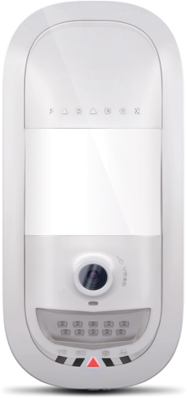
HD77 Features
Event Notification
  Email notification to authorized users and monitoring station
    10 x JPEG stills (3 pre-event and 7 JPEGs at one
    second intervals)
    360p encrypted 10 second video with 3 second
    pre-recording
    A link to a 720p 10 second video with 3 second
    pre-recording
Share live streaming videos (max.2 hours) via email with up to 4 recipients
Record on Motion (ROM) is activated every time the motion detector is triggered. Video is recorded for 10 seconds
Record on Demand (ROD) is activated by user. Video is recorded for 2 minutes
Record on Trigger (ROT): Recording is done based on alarm received
from up to 4 different detection devices (zones), (e.g. opening a door can
trigger recording)
Notes:
Alarm Verification through camera video and JPEG stills
The camera views and records in full HD color 720p resolution when lighting permits
For low and zero light conditions the camera has IR LEDs for video capture in Black and White mode
Even with absolutely no light the camera will still capture clear black and white video and stills. Clear enough for alarm verification and
face recognition.
The camera contains a light sensor that controls the IR LEDs, and switches the camera between full color and black and white mode.
The camera views and records in full HD color 720p resolution when lighting permits
For low and zero light conditions the camera has IR LEDs for video capture in Black and White mode
When the camera is recording 3 end user files are created:
encrypted 360p resolution file
1720p resolution file
10 JPEGS file
Permitted viewers also are taken from the system users. The list of contacts is a subset of permitted viewers. Managing the recorded files is another major feature. A major concern that should be explained to the end user is the legality of turning off the VOD LED. This is dependent on local laws. Another concern is the legality of recording audio without the knowledge of those recorded.

Slide 18
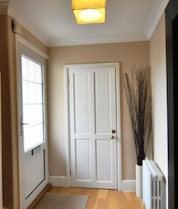
Recording on Demand (ROD)
Record on Demand
IR Illumination and Camera LED Assignment
  Camera views and records in full HD color 720p resolution when lighting permits
  Low light and zero light IR illumination
  Camera LED assignment for the center triangle LED
The micro SD card has 3GB of space available for saving recording files
  After the 3GB are filled the memory card records over the files FIFO (first in first out)
Notes:
1 – encrypted 360p resolution file is to be sent through email to the list of contacts programmed into the App
1 – 720p resolution file is saved on the card. To view this file the master requests the file and a link to a secured site is sent to the user where he can view the recording.
1 – 10 JPEGS

Slide 19
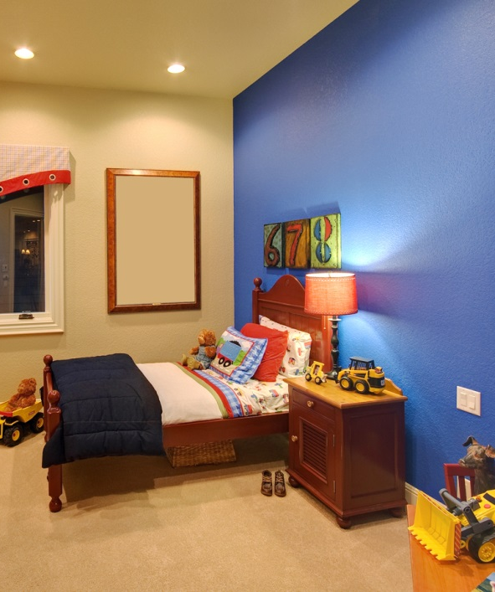
HD77 Privacy Respected
Master User
One master user
Master user can add / remove write protect settings, share, or delete the recorded files
Manage user authorization per camera
  Only permitted users can access VOD
Security
No external server receives the video recordings
Up to 8 contacts (master + 7 ) for event notification
CMS notification is sent to 8 users + CMS
Only encrypted HD 360p video sent over the web
VOD configurable LED indicator
Quick VOD block
Notes:
The HD77 respects the end-users privacy. Recordings are only 10 seconds long. All files are stored on hte HD77. All 360p files for streaming or viewing are encrypted.
All 720p files are protected by restricting download to the user that recorded the file or the master user only. download is available only on request and then only through a special changing link that is good for 15 minutes.
Video on demand permitted viewers are restricted by the master user. There are 2 levels of permitted viewer. 1 that can view VOD anytime and 1 that can only see VOD on an alarm.
The master user can also deny access to all of the viewers of VOD for as long as he/she wants by restricting viewer access in the settings tab.
The 4GB micro SD card can hold 1.4GB of recordings. That is ~160 10 second videos.
The recording folders each contain a 720p resolution file, an encrypted 360p resolution file and 10 JPEGs. This folder is ~10MB in size
for a 10 second video.
This restriction of the recording time is a major privacy issue. Limiting the recordings to 10 seconds or ROD limited to 5 minutes does more than just save space.
It is a huge concession to the right to privacy of all individuals that enter into the protected space, especially people that live and work in the protected space.
There can be no unlimited recording of people 24/7.
“The right to privacy shall not be infringed”.
A blue triangular LED on the camera means that someone is watching you.
There are legal implication to making video and audio recordings of people without their knowledge.
Please be sure to explain the relevant local restrictions to the end user.
It is highly recommended that the camera LEDs indicate when VOD is activated
(indicated by a blue triangle LED on the camera)
-Unsuccessful User Login Attempts: If incorrect password was entered five consecutive times, user access to Paradox Insight app will be blocked for 15 minutes; email will be sent to master user to unblock user access if requested

Slide 20
Paradox Insight App

Slide 21

Paradox Insight™ Mobile App
Monitor: Video & Audio
Manage 4 x HD77 per site
VOD access
Verify events
Ability to monitor multiple sites
Remote Control
Arm / disarm, panic
Receive event alerts
Manage media files
Compatibility iOS V6.0 or higher

Slide 22
LEDs on the Camera
The center triangular shaped LED has the following LED assignment
Function | LED Assignment
HD77 module is up and running. There are currently no alarms or requests for VOD / ROD | OFF
Firmware upgrade in progress | Purple flash
VOD (no PIR detection) | Blue on
Power-up (PIR stabilization and CPU not fully ready – waiting for all labels) | Blue flash
Locate mode | Blue flash
General bus failure, wiring problem, too many modules communication problem | Red on
Bus low power | Red flash
PIR alarm | Red for 5 sec

Slide 23
EVOHD
192-Zone Panel with Digiplex Bus
Notes:
Now we go a little deeper into the components of the Insight system.

Slide 24

EVOHD Features
  Constant power, supervision, and two-way communication between the control panel and all of its modules
  Manage up to 4 x HD77s
  5 PGMs (3 solid state relays)
Battery backup
4 wire proprietary Digiplex combus
16 Vac input
12 Vdc board voltage and Digiplex bus voltage
PSTN connections for phone line interface
Serial port: used for connection of 307USB,
IP150 or PCS250/G
Optional VDMP3 voice module
  Integrated tamper reporting
Notes:
This powerful control panel can manage up to 4 cameras
The control panel gives you a lot of options. One main advantage of Paradox systems is the DigiPlex combus wiring system. This allows all of the modules to be connected to a single combus which then connects to the panel. There are 5 PGMs and connections for the PSTN. The VDMP3 voice module can be added to the panel.

Slide 25
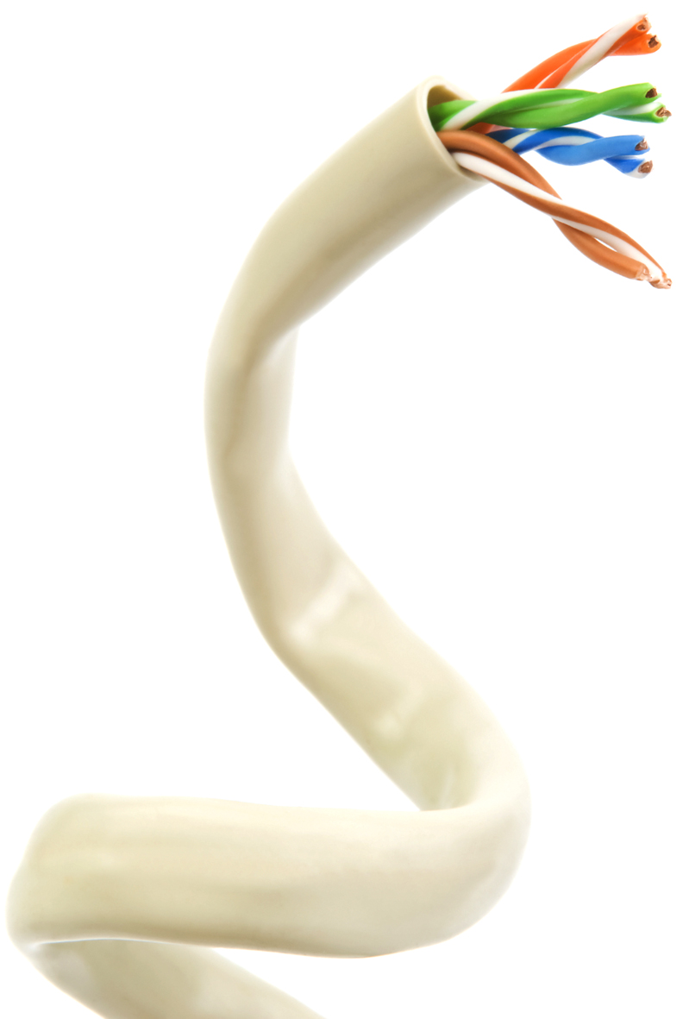
EVOHD Advances
Power Supply Improvements:
Improved auxiliary output (2A)
  Support 4 x HD77
  Shutdown at 2.5A
New 3.5A power supply with
1.5A battery charger totally separated and independent of main power supply
  Battery charger much faster -> 7AH in 6Hr
Faster Dialer Communication for software upload / download:
Chip bases 1200 bauds communication line (300 bauds for reporting)
Manage VoIP line and bypass signal distortions
Notes:
Recent improvements in the panel increase the stability and effectiveness of your security system.
Faster phone line and VOIP communications with less noise and interference. This gives faster uploading and downloading capabilities.

Slide 26
Paradox Insight
Enhanced System
Notes:
This is a standard middle of the road system that will meet most customer needs. Of course up to 4 HD77 cameras, door and window contacts, smoke and fire detectors and all kinds of PIR / MW / indoor and outdoor motion detectors can be added. The system shown will be able to communicate with the Internet and cellular systems, with the CMS and with permitted users smartphones.

Slide 27
Components of an Enhanced System
Paradox InSight
Enhanced
System
IP150
IPRS-7
Touchpad / Keypad
PCS250/G
Notes:
IP150 - Internet communication module to control and monitor the security system through any web browser (e.g. Internet Explorer)
IPRS-7 - Desktop application that acts as a Monitoring Receiver
Touchpad / Keypad
PCS250G - GPRS Communicator Module, provides wireless communication solutions for Paradox control panels
Insight App - Management Application

Slide 28
Communication Module IP150
IP150 | IPRS-7 | Touchpad / Keypad | PCS250/G
IP150 communications Internet module
Ethernet port to connect to the Internet
Serial connector to connect to EVOHD panel
Allows you to connect a laptop to the EVOHD panel through the Internet
Receive SSL encrypted email notifications anywhere in the world when your system detects activity
Notes:
This product is a software product and needs to be installed on a computer or server at the CMS site. This is a receiver and reporting module. This is a free download for the CMS.
Confirm that the CMS will be able to accept reports through an IPRS-7.

Slide 29
Receiver module IPRS-7
IP150 | IPRS-7 | Touchpad / Keypad | PCS250/G
IP / GPRS PC Receiver Software
Supports SMS registration and reporting protocol through commercial GSM / GPRS modem
Converts incoming IP signal from a Paradox communication device to ADEMCO 685, SURGARD MLR2-DG, or RADIONICS 6500 and sends via PC communication to a monitoring software
Notes:
Connect to your EVOHD through the internet from anywhere you are.
Receive emails about your system when you are anywhere in the world.

Slide 30
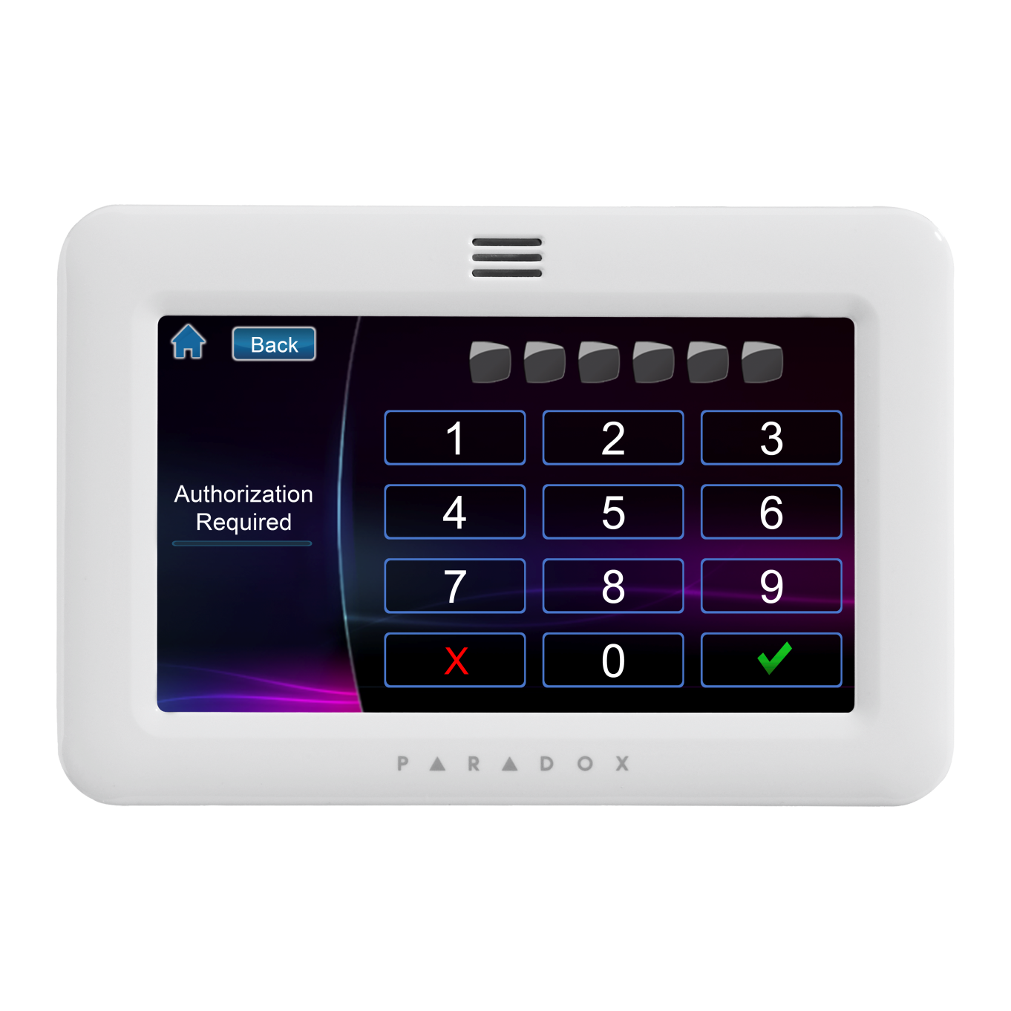
Touchpad / Keypad
IP150 | IPRS-7 | Touchpad / Keypad | PCS250/G
Multi language programmable
Panic buttons
SpotON locator
OneScreen monitoring
TM50 Touch-pad
System Arm / Disarm
Compatible for configuring all other Paradox components through the touchpad
Personalization
Notes:
Except for the HD77 all paradox components can be configured through the touchpad/keypad. The end user has the following features at his disposal: Arm/disarm functionality
See the whole house at a glance.
Spot on locator and on screen monitoring.
The TM50 is a very versatile tool in the end user security toolbox.
Personalize your touchpad/keypad
Touchpad/keypad can be configured to display indoor and outdoor temperature readings.
Except for Video and Audio everything else can be managed from your TM50 touchpad.

Slide 31
PCS250/G
IP150 | IPRS-7 | Touchpad / Keypad | PCS250/G
Empowers Paradox Insight™ with the ability to send alarm notifications via SMS/text messages
Can be used as a backup to a traditional landline, or as a primary communicator where no landline is available.
In GPRS mode, messages are secured with 128-bit (MD5) and 256-bit (AES) encryption (PCS250G only)
Notes:
The PCS250/G can be used as a backup to a traditional landline, or as a primary communicator where no landline is available. The PCS250G GPRS Communicator Module, leverages the GPRS data channel to provide wireless communication solutions for Paradox control panels.

Slide 32
Paradox Insight
System Requirements

Slide 33
Requirements for a Full System
Internet connection w/ minimum upload speed of .5Mb/s
Router with at least 5 available hardwired physical connections (Ethernet connections)
Switch with enough ports to connect all of the cameras plus 2 more ports
  Each HD77 port will need to be reserved (or bound) for its camera
  Each HD77 in the system will have a different IP address
    Each IP address will need port forwarding to two ports of its IP address
PMH account (for registration of the HD77 for access through the APP)
  One PMH account is enough to accommodate sites for all of your customers
Applicable with iPhone iOS 6 or higher
Notes:
Always on internet connection with minimum upload speed of .5Mb/s
Router with at least 5 available hardwired physical connections (Ethernet connections)
• a router with enough ports to connect all of the cameras plus 2 more ports. If the router does not have enough ports you will also need a switch. Each HD77 port will need to be reserved (or bound ) for its camera. Each HD77 in the system will have a different IP address and each one will need port forwarding to two ports of its IP address. One to <IP address>:80 and one for <IP address>:443.
A ParadoxMyHome (PMH) account (for registration of the HD77 for access through the APP). One PMH account is enough to accommodate sites for all of your customers.
An iPhone or Android phone V. 4.0 or higher
iPhone 4 or better with iOS 6 or higher

Slide 34
Tools and Software Requirements
Additional tools and softwares
A laptop With Windows XP or 7
A connection from laptop to the system either by: 307USB cable to connect to the EVOHD serial port or IP150 Internet module
Softwares
BabyWare Installer software V2.8 or higher (downloadable from paradox.com)
Paradox IP Exploring Tool V1.7 or higher (downloadable from paradox.com)
Paradox InSight App (downloadable from iTunes)
CMS will need IPRS-7 version 4 or above
** Make sure the CMS receives reports through an IPRS-7
Notes:
The installer will also need to have the following tools and softwares:
A laptop With Windows XP or 7
A connection from laptop to the system either by: 307USB cable to connect to the EVOHD serial port or IP150 Internet module
Softwares
BabyWare Installer software V2.5 or higher (downloadable from paradox.com)
Paradox IP Exploring Tool V1.69 or higher (downloadable from paradox.com)
Paradox InSight App (downloadable from iTunes)
CMS will need IPRS-7 version 4 or above.
** Make sure the CMS receives reports through an IPRS-7

Slide 35
Softwares
Installer Software
BabyWare
InField
IP Exploring Tool
End User Software
Insight App
NEware
Notes:
Now we turn to the software side.

Slide 36

Installer Software
BabyWare: Installer PC Software
Configure the whole system from your computer
No punching in dozens of numbers into a keypad
Access to all configurable parameters
No programming codes
Notes:
BabyWare is the installer software to ease configuration of the system including all components especially the HD77. Once the installer puts in his 6 digit code he can configure the system using a GUI interface instead of a keypad.

Slide 37

Installer Software
InField: Firmware Upgrade Software
Downloadable through Paradox.com with a login and password
Available within BabyWare
This SW allows you to upgrade FW for all components EXCEPT HD77 cameras which get updgraded through BabyWare
Notes:
Infield allows you to upgrade FW on all components except for the HD77 which is upgraded through BabyWare.
If you are using BabyWare then Infield is right on the toolbar. Otherwise all of these programs, including the IP Explorer tool, can be downloaded from the Paradox.com website with a registered user name and password.

Slide 38
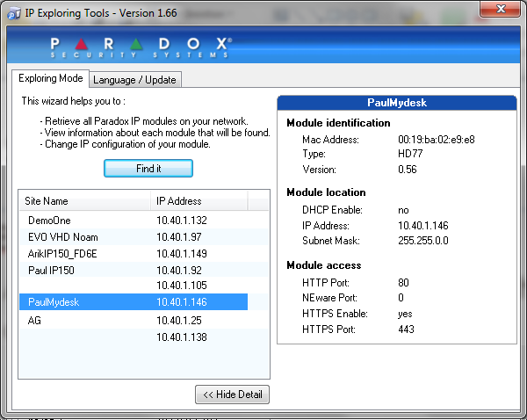
Installer Software
IP Exploring Tool
Identifies each Paradox component connected to your network
Gives you the:
  IP address
  Subnet mask
  Port
  Device type (V1.7)
Notes:
The IP Explorer Tool find the IP addresses and ports for all Paradox components connected to the Internet.

Slide 39
ParadoxMyHome Site
The ParadoxMyHome site is a FREE DNS site that allows you to register your Paradox IP module for easy access to sites with a Dynamic IP address
Registration site for systems with HD77 detector / cameras
Installers need to be registered with a login username and password
Each of your installations will have a ParadoxMyHome SiteID
Notes:
This is a site that you, as the installer, will need to register with and get a user name and password. Once you are a registered user at ParadoxMyHome.com you will have your own page
with all of your customers listed by site name and site ID. Each site will have up to 4 cameras.
This site is a DNS Domain Name Service. IP Addresses normally can change. A DNS takes the IP address, in this case of the camera, and assigns a name to the IP address. Then it polls the camera and checks to see if the IP address is changed. If it has changed then the DNS updates the IP address stored for the site ID to the new one. In this way the site ID which is text, is continuously mapped to the changing IP address.
The site ID from your ParadoxMyHome.com site will need to be passed along to the master user.

Slide 40
End User Software
Insight App
Manage your system through WIFI or your smartphone both
  iOS
  Android
Neware
End-user Software Management through your laptop, or desktop
Notes:
There are 3 end user programs. One is the Insight app, one is the NEware app, and the thrid is the iParadox app.
The Insight app lets you control the major functions of your system and camera.
The NEware app lets you fully manage your security system from your laptop or desktop. It does not manage the HD77 including VOR, ROD, or media files management.
The iParadox app is a management app for your security system that is controlled by your smart phone, but it does not manage the HD77 detector.

Slide 41
Installation Overview
Installing the Paradox Insight™ System

Slide 42
Paradox Insight™ Installation
In just 7 steps…
1. Install the EVOHD and HD77
2. Program the HD77 into the EVOHD system
3. Register the system to the ParadoxMyHome DNS Server
4. Add the HD77 camera to the ParadoxMyHome site
5. Configure the HD77 network IP and ports
6. Install the mobile application on your SmartPhone
7. Use your SmartPhone to view and interact with the HD77
Notes:
As you can see, installation is not really for do it yourselfers, but professionals will quickly learn all of the ins and outs of the system and be able to troubleshoot any problems. The hardware installation is straightforward. The expertise comes to play with the system design, configuration, and making the correct internet connections.

Slide 43
Compatible Paradox InSight
Components
Notes:
Now we turn to the software side.

Slide 44
Compatible Paradox Components
GPRS / IP Receivers
Communication Modules
Touchpads / Keypads
Access Control
Zone Expansion
Motion Detectors
Wireless components
Accessories
Notes:
Other components to enhance your system.

Slide 45
Compatible Paradox Components
Compatible Communication modules
VDMP3: Plug-in Voice Module
PCS250: Using cellular networks, the PCS250 reports to
the monitoring stations automation software via two channels (GPRS / GSM)
PCS250G: Cellular – IP / GPRS PC Receiver Software enables Paradox systems to be continuously monitored, and reliably connected at all times
Notes:
Other components to enhance your system.

Slide 46
Compatible Paradox Components
Keypads
TM50: Intuitive Touchscreen
K656: Touch Sense Keypad
K641+: 32-Character Blue LCD Keypad (EN)
K641: 32-Character Blue LCD Keypad
K641R: 32-Character Blue LCD Keypad with Integrated Card Reader
K641LX: 32-Caracter Blue LCD keypad with built-in transceiver
Access Control Modules
ACM12: 4-Wire Access Control Module
R910*: 4-Wire Proximity Card Reader
R915*: 4-Wire Proximity Card Reader / Keypad
Notes:
Keypads

Slide 47
Compatible Paradox Components
Zone Expansion & Door Contact Modules
ZC1: Door Contact Module
ZX1: 1-Zone Expansion Module
ZX4: 4-Zone Expansion Module
ZX8: 8-Zone Expansion Module
ZX8D: 8-Zone Expansion Module
ZX16D: 16-Zone Expansion Module
ZX32D: 32-Zone Expansion Module
RTX3: Wireless Expansion Module
ZX8D, ZX16D and ZX32D Support 35m DIN Rail mounting with removable terminals
Notes:
Zone expansion and Wireless modules.

Slide 48
Compatible Paradox Components
Digital Motion Detectors
NVX80: Motion Detector with Anti-Mask and SeeTrue™ Technology for Indoor / Outdoor Use
NV780: Digital Outdoor Dual Side-View Detector with 4x Dual Sensors
DM50: Dual Element Motion Detector
DM60: Quad Element Motion Detector
DM70: Dual-optic High-performance PIR
DG85: Outdoor Dual-optic High-performance PIR
DG457: GlassBreak Detector
DG467: 360º Ceiling-mounted PIR
Notes:
Indoor, outdoor, break the glass, ceiling mounted, 360degree microwave, and PIR, detectors.

Slide 49
Compatible Paradox Components
Wireless through the RTX-3
SD360 - Wireless Smoke Detector
G550 – Wire Glass Break Detector
NVR780 – Outdoor Detector
To see more compatible devices please go to www.paradox-insight.com
Notes:
Heat , smoke, and Carbon Monoxide detectors.

Slide 50
Accessories
307USB: Direct Connect Interface up to 300 ft.
CV4USB: RS-485/RS-232 Converter
Direct Connect Interface up to 1000 ft. (300 meters)
IP150 Internet Module
Notes:
Connecting the control panel to your laptop directly.

Slide 51

Questions &
Answers

Slide 52

Thank You
Notes:
Finally, I’d like to finish by thanking you all for your attention if you have any questions pls do not hesitate to contact us
Have a great day...hopefully with an insight ☺

