Slide 1


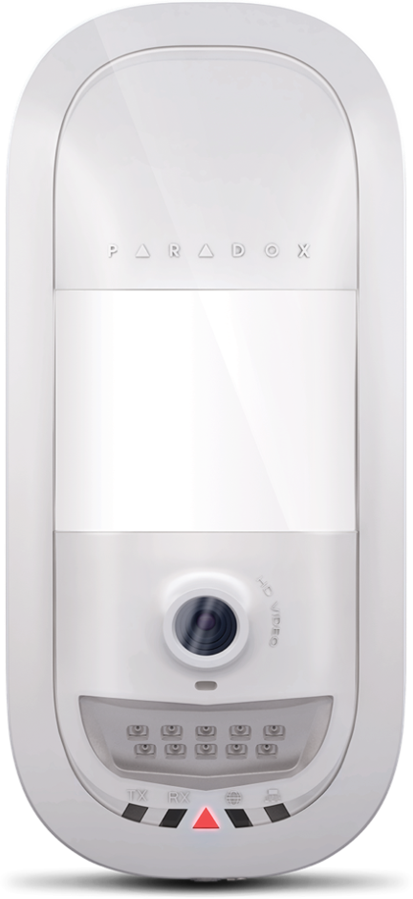
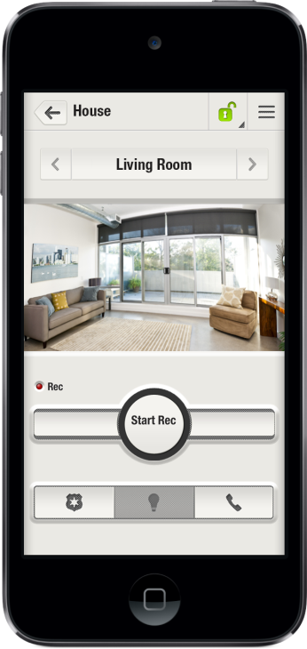
Security designed for your lifestyle
www.paradox-insight.com
Notes:
Hello everyone and thank you all very much for joining us today. We are very excited to present you with Paradox Insight systems today.

Slide 2
Topics
Paradox Insight Offering
Paradox Insight Tech. Overview
Q&A
Questions & Answers
Notes:
In today’s presentation we would like to give you an overview of Paradox Insight.
We will start by talking about the Insight offering, system highlights and its value to the end-users and the installers.
After that we will look at the core components for the system and key features of the system
If you have any questions you’d like to ask, please send them over during the session using the chat box and at the end we’ll do our best to answer them.

Slide 3
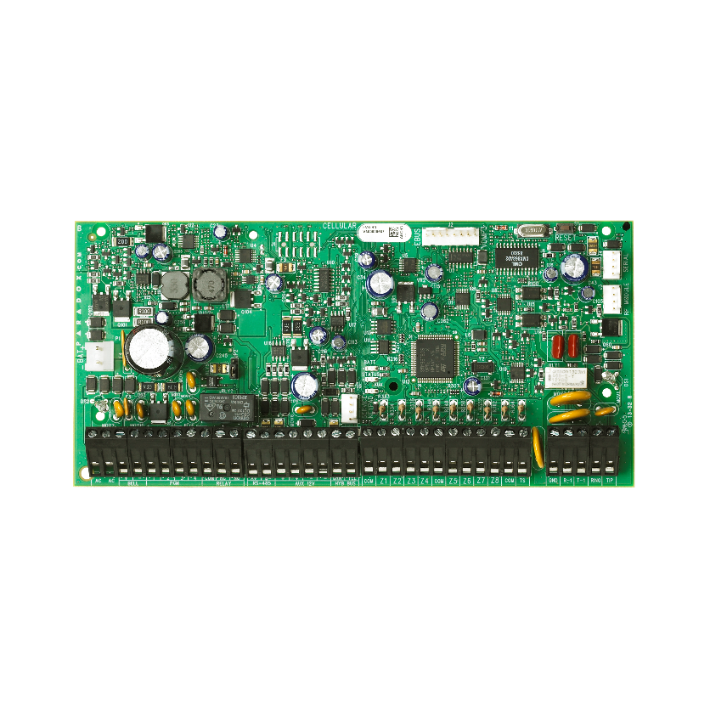
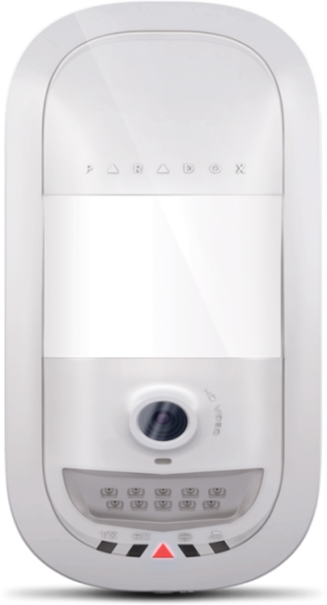
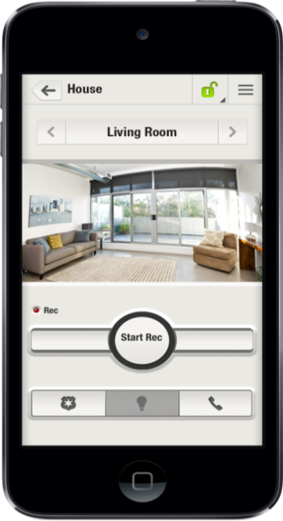
Paradox Insight™ Offering
The 1ST integrated solution of HD video/audio monitoring with superior security capabilities to monitor your home & business anytime from anywhere
HD77 Camera
Paradox Insight™ app
EVOHD
Notes:
Paradox Insight is the first integrated solution of HD video/audio monitoring with superior security capabilities that allows users to see and hear what is going on and protect their home or business anytime, anywhere right from their smartphone. In a case of a security breach, Paradox Insight provides HD videos with high quality audio of events for visual verification and reporting purposes.
Suitable for both commercial and residential use.
Now let’s start by looking at what we are offering;
The Paradox InsightTM is an integrated security system, including a Quad PIR detector with HD camera, that provides the Central Monitoring Station (CMS) and end-users with enhanced video verification capabilities to deal with the ever growing issue of false dispatch.
Paradox Insight is a modular system composed of three advanced modules:
The EVOHD control panel
HD77 HD camera with an integrated PIR detector and a microphone (supports 4 x HD77s)
The Paradox Insight™ Mobile App

Slide 4
Paradox Insight™ Highlights
HD video and audio camera (720p) with superior PIR detector
Unlimited viewing/recording of live HD video and audio streaming – anytime, anywhere
Instant video and audio notification with 10JPGs for alarm verification
Free SDK – enables CMS automation software to receive both video and alarm for efficient event reporting
User privacy protection – set of permissions limit non-master users and CMS system access
Secure multiple locations via one app
Self-monitoring application allows immediate access to secure locations from anywhere
Notes:
Few highlights of the system:
- We provide HD video (720p) & audio for event verification including pre-alarm recording – 3 seconds prior to the actual alarm. Using the Paradox Insight app users can view what happened just before the alarm was triggered
- Instant notifications (+ video) of events to permitted recipients (CMS & up to 8 additional users)
-Privacy controls capabilities. Master user can define notification recipients, viewing & recording permissions)
CMS allowed to view live video on alarm only
- APP: System management via app
Watch 4 live HD video & audio quality streams (VOD) with night vision- each site will support 4 cameras
Start Record on Demand (ROD) –will last for two minutes , Record on Trigger (ROT), Record on Motion (ROM) – you can review this through the app
Arm, stay & disarm system
Control & manage multiple locations from one app
Record on Trigger (ROT): Recording is done based on alarm received from up to 4 different detection devices (zones), (e.g. opening a door can trigger recording)
Record on Motion (ROM) is triggered if a motion is detected by the HD77 camera. ROM is done when system is armed or disarmed

Slide 5
Customer/CMS/Installer Benefits
 | Instant view into your secured location/s anytime, anywhere | Unlimited live HD video & audio monitoring of multiple zones ROD/ROM/ROT
 | Effective response | Receive instant notifications (email alerts) of any alarm or event 10 Seconds of video are recorded including 3 seconds of video preceding the alarm 10 JPEGs are taken at 1.0 second intervals
 | Establish a security network | Add up to 8 additional users to receive notifications in addition to CMS Share live streaming videos (max.2 hours) via email with up to 4 recipients
 | Privacy controls | CMS receives video & audio event alarm Recording only takes place when an alarm is triggered Video records are stored within the HD77 device Camera LEDs indicate when VOD is activated
 | Built to fit different needs | Scalable & Robust control panel to fit different security needs
 | Reliability | No battery dependency required ensures users can watch unlimited videos or set the camera to Record on Motion and Record on Trigger automatically; GSM backup option is available in case of PSTN failure
 | Dramatically reduce false dispatches | Verify alarm within seconds of the event Pre-recorded video (360p), in color or black & white (night vision), 10 JPGs Permitted users (e.g. CMS) can watch live video streams when alarm is triggered
 | Easy & Intuitive CMS SW/SDK | Provide CMS with Video verification capabilities of alarm events Free SDK enables CMS automation software to receive both video and alarm for efficient event reporting
 | Reduced maintenance costs | Remote programming through Paradox SWs offers installers convenient maintenance options while reducing overall cost
Notes:
Instant view into your secured location/s anytime, anywhere
Suitable for both commercial and residential use
Connection on-demand. Allows users to stay connected to their home or business from any mobile device with on-demand HD video & audio monitoring of multiple zones (up to four zones for each camera).
Instant notifications. Receive instant notifications (email alerts) of any alarm or event and manage how to respond in real-time.
Effective response when an alarm is triggered
- 10 seconds of video are recorded including 3 seconds of video preceding the alarm
- 10 JPEGs are taken at 1.0 second intervals
Both the video and the JPEGs are sent to the list of pre-programmed contacts and the CMS
Respond effectively. VOD/ROD capabilities allow the CMS and end user complete visual verification into the events that triggered an alert to determine an appropriate response. This provides police and other emergency responders with live information about the event if needed or helps eliminate false alarms.
Build a security network. Add up to eight additional users to the network to receive notifications in case of an alarm or event, in addition to the CMS.
Privacy controls. Set by the master user, privacy is protected by limiting user access. The CMS only receives video in the event of alarm – and for a limited time frame of 15 minutes. Recording only takes place when an alarm is triggered, or when an authorized user implements Record On Demand which are stored within the HD77 device.
Your CMS can verify the alarm within seconds of the event. You will need to decide with your customer exactly what the CMS will receive on an alarm. This can be just JPEGs with 10 second of video, or up to 15 minutes of video after an alarm.
Real time on the spot video and audio gives your customer all of the information he needs for instantly reacting to the alarm event.
Your customers do not need more remotes.
No need for more devices weighing them down. One smart phone is all they need.
Central monitoring stations get feeds from the system for each alarm (10 seconds of video)
360p video with audio
10 JPGs 1 per second 3 pre-alarm and 7 post alarm
Images sent to CMS include only those from actual alarm events
The CMS can be allowed 15 minutes of video after an alarm only with configuration by the master
Record on Trigger (ROT): Recording is done based on alarm received from up to 4 different detection devices (zones), (e.g. opening a door can trigger recording)
Record on Motion (ROM) is triggered if a motion is detected by the HD77 camera. ROM is done when system is armed or disarmed

Slide 6
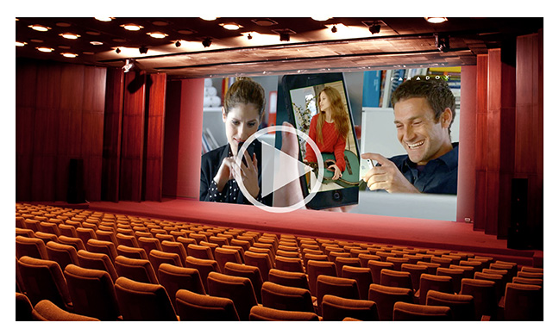
A Day with Insight
Notes:
Pls click on the pic to plat the movie (presentation mode) or use the following link:
https://vimeo.com/101416969

Slide 7
Topics
Paradox Insight Offering
Paradox Insight Tech. Overview
Q&A
Questions & Answers

Slide 8
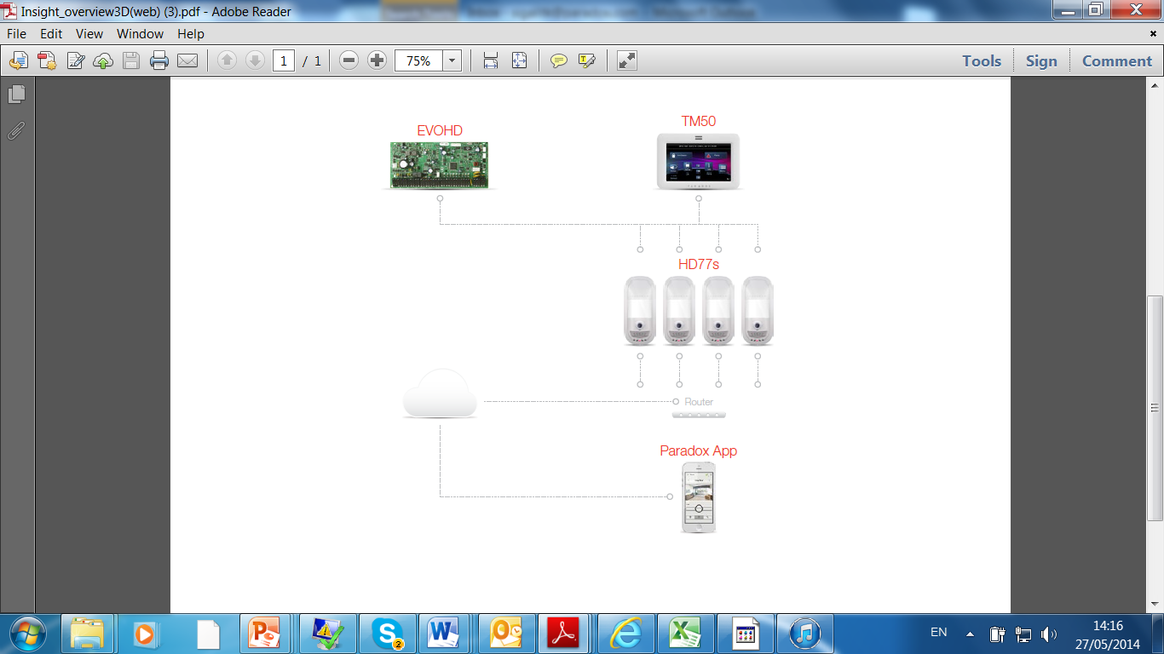
The Paradox Insight™: The Big Picture
A single CAT5 or higher cable can be used to wire a single HD77 camera.
Notes:
** A single CAT5 or higher cable can be used to wire a single HD77 camera. This cable includes 2 twisted
pairs for the 4-wire combus and 2 twisted pairs for the Ethernet lines. When using this option the cable length is limited
to 50 meters.

Slide 9
HD77 Camera
HD video and audio camera
HD (720p) color video & high quality audio recording
(3 seconds pre-alarm recording)
Superior Quad PIR detector
Illumination IR for clear & concise view of premises
Video Verification of alarm events
  Email (end-user & CMS)
  CMS via IPRS-7 integrated with automation Software
Covering areas up to 12m x 12m (40ft x 40ft)
Onboard 4GB SD card, 3GB available for recording
Notes:
HD77 camera is a highly reliable Quad PIR camera (110 degrees) that provides live HD video and audio for verification of alarm events. This helps users detect potential trouble the moment it starts and reduce the number of false alarms. When an alarm is triggered, the HD77 camera sends a pre-recorded video (360p), in color or black and white (night vision) to allow users to view what happened before the alarm (3 seconds) was triggered and 7 seconds when an alarm is triggered, only permitted users (set by the master user) can watch live video streams. The Paradox Insight HD77 camera can also be set to Record on Motion (ROM), RECORD ON Trigger (ROT) and Record on Demand (ROD) based on a user’s decision.
It includes onboard SD card 3GB available -------------
HD77, the showcase product of the Paradox InsightTM solution, provides HD quality camera and Video on Demand (VOD) as well as HD audio/video verification of alarm events. Users can see and hear what is going on in their secured locations – anytime, anywhere. An integral part of the EVOHD security system, the HD77 combines high definition (720p) color video and audio. Paradox HD77 camera withits highly quality (quad) motion detector is capable to monitor areas up to 12m x 12m (40ft x 40ft) what makes it perfect as a security solution for for indoor residential and commercial sites where camera and detector are needed.
During alarm events the quad PIR detector within Paradox HD77 camera detects the event, instantly sends an alert which contains 14 seconds, 360p pre-recorded video clip, 10 frames per seconds, and a link to 720 pre-recorded video clip of the event to the Central Monitoring Station (CMS) and to all permitted users smartphone to verify the alarm and respond accordingly. If needed CMS can continue and watch live events by connecting directly to the camera during evens only (based on privacy definitions)
With the HD77, users will get:
24 hour monitoring and alarm verification with infrared night visibility of up to eight meters and full color and black and white (night vision) video recording capabilities.
Live HD video & audio as well as 10 JPEG still images are sent to the monitoring station (via IPRS-7) and to authorized user’s email to help determine the cause for an alarm and an appropriate response. Event reports include HD video at 360p and. And a link to HD streaming video at 720p.
CMS and authorized users can access the camera to watch live events to continue view and dispatch if needed.
Streaming Video on Demand (VOD) functionality using the Paradox InsightTM mobile application or by using the NEware PC application. VOD functionality allows the user to view the scene through the camera without using up memory storage.
Record on Demand (ROD) through the Insight Mobile App with video streaming for up to five minutes.. Recordings are stored on site and can be managed via the mobile application. The HD77 can also be set to record on motion.
Privacy protected recordings stored on a memory card built into the module that allows audio and video recording initiated by the user or an alarm. Access to VOD and ROD are controlled by the master user.

Slide 10
LEDs on the Camera
The center triangular shaped LED has the following LED assignment
Function | LED Assignment
HD77 module is up and running. There are currently no alarms or requests for VOD / ROD | OFF
Firmware upgrade in progress | Purple flash
VOD (no PIR detection) | Blue on
Power-up (PIR stabilization and CPU not fully ready – waiting for all labels) | Blue flash
Locate mode | Blue flash
General bus failure, wiring problem, too many modules communication problem | Red on
Bus low power | Red flash
PIR alarm | Red for 5 sec

Slide 11
HD77 Comparison of Features
For internal use only
Category | Paradox Insight HD77 | Competitor 1 (Visonic) | Competitor 2 (Essence) | Competitor 3 (RSI) | Competitor 4 (Risco)
Audio | 16KHz/16Bit | Yes | None | None | None
Image Output (on alarm) | Video Stream 640 × 360 HD video: 1280 × 720 10 jpegs per alarm | Motion JPEG QVGA: 320x240 | 1Motion JPEG VGA/QVGA: 640 × 480 | Motion JPEG; snapshot QVGA 320x240 VGA: 640 × 480 | Motion JPEG QVGA: 320x240 VGA: 640 × 480
Video on Demand (VOD) | Unlimited viewing time | Motion jpeg | Motion jpeg (limited time) | Motion jpeg OR Snapshot only for CMS | Motion jpeg
Night Vision | Camera w/ IR illumination | Camera w/ IR illumination | Camera w/ White LED Flash | Near visible IR LEDs | IR LED Flash
Camera Range | 12m (40ft) | 12m (40ft) | 10m (33ft) | 12m (40ft) | 10m (33ft)
Viewing Angle | 100° | 90° | 67° | 110° | 85°
Frame Rate | 10fps | 2fps | 5fps (can go up to 15 fps but image quality is limited due to low bit RF link – 38kbps) | 5fps | 3-7 configurable
PIR Type | Quad PIR element | Dual PIR element | Dual PIR element | Dual PIR element | Dual PIR element
Notes:
This is a full comparison of features. (need to pick few highlights and talk about them)
- Quad PIR element compare to Dual PIR element
High definition video & Audio
VOD
Frame rates is higher than others
For us it is a real motion files for the others they take snapshots
------------
Paradox: Camera with IR illumination 10m (33ft)
Visonic: Camera with IR illumination - 10m (33ft)
Risco: IR LED Flash -10m (33ft
Essence: . Motion JPEG VGA/QVGA:
640 × 480
2. Up to 15 frames per
alarm
(**Image quality is limited due to low bit RF link – 38kbps, default setting is QVGA and 5 frames per alarm)

Slide 12
EVOHD Control Panel
Robust to support enhanced security capabilities
Chip based 1200 bauds communication line (300 bauds for reporting)
Manage VoIP line and bypass signal distortions
Faster Dialer Communication
Chip based 1200 bauds communication line (300 bauds for reporting)
Manage VoIP line and bypass signal distortions
Faster Dialer Communication
Added Protection to System Integrity
Added Protection to System Integrity
Dedicated input for box tamper switch
Supervised bell output 1A, fuse-less shutdown at 3A
Dedicated input for box tamper switch
Supervised bell output 1A, fuse-less shutdown at 3A
Notes:
EVOHD is a robust control panel with a powerful processor to support the enhanced functionality of the HD77 camera. Its redundant communication method is capable of sending reports to the CMS over IP, GSM, GPRS, landline or any combination. Designed for easy installation and expansion of additional products, the EVOHD can support up to 254 security devices and 192 zones. Its flexible zone assignment allows any detector to be connected or can be assigned to any zone regardless of the physical location of the connection.
----
The only panel that support the HD77 camera
Provide more power to the auxiliary as it provide more power
---
At the core of the Paradox Insight™ solution is the EVOHD professional control panel, designed with a powerful processor enabling it to support
access control, alarms, and video & audio verification functions which includes an advanced PIR (Passive Infra Red) detector with integrated camera (Paradox HD77).
EVOHD is capable of faster processing speeds, programming for tamper reporting, improved zone definitions and PGM configuration changes. It's Digiplex bus system enables plug and play functionality that simplifies installation and upgrade and allows module by module deployment (e.g. zone expansion module, access control, etc.). All bus modules, including motion detectors, can be programmed remotely via a keypad or the Babyware upload/download software.
EVOHD key features:
Zones 192
Partitions 8
Users 999
On-board PGMs* 5
Modules 254
Digital bus
Provides constant power, supervision and two-way communication between the control panel and all its modules
Efficient and effective use of zone deployment
Integrated tamper reporting of EVOHD connected devices without additional wiring
PGM configurations:
3 on-board solid-state PGMs (2, 3, 4) are either inputs or outputs
PGM1 can be used as a 2-wire smoke input
Faster landline communications for software (1200 baud)
Faster battery charging providing up to 1.5A
Power supply features:
2.5A switching power supply
Transformer increased to 75VA
Power consumption of connected modules increased to 2A

Slide 13
EVOHD Control Panel
Robust to support enhanced security capabilities
Power Supply Improvements
New 2.5A internal power supply
Improved auxiliary output (2A)
  Support 4 x HD77
  Shutdown at 2.5A
Fixed Load on DC – no Bus drop on BAT test
1.5A battery charger totally separated and independent of main power supply
  Battery charger much faster – 7AH in 6hr
Support
all EVO192 parameters and more

Slide 14
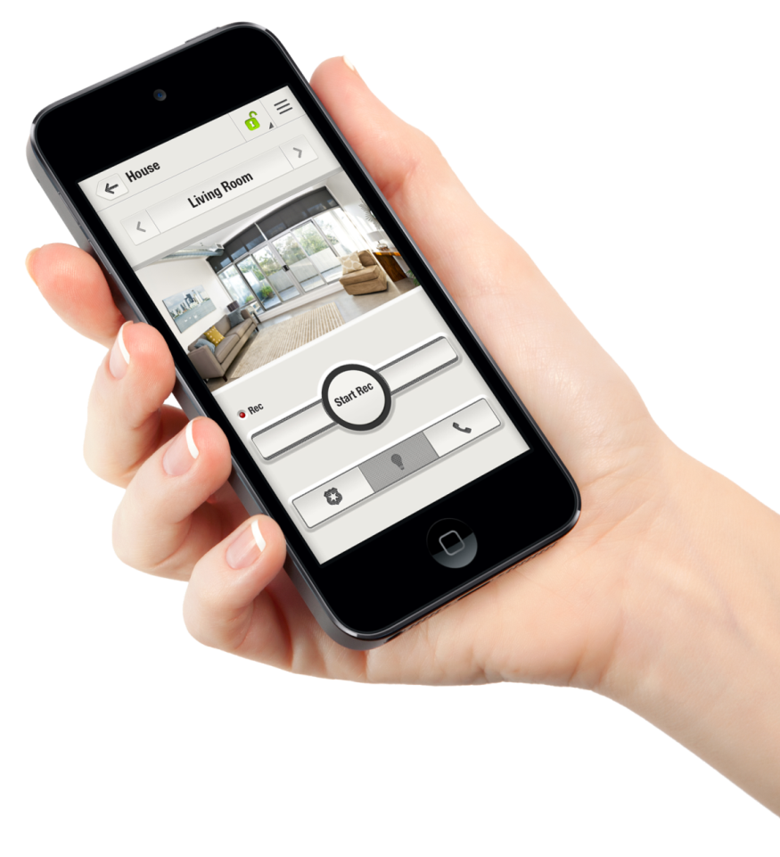
Insight Mobile App
Protect and manage from your smartphone
Manage the entire system from your smartphone
Unlimited live video on demand
Capture and view video clips (ROD)
Email & Camera users management
File management
Panel management
(Status, Arm / Disarm)
Enabled panic triggering
Build a security network of up to 8 people
to receive notifications
Monitor & control multiple locations from one Insight app
View alarms & alarm history
Notes:
Paradox Insight mobile application provides allows instant access to the HD77 to manage multiple secure locations directly from your iphone (in the future we will support other devices as well) including arming/disarming, recording and watching live videos, and manage user permissions, and media files. With the Insight mobile app, users can:
Watch up to four live HD streaming videos simultaneously for unlimited time from each secured zone
Access system event logs to quickly verify or monitor the reason for an alarm, enabling instant response
Respond to alarm notifications with options such as contact police, fire, or the Central Monitoring System (CMS) via a panic button or call anyone listed in the mobile phone contacts
------
Unlimited live HD video & audio streaming anytime, anywhere
Instant HD video & audio notification to multiple recipients
Three second video & audio pre-alarm
HD video and audio camera (1280x720p) with superior PIR detector
Zero-lux vision using high power IR LEDs
Monitor & control multiple locations from one Insight app
Protect end-users privacy
Capture and view video clips (Record on Demand, Record on Motion)
Enabled panic triggering
Manage the entire system from Paradox Insight app (arming/disarming, user permissions, etc.)
View alarms & alarm history
The Paradox InsightTM mobile application provides instant access into your secured locations- anytime, anywhere. With the Paradox Insight mobile app, you can protect and manage what matters most right from your mobile device.
With the Paradox Insight app, you can:
Manage the entire system from your mobile device including arming/disarming, user permissions, and media files
Leverage Video on Demand (VOD), Record on Demand (ROD), Record on Trigger (ROT), and Record on Motion (ROM) to see and record what is happening in your secured locations and give you the knowledge to respond in real-time
Receive and respond to alarm notifications with options such as contact police, fire, or the Central Monitoring System (CMS) via a panic button within the app or call anyone listed in the mobile phone contacts
Build a network of up to 8 people you trust to receive notifications in the event of an alarm or event, in addition to the Central Monitoring System
Secure multiple locations which can be controlled within a single system
Watch up to 4 live HD streaming videos from each secured location directly from your app. Multiple locations can be access & controlled from one Insight app
The Paradox Insight app is compatible with any iOS device.

Slide 15
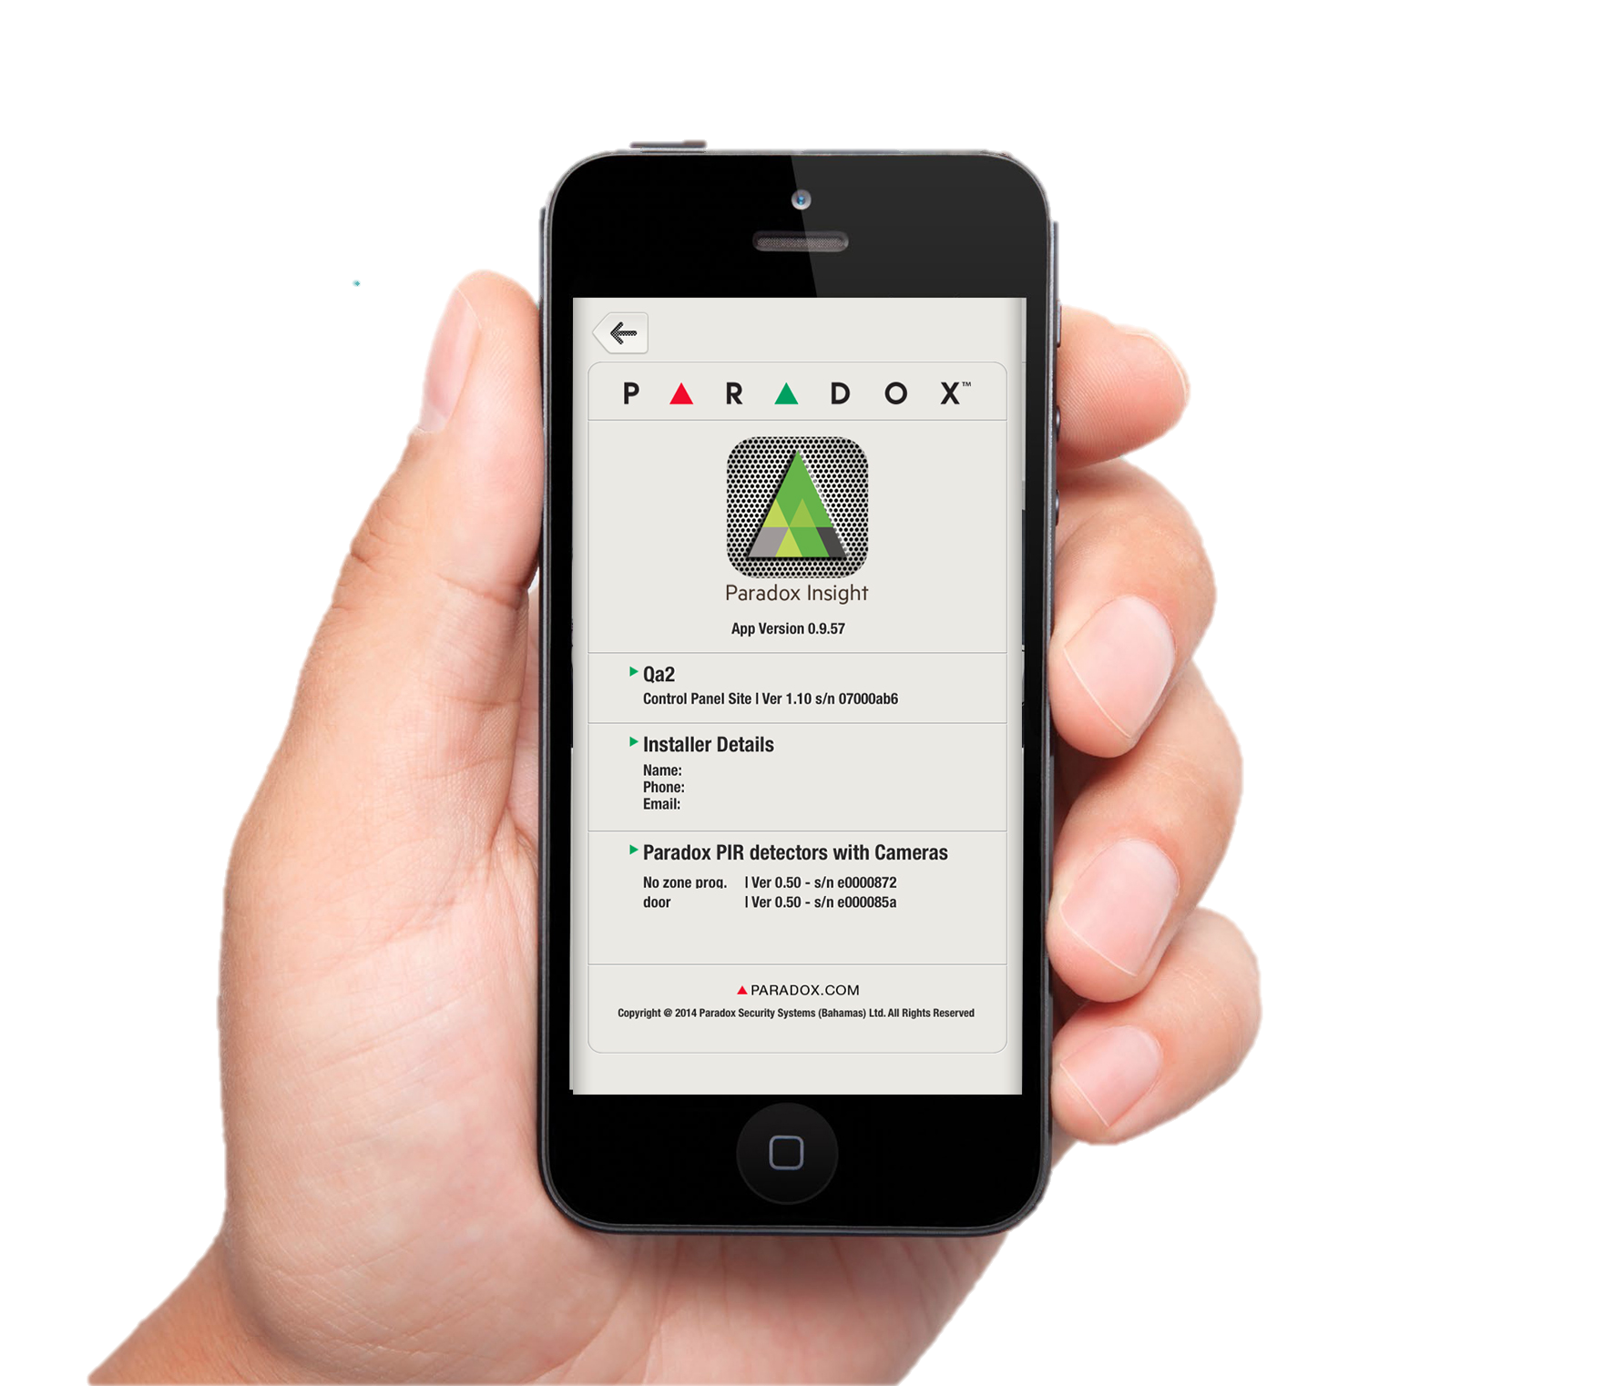
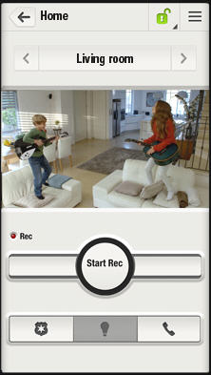
Paradox Insight App Movie
Unlimited live HD video & audio streaming anytime, anywhere
Notes:
Pls play movie by clicking on the app image (presentation mode)
https://vimeo.com/93154333

Slide 16

Increased Security & Privacy Control
Your security network
One master user
CMS
Up to 8 permitted users to receive alarm notifications
All permitted users can record files
Turn off VOD
View live video anytime, from anywhere
Only master user can write protect, share, or delete the recorded files
Receive alarm notificatons
Restricted to view video (10 sec) + jpegs on alarm only
View live streams (VOD) for 15 minutes after alarm
Up to 8 permitted users to receive alarm notifications
All permitted users can record files
  Recordings are saved on HD77, no external server gets the video recordings
  Only encrypted HD 360p video sent over the web
Notes:
Privacy controls. Set by the master user, privacy is protected by limiting non-master user access. The CMS only receives video in the event of alarm – and for a limited time frame of 15 minutes. Recording only takes place when an alarm is triggered, or when an authorized user implements Record on Demand which is stored within the HD77 device.
Unsuccessful User Login Attempts: If incorrect password was entered five consecutive times, user access to Paradox Insight app will be blocked for 15 minutes; email will be sent to master user to unblock user access if requested

Slide 17

Central Monitoring Station (CMS)
Verify the alarm within seconds of the event - CMS gets feeds from the system for each alarm (10 seconds of video)
  360p video with audio
  10 JPGs 1 per second 3 pre-alarm and 7 post alarm
Images sent to CMS include only those from actual alarm events
The CMS can be allowed 15 minutes of video after an alarm only with configuration by the master
IPRS7 (CMS software) – Easy and intuitive software to remotely connect to customers’ secured locations.
  An unlimited number of accounts can be registered via IP or SMS
  IPRS-7 can display and help the CMS to manage up to 50,000 video and alarm events to achieve an effective response
  Free SDK enables CMS automation software to receive both video and alarm for efficient event reporting
Notes:
Your CMS can verify the alarm within seconds of the event. You will need to decide with your customer exactly what the CMS will receive on an alarm. This can be just JPEGs with 10 second of video, or up to 15 minutes of video after an alarm.
Images sent to CMS include only those from actual alarm events
The CMS can be allowed 15 minutes of video after an alarm only with configuration by the master
IPRS7 (CMS software) – Easy and intuitive software to remotely connect to customers’ secured locations.
An unlimited number of accounts can be registered via IP or SMS
IPRS-7 can display and help the CMS to manage up to 50,000 video and alarm events to achieve an effective response
Free SDK enables CMS automation software to receive both video and alarm for efficient event reporting

Slide 18
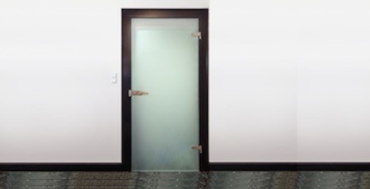
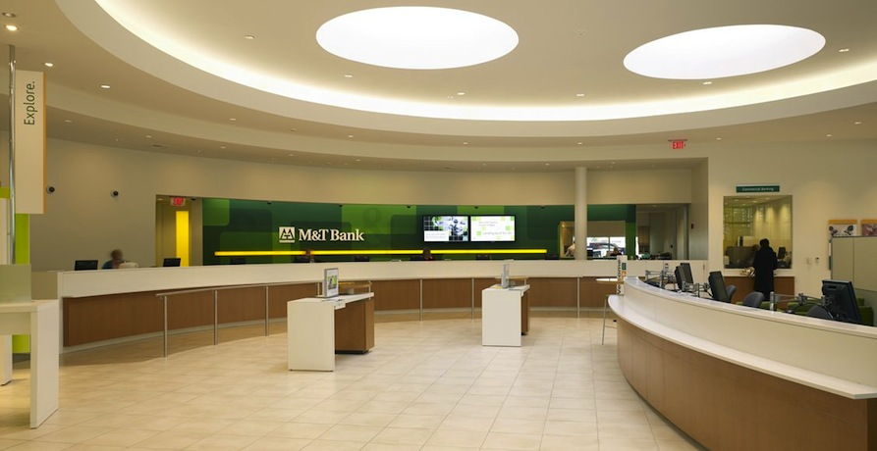
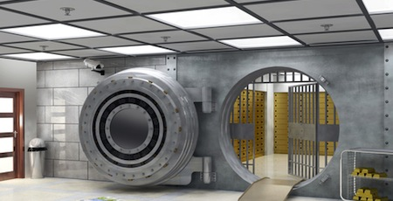

Paradox Insight @ Bank
Main hall view – VOD/Panic buttons available from app
Back door – ROM
ATM back room – Turn off detector while camera is on
Safe room entrance – ROM

Slide 19



Paradox Insight @ Pharmacy
Counters/Cashier – VOD/ROD
Back door – ROM
Cashier view – VOD/ROD
Drug storage – ROM

Slide 20

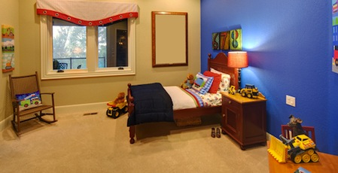
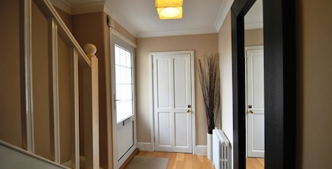

Paradox Insight @ Home
Children bedroom – VOD, ROD
Play room – VOD, ROD
Garage – VOD, ROD, ROM
Entrance – VOD, ROD

Slide 21
Topics
Paradox Insight Offering
Paradox Insight Tech. Overview
Q&A
Questions & Answers

Slide 22

Questions &
Answers

Slide 23

Thank You
www.paradox-insight.com
Notes:
Finally, I’d like to finish by thanking you all for your attention if you have any questions pls do not hesitate to contact us
Have a great day...hopefully with an insight ☺

Slide 24
BACK UP SLIDES

Slide 25
Paradox Insight™
Security designed for your lifestyle
  Ideal for:
  Residential / commercial
  Built to:
  Unlimited view into home or business right from Paradox Insight app
  Receive instant video notifications (email alerts)
  Reduce false dispatch
  Provide a security network
  Manage end-user privacy
  Comply with insurance demands for video verification
  Create new revenue opportunities (for installers)
    Robust & modular system to support users personalized security needs
    Drive new sales - one app, multiple locations
Notes:
When we look at the target market , the Paradox Insight is suitable for both commercial and residential use.
It provides instant access to HD video and audio verification to enable quick response to any alarm event, as well as mobile management for remote monitoring of any secure site.
Reduce false dispatch
Provide an instant view into home or business right from your smartphone
Receive instant video notifications (email alerts)
Provide an added layer of security – by allowing the owner of the system to add up to 8 users who receive notifications when alarm is triggered.
Now many of our customers keep asking us what about privacy? After all we are talking about video cameras and privacy can be an issue. The Paradox Insight app allows the master-users to manage all users , CMSs permissions and more on that in the next few slides.
It is also important to mention that the Paradox Insight brings value to installers as well as it is a
Robust & modular system that can support different combination of security devices.
It also drives new sales – as from one app you can control multiple locations. Now think about the huge sales potential here. In the selling process when the Installer sells the Insight system to one household he can then generate more sales by offering another system to be installed in the owner’s vacation house or in his elderly parents home, where all these locations can be monitored and controlled from one Insight application.
So that was a short overview of Paradox Insight offering
---------
Additional info
Key benefits for users include:
Connect on-demand. Instant view into their home or business from any smartphone or device with on-demand HD video & audio monitoring of multiple zones.
Stay informed. Receive instant notifications (email alerts) of any alarm or event and manage how to respond in real-time.
Build a security network. Add up to eight additional users to the network to receive notifications in case of an alarm or event, in addition to the CMS.
Privacy controls. Set by the master user, privacy is protected by limiting non-master user access. The CMS only receives video in the event of alarm – and for a limited time frame of 15 minutes. Recording only takes place when an alarm is triggered, or when an authorized user implements Record on Demand which is stored within the HD77 device.
Reliability. Battery backup ensures the system is always on in case of mains failure; GSM back up option is available in case of PSTN failureReduce false positive. With an instant view of secured locations, the CMS can distinguish between real and false events. VOD capabilities allow the CMS and user complete visual verification into the events that triggered an alert to determine an appropriate response. This provides police and other emergency responders with live information about the event if needed, eliminate fees due to false alarms, and helps users to comply with alarm verification regulations and insurance requirements.
Reduce maintenance costs. Remote programming through Paradox SWs offers customers convenient maintenance options while helping to reduce overall cost.

Slide 26
Paradox Insight™ System Highlights
 | HD video (720p) & audio for event verification including pre-alarm recording | Report video to CMS with add-on SW (IPRS7)
 | System management via app | Watch 4 live HD video & audio quality streams (VOD) with night vision Start Record on Demand (ROD), Record on Motion (ROM), and Record on Trigger (ROT) Arm, stay & disarm system Control & manage multiple locations from one app
 | Instant notifications (+ video) of events to permitted recipients | CMS & up to 8 additional users
 | Privacy controls | Define notification recipients, viewing & recording permissions CMS allowed to view live video on alarm only
Notes:
Few highlights of the system:
- We provide HD video (720p) & audio for event verification including pre-alarm recording – 3 seconds prior to the actual alarm. Using the Paradox Insight app users can view what happened just before the alarm was triggered
- APP: System management via app
Watch 4 live HD video & audio quality streams (VOD) with night vision- each site will support 4 cameras
Start Record on Demand (ROD) –will last for two minutes , Record on Trigger (ROT), and Record on Motion (ROM) – you can review this through the app
Arm, stay & disarm system
Control & manage multiple locations from one app
- Instant notifications (+ video) of events to permitted recipients (CMS & up to 8 additional users)
-Privacy controls capabilities (define notification recipients, viewing & recording permissions)
CMS allowed to view live video on alarm only
- Robust EVOHD panel to support enhanced security capabilities

