Slide 1


EVO192
High Security and Access Control Systems
Product Information
www.paradox.com

Slide 2
EVO192 Overview
8 to 192-zone expandable security system
Built-in access control features (32 doors)
Supports PCS Series (PCS260/265) for GSM / GPRS communication
Supports Plug-In Voice Dialer (VDMP3)
Supports Internet Communication Module (IP150)
Multibus
Bus modules can be configured from the Panel
Allows to upgrade the firmware of multiple identical modules simultaneously through the combus
In-field upgrade caability for simple on-site updates
999 remotes with only one Transceiver [RTX3], programmable by the installer / Master user
New menu-driven zone programming method

Slide 3
Overview
Digiplex EVO systems provide the highest level of protection
Designed to be easy to use
Modular concept
Provides installers with labour saving features
Makes expanding, installing, and servicing quick and convenient
Expand the system by adding plug-and-play expansion modules
Modules are connected to the combus
Modules can be configuered remotely
More processing power to offer more Users, zones, features, and flexibility

Slide 4
EVO Features
Features | EVO192 / EVOHD
Maximum zones | 192
On-board zones | 8 (16 with ATZ)
Partitions | 8
User codes | 999
Panel In-Field firmware upgradeable | 
Access control (doors) | 32
Access levels / schedules | 16/32
Events buffered | 2048
PGMs | 250 (5 on board)
BUS modules | 254
Software | BabyWare / Neware / INSITE GOLD

Slide 5
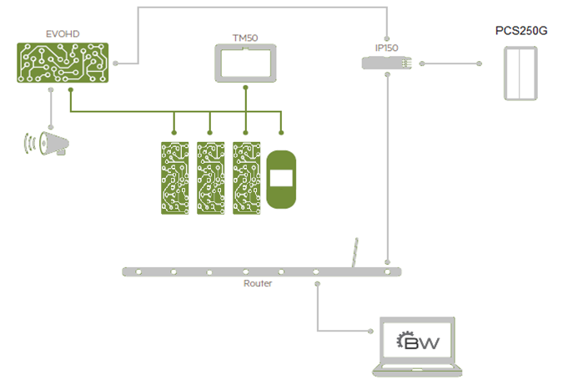
ComBus Architecture

Slide 6

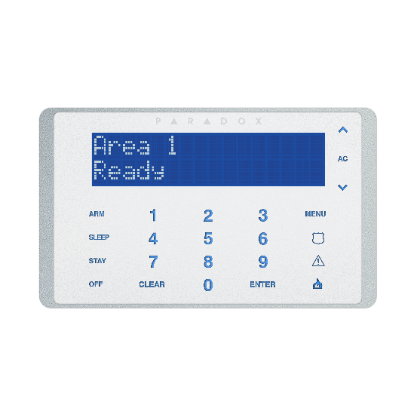
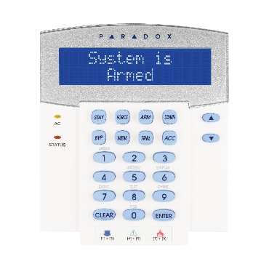
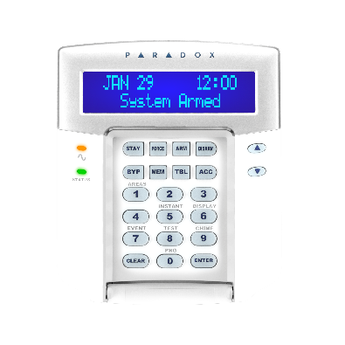
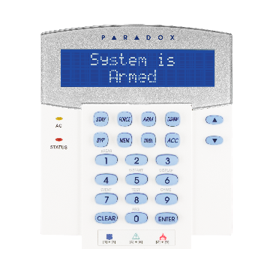
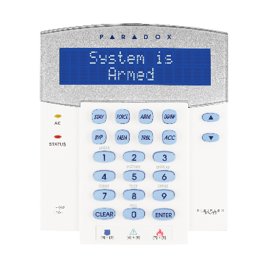
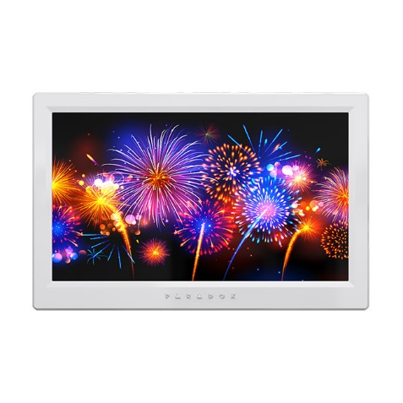
Keypad Modules
K641
32-Character Blue LCD Keypad Module
K641+
32-Character Blue LCD Keypad Module
TM50 Touch Interactive Touchscreen
K656
Touch Sense Keypad
TM70 Touch
7” Interactive Touchscreen
K641R
32-Character Blue LCD Keypad Module with Integrated Card Reader
K641LX
32-Character Blue LCD Keypad with Built-in Transceiver
TM70 Touch
7” Interactive Touchscreen
7-Designer Colours

Slide 7

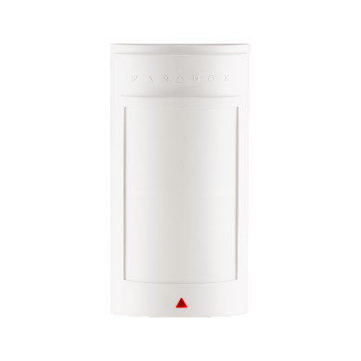
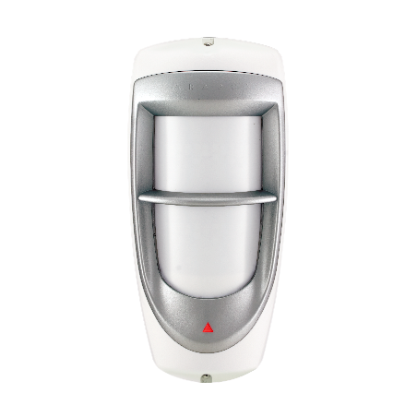


Available Motion Detectors Modules
DM50
Dual Element
Motion Detector Module
DM60
Quad Element
Motion Detector Module
DM70
High-Security Motion Detector Module with Pet Immunity
DG85
Series Outdoor High-Security Digital Motion Detector Module
DG467
360° Ceiling Mounted Digital Motion Detector
DG457
Glassbreak BUS Detector

Slide 8
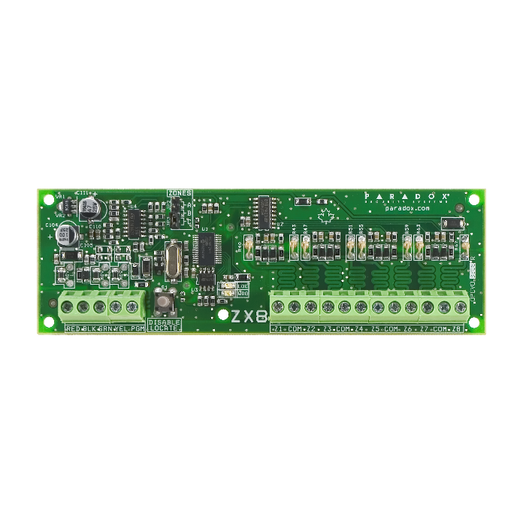
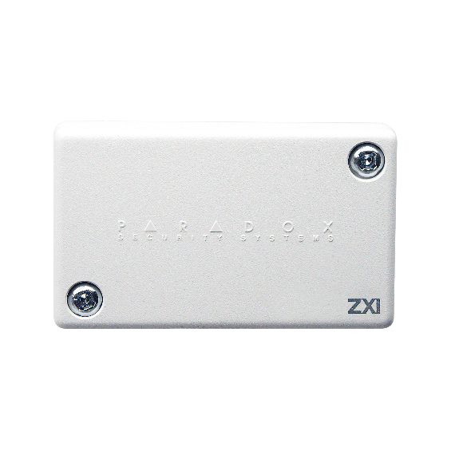
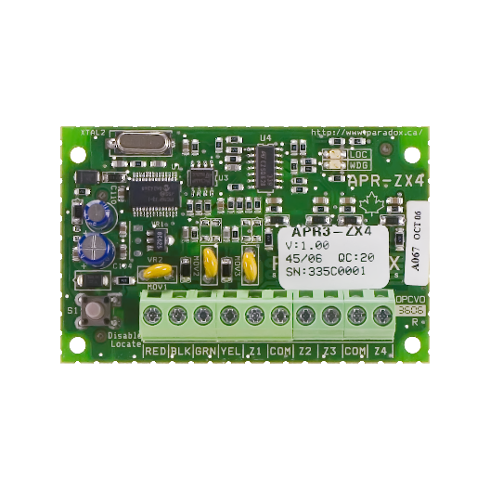
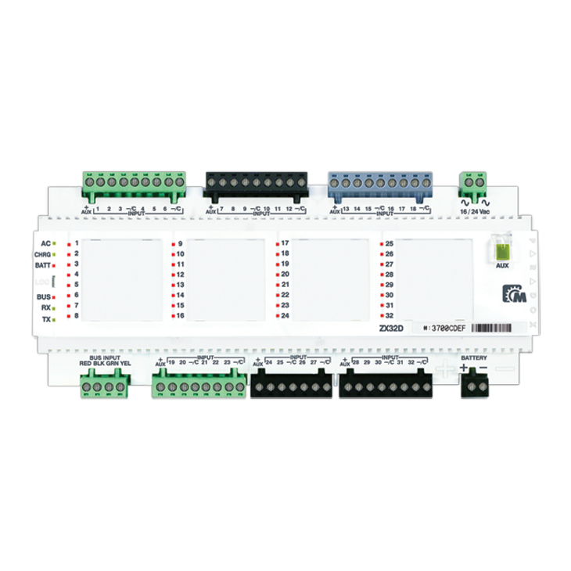
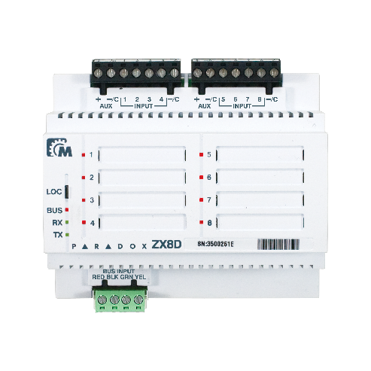
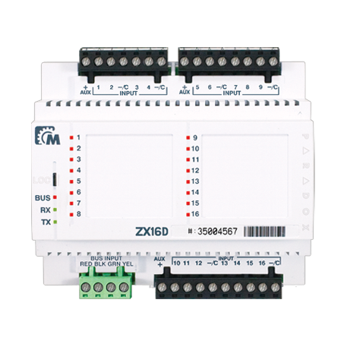
Available Zone Expansion Modules
ZX1
1-Zone Expansion Module
ZX4
4-Zone Expansion Module
ZX8
8-Zone Expansion Module
ZX32D
Discontinued
ZX8D
Discontinued
ZX16D
Discontinued

Slide 9
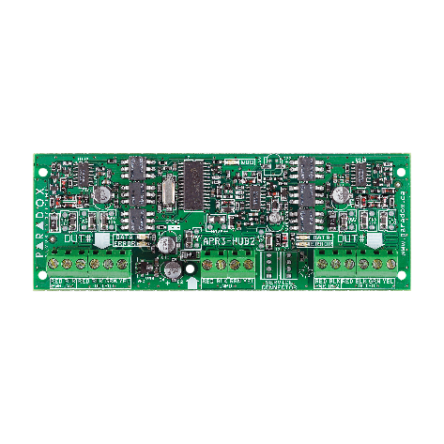
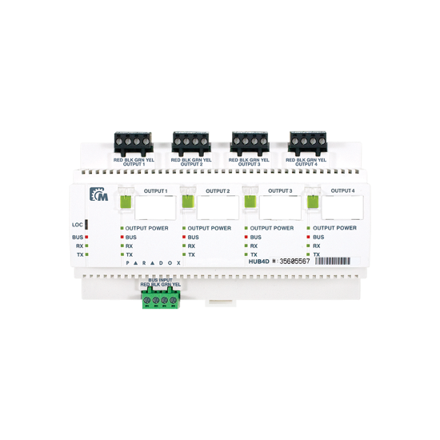
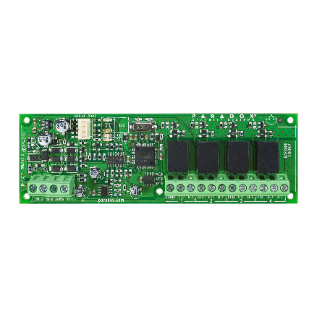
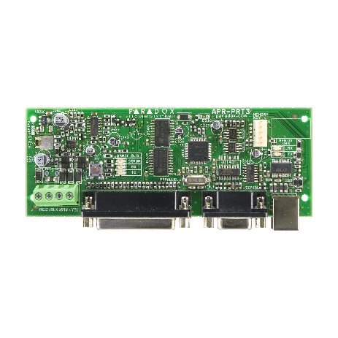
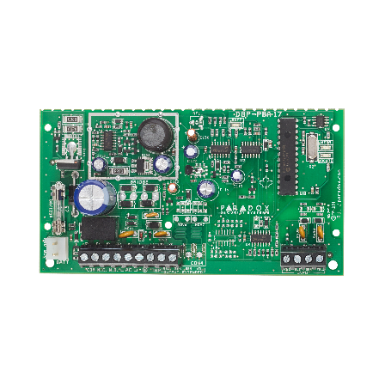
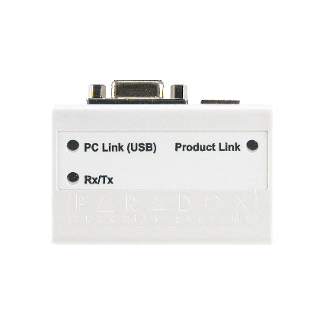
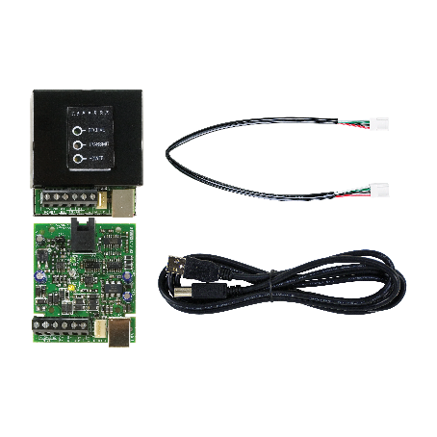
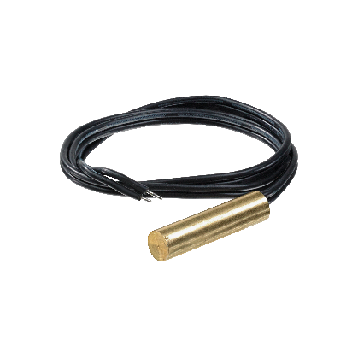
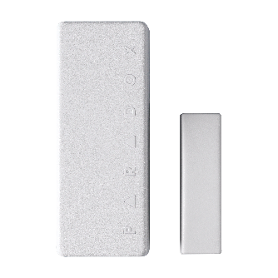
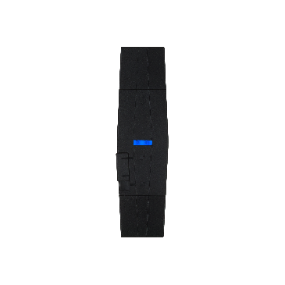
Available Modules, Special Modules,
& Output Expansion Modules
PGM4
4-Output Expansion Module
PRT3
Integration Module
PS25/45
Power Supply Module
HUB2
Hub and Bus Isolator
HUB4D
Discontinued
ZC1
Door Contact Module
PMC5
Hand-Held Plug-In Memory Key
307USB
Direct Connect Interface
CV4USB
RS-485/RS-232 Converter Kit
TEMP07
External Temperature Sensor

Slide 10
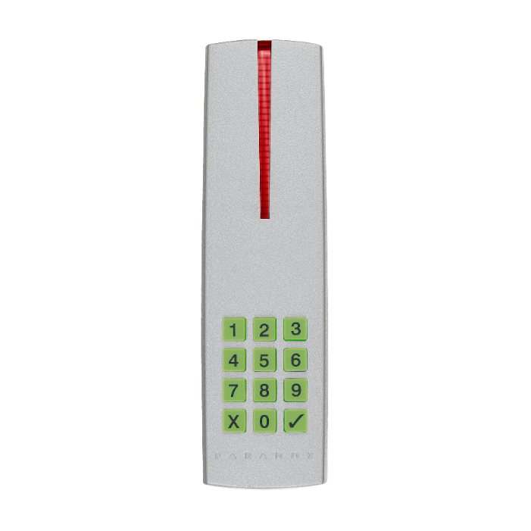
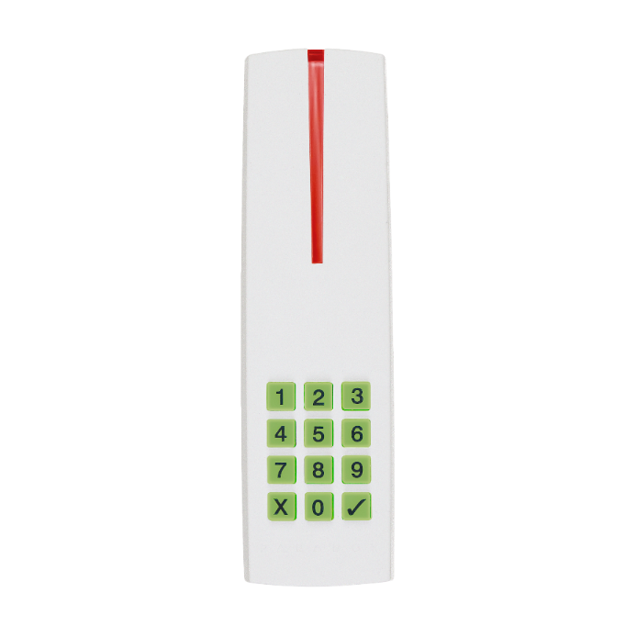
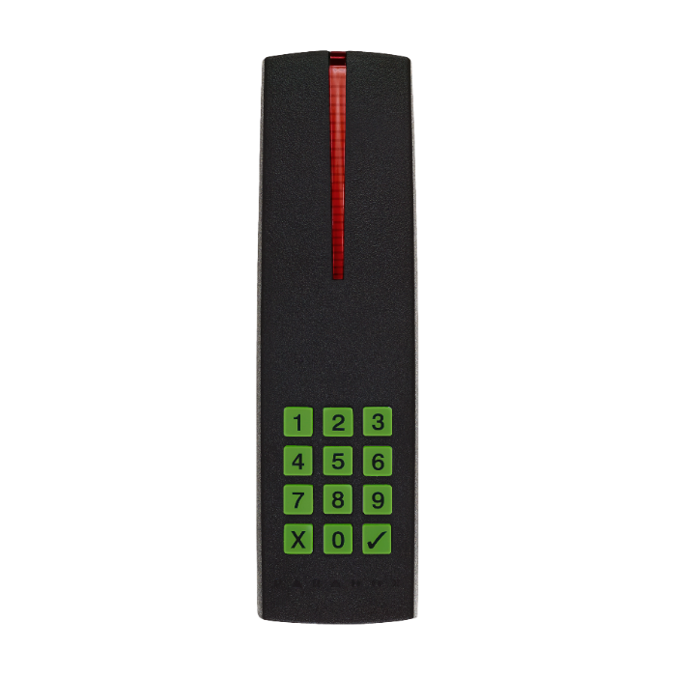
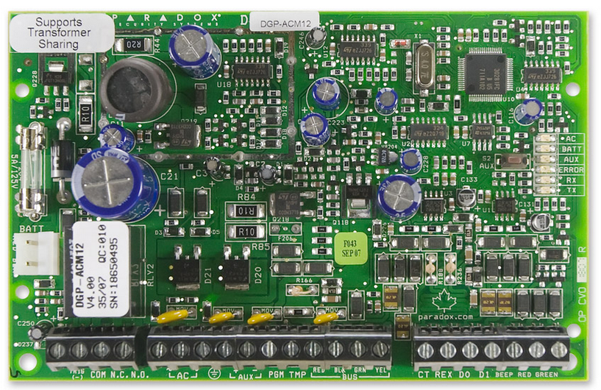
Access Control
EVO systems has a built-in access control Platform With ACM12
Use your alarm system user database (999 cards)
Manage access to up to 32 doors
16 access levels
32 (EVO192) User schedules
1-year holiday schedule
R915 Readers
Simple 4-wire readers and access modules
Log access events
Report Access Events to Monitoring Station [CID]
ACM12

Slide 11


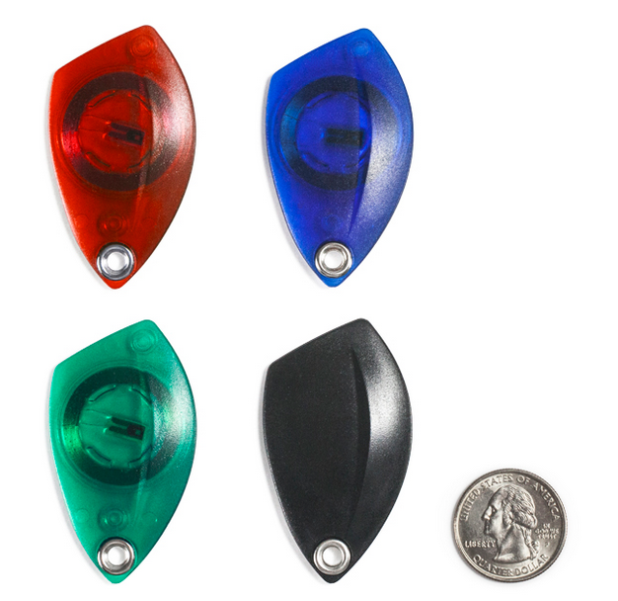
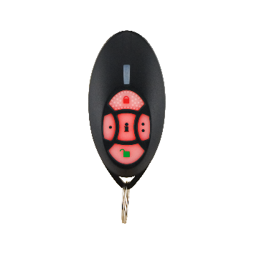
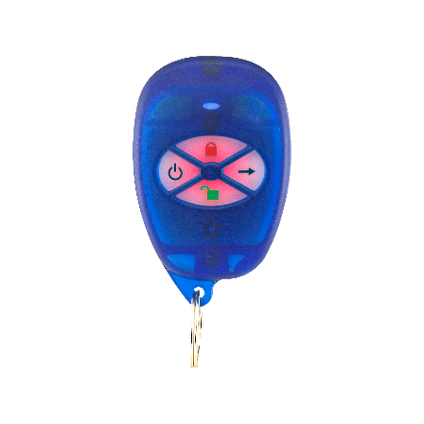
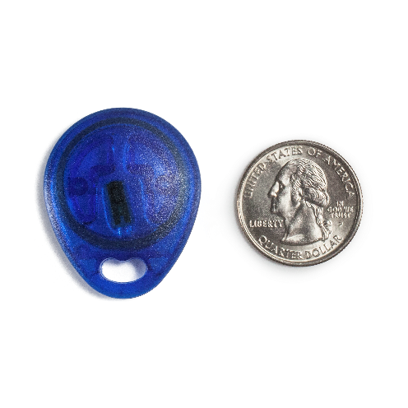
Access Control
C702
Standard Proximity Card (Clamshell)
C706
ISO Proximity Card
C705
Proximity Key Tags
RAC2
2-Way Remote Control with Integrated
Access Card
RAC1
Remote Control with Integrated Access Card
C704
Blue Proximity Key Tag

Slide 12
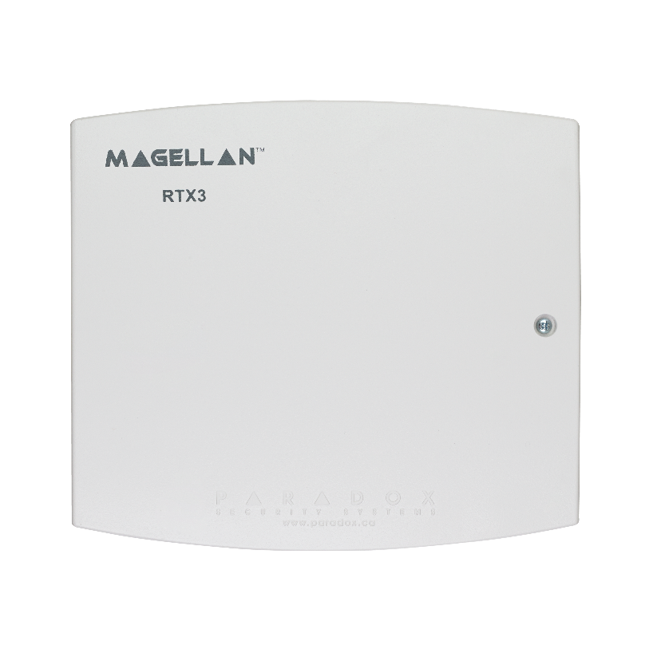
Magellan 2-Way Wireless
Expansion Module (RTX3)
32 wireless zones per module
Up to 999 remote controls with a single module
(programmable by the installer and master user)
8 wireless PGMs
In-field firmware upgradeable via CV4USB and WinLoad
3 hardwired PGM outputs and 1 optional output
Fully supports all Magellan transmitters
including 2WPGM and REM2
RTX3

Slide 13
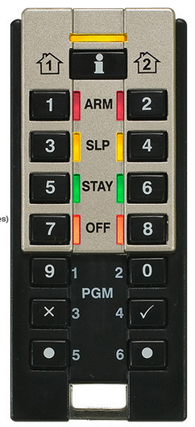
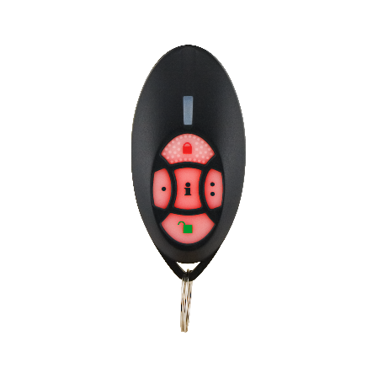
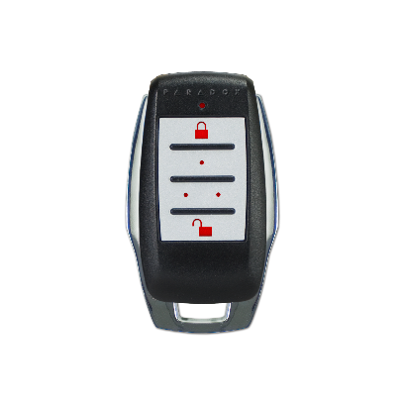

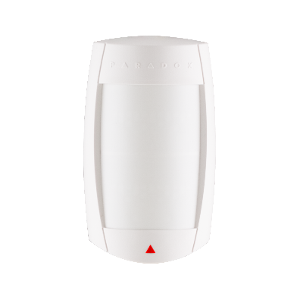
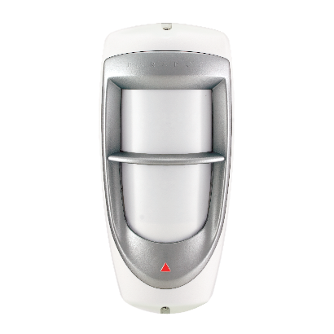



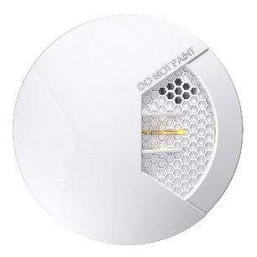
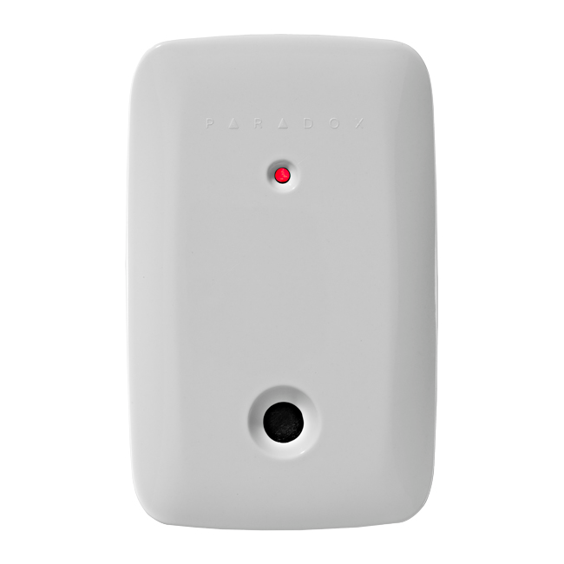

Wireless Expansion Modules
Remotes
Motion Detectors
Wireless PGM
REM3
REM2
REM15
PMD2P
PMD75
PMD85
2WPGM
Smoke & Glass Break Detectors
Door Contacts
SD360
G550
DCT10
DCTXP2
DCT2

Slide 14
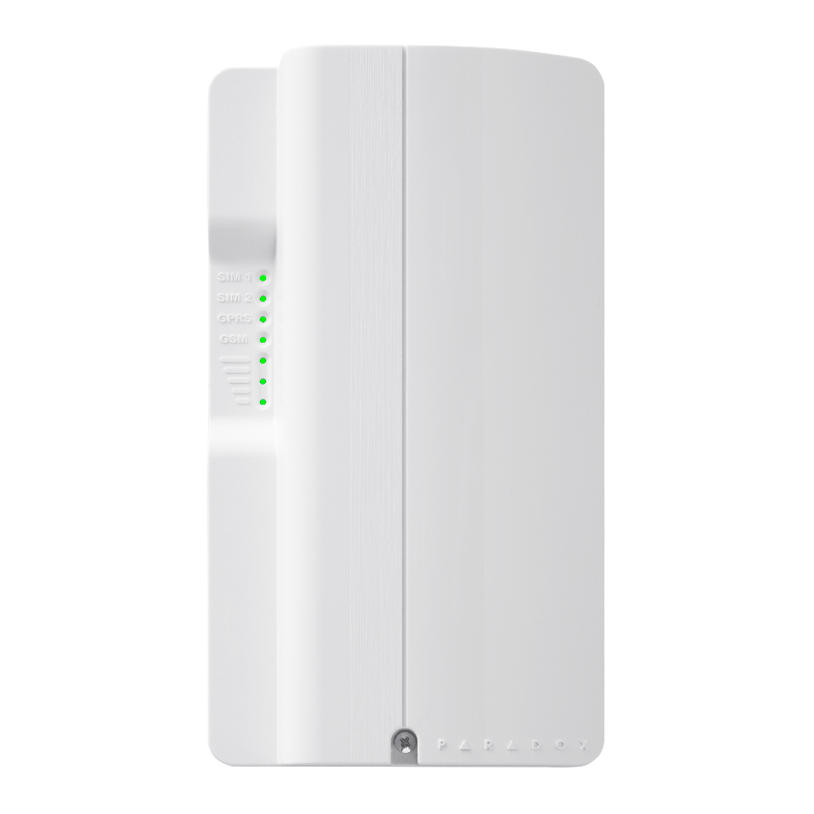
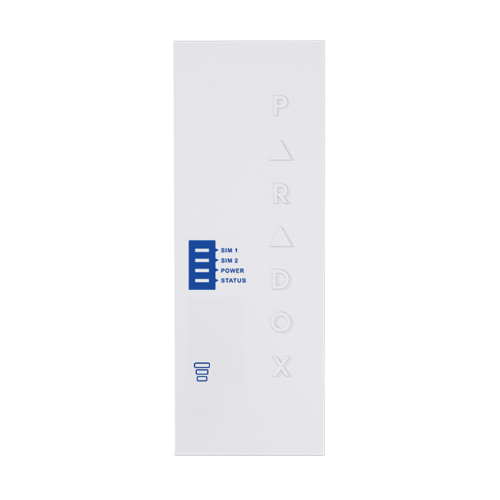
PCS260/265
GSM/GPRS Communicator Module
Report events to the IPR512 GPRS/IP Monitoring Receiver
and/or IPRS-7 GPRS/IP PC Receiver Software
Report via text message (up to 16 phone numbers)
Control panel communication supervision
End-user can arm or disarm the system by sending
a text message (SMS) to the PCS250
Send pre-recorded voice messages to up to 8 telephone
numbers to report alarms using the optional VDMP3
Paradox Plug-in Voice Module (GSM mode)
End-user can arm or disarm the system by sending
a text message (SMS) to the PCS260/265
PCS260/265

Slide 15
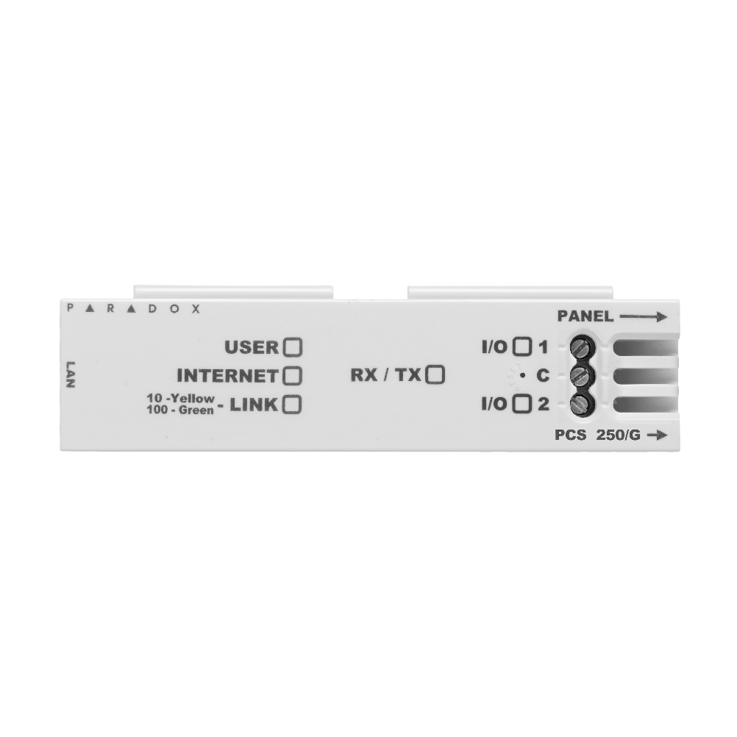
Internet Module (IP150)
Control and monitor your control panel through
an IP network (LAN/WAN/Internet)
Send notification of arming/disarming via email
Send notification of system alarms via email
IP150
Upgrade the firmware of the panel, bus modules
or of the IP150 through the Internet
Arm/disarm individual partitions, activate PGMs or I/Os via web browser
View live status of all zones and partitions via a web browser
Supports static or dynamic IP addresses
Paradox DNS website: www.paradoxmyhome.com
Multiple Languages supported

Slide 16
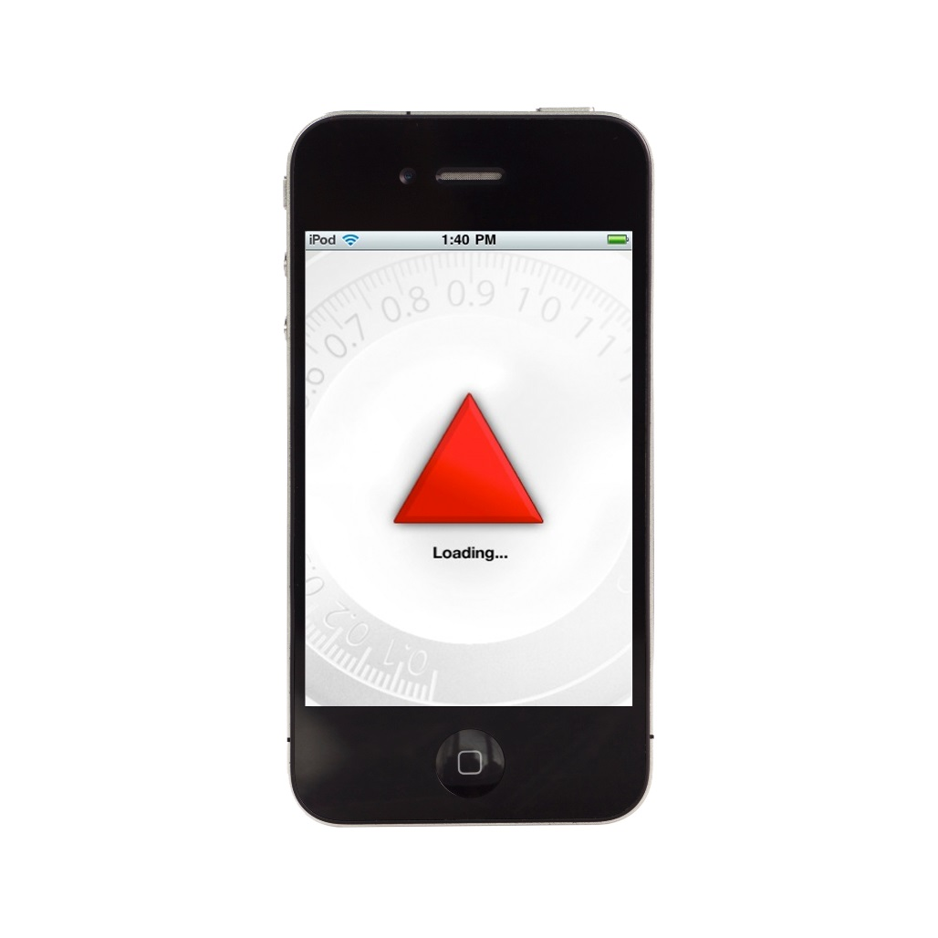

BLUEEYE (for iOS and Android)
Multi-site support: one connection at a time
Arm/disarm system remotely
Control up to 16 PGMs with MG/SP panels and up
to 13 with EVO panel (V2.71 and up)
And much, much more!

Slide 17
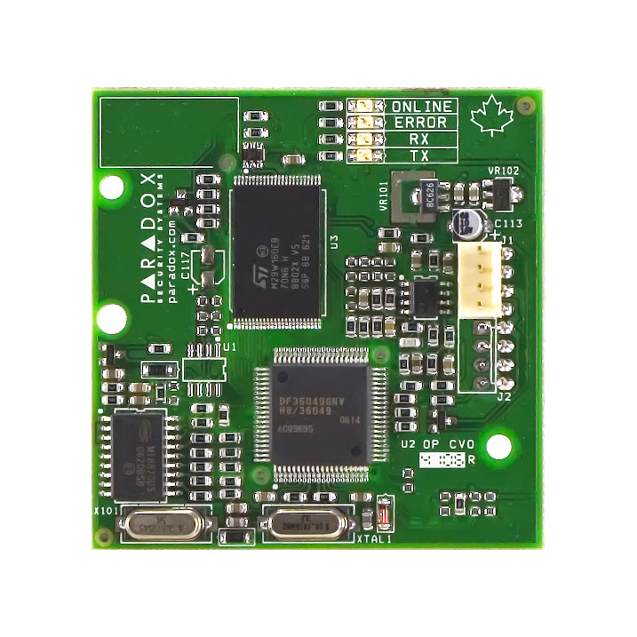
Plug-In Voice Dialer (VDMP3)
Dial up to 8 telephone numbers per partition to report
events using pre-recorded messages
Arm/disarm the system remotely via telephone
Control PGMs and toggle utility keys remotely
via telephone
Voice-guided menus
VDMP3
In-field firmware upgradeable
Connects directly onto the control panel

Slide 18
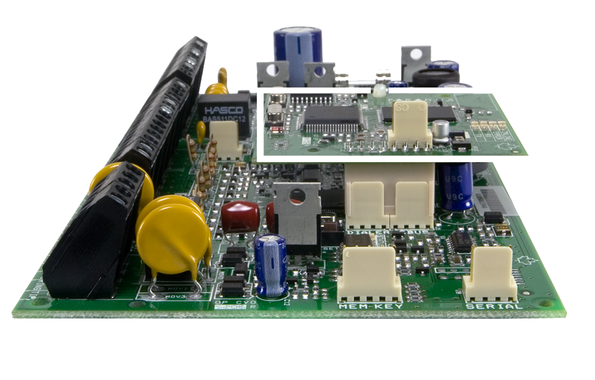
Plug-In Voice Dialer (VDMP3)
VDMP3 plugs in directly to the EBUS and SERIAL ports of
the EVO panel

Slide 19
Summary
192-zone system
Up to 999 user codes
8 partitions
Built-in access control (32 doors)
Multibus support
Supports internet module and plug-in voice dialer
Supports wireless expansion
In-field firmware upgradeable
Installer (Babyware) and end-user (NEware) PC software

Slide 20
Thank You
www.paradox.com

