Slide 1
PTZ Tracking Function Introduction
© 杭州海康威视数字技术股份有限公司版权所有

Slide 2
Content
1
Smart Tracking
2
Manual tracking
3
Panoramic Tracking
4
Person arming
5
Vehicle arming
6
Common Problems
7
Information collection

Slide 3
01
Smart Tracking

Slide 4
Introduction
When there are any alarms do linkage with Smart Tracking, our PTZ will do zoom and PT movements to focus on the objects trigger the alarms.
What is the difference between auto-tracking & smart-tracking？
Old and new translations, they both are the same function
Field of view
Path of target movement
Tracking

Slide 5
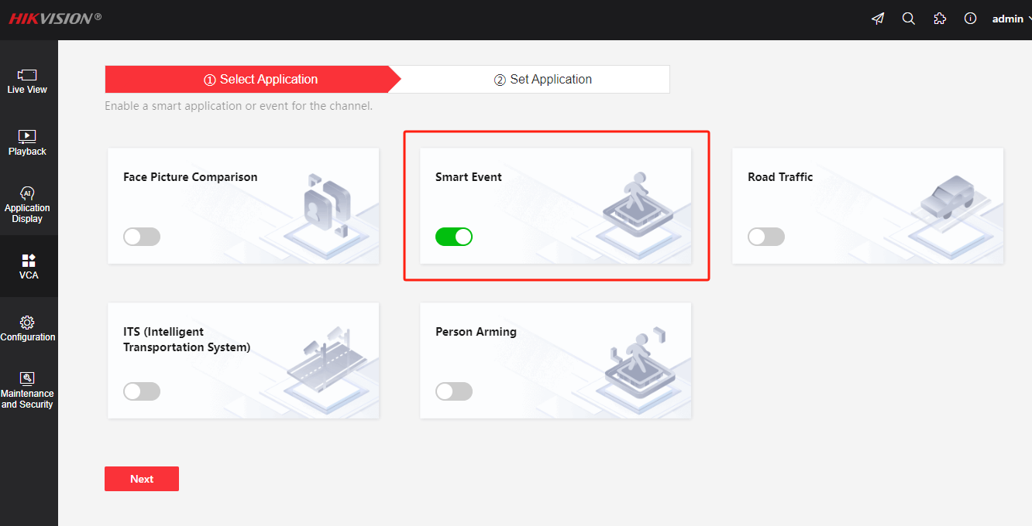
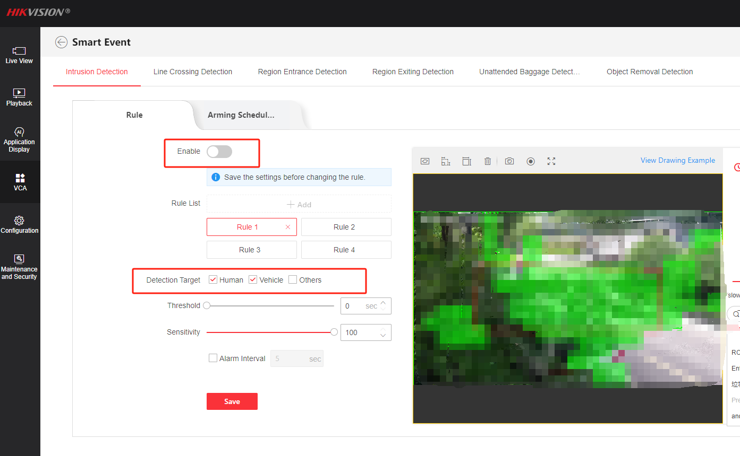
Configuration
1. Enable VCA Event
Take intrusion detection as an example
Choose applicant as Smart Event
Enable intrusion detection
Set rule, detection target, threshold and sensitivity
Set the arming schedule
Note: Detection Target Other does not mean every object ，but means small animals like birds, cats, dogs etc.

Slide 6
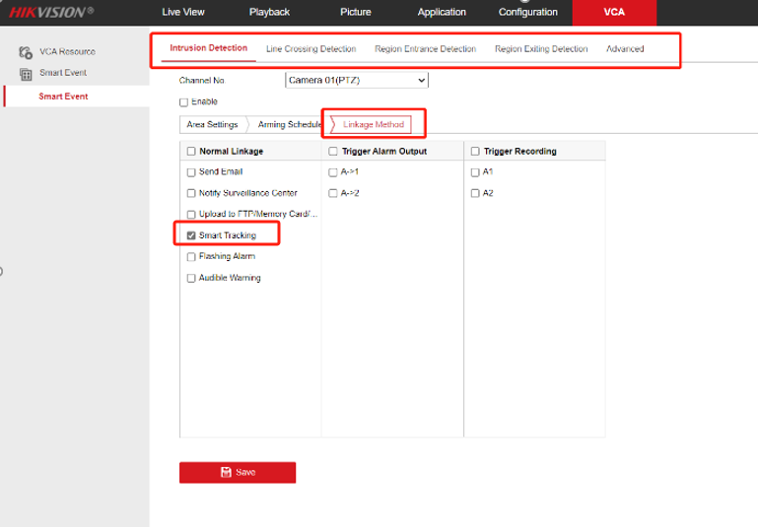
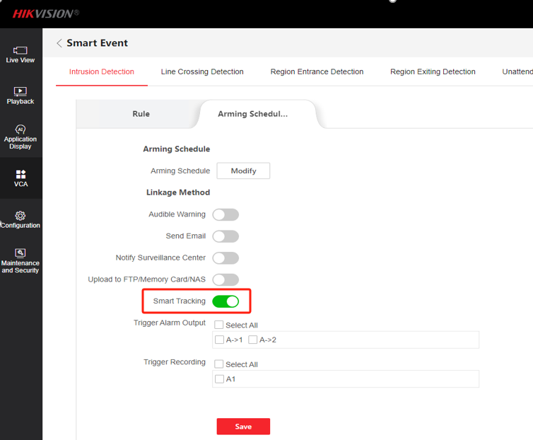
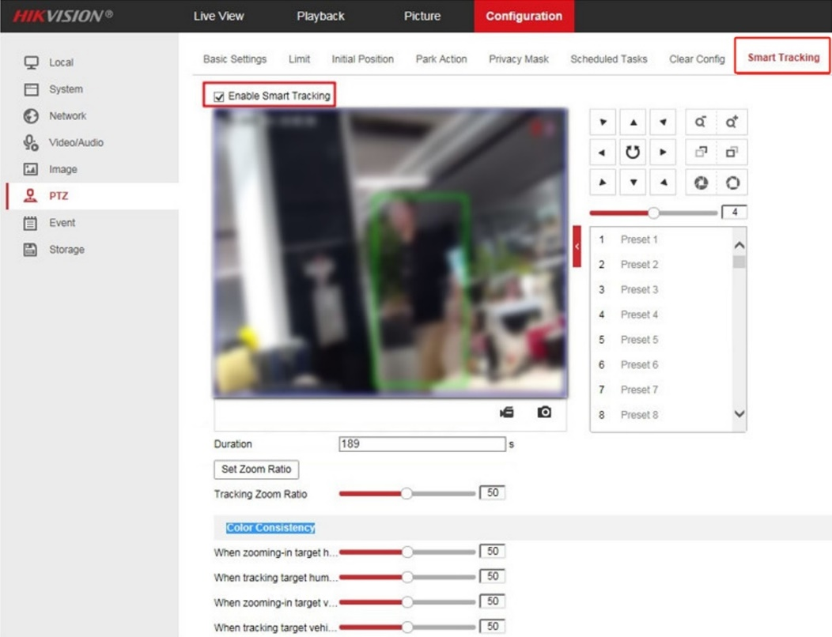
Configuration
2. Enable Smart Tracking
H8 Platform: VCA-Smart event-linkage-Smart tracking (adjust details in Advance)
H5&H7 platform: Configraution-PTZ-Smart Tracking
Note: Some versions translate smart tracking as tracking linkage, both of which are the same thing

Slide 7
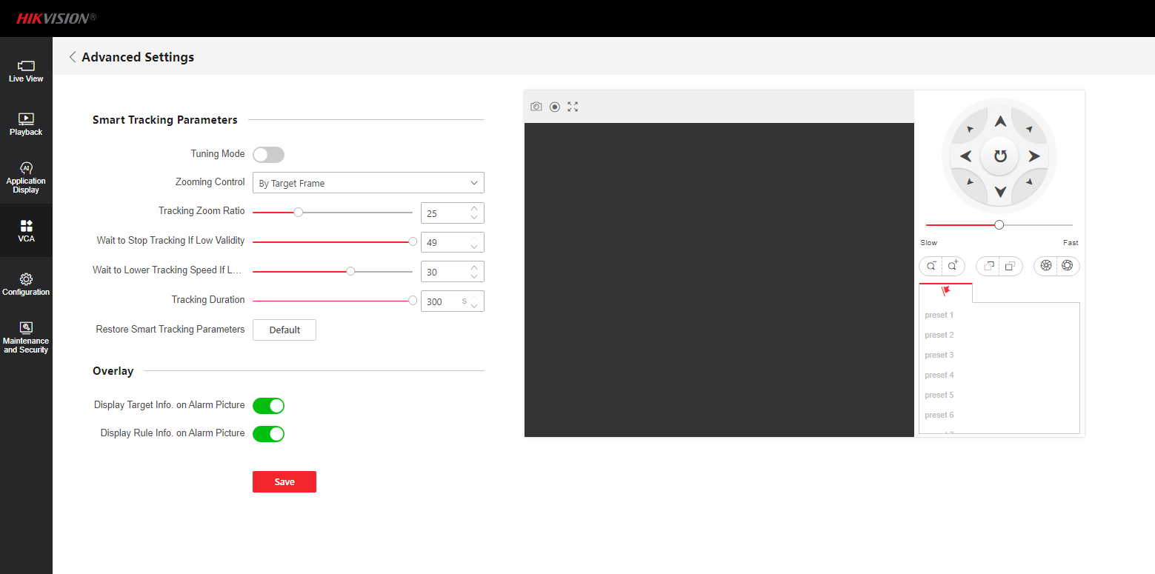
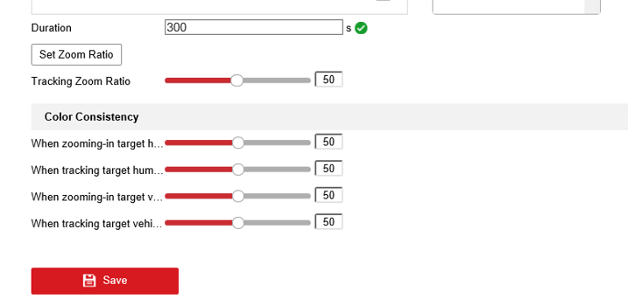
Configuration
3. Configure Smart Tracking parameter
old web interface
Tracking Zoom Ratio: You can set to a desired value. Then the camera determines the actual zoom ratio dynamically according to the detected target size and the set value. Larger value means larger zoom ratio.
Set zoom ratio: you can set a fixed zoom ratio
Move the Tracking Zoom Ratio cursor to 0.
Select a target in the live image and adjust the PTZ buttons to see the target at desired size.
Click Set Zoom Ratio to set the current zoom ratio as the zoom ratio.
Web 5.0
Tuning Mode: The mode is only for professional users;
Zooming Control: Two modes are available, controlled by Target Frame or by Tilt Angle of the camera;
By Target Frame: The tracked target has a virtual frame around. The device calculates a suitable zoom ratio according to the frame and the Tracking Zoom Ratio. Larger value means bigger zoom ratio
By Tilt Angle: The device calculates the tracking zoom ratio according to the tilt angle of the camera
Tracking Duration: The camera stops tracking the target when the tracking duration exceeds the set value
Note: As long as you set the Tracking Zoom Ratio value as not 0, the zoom ratio you set manually is invalid.
Set Color Consistency: The camera checks the color of the detected target several times during tracking and compares the color resemblance to determine whether it should continue to track the target or not. If the returned resemblance is lower than the set value, the camera stops tracking.

Slide 8
02
Manual Tracking

Slide 9
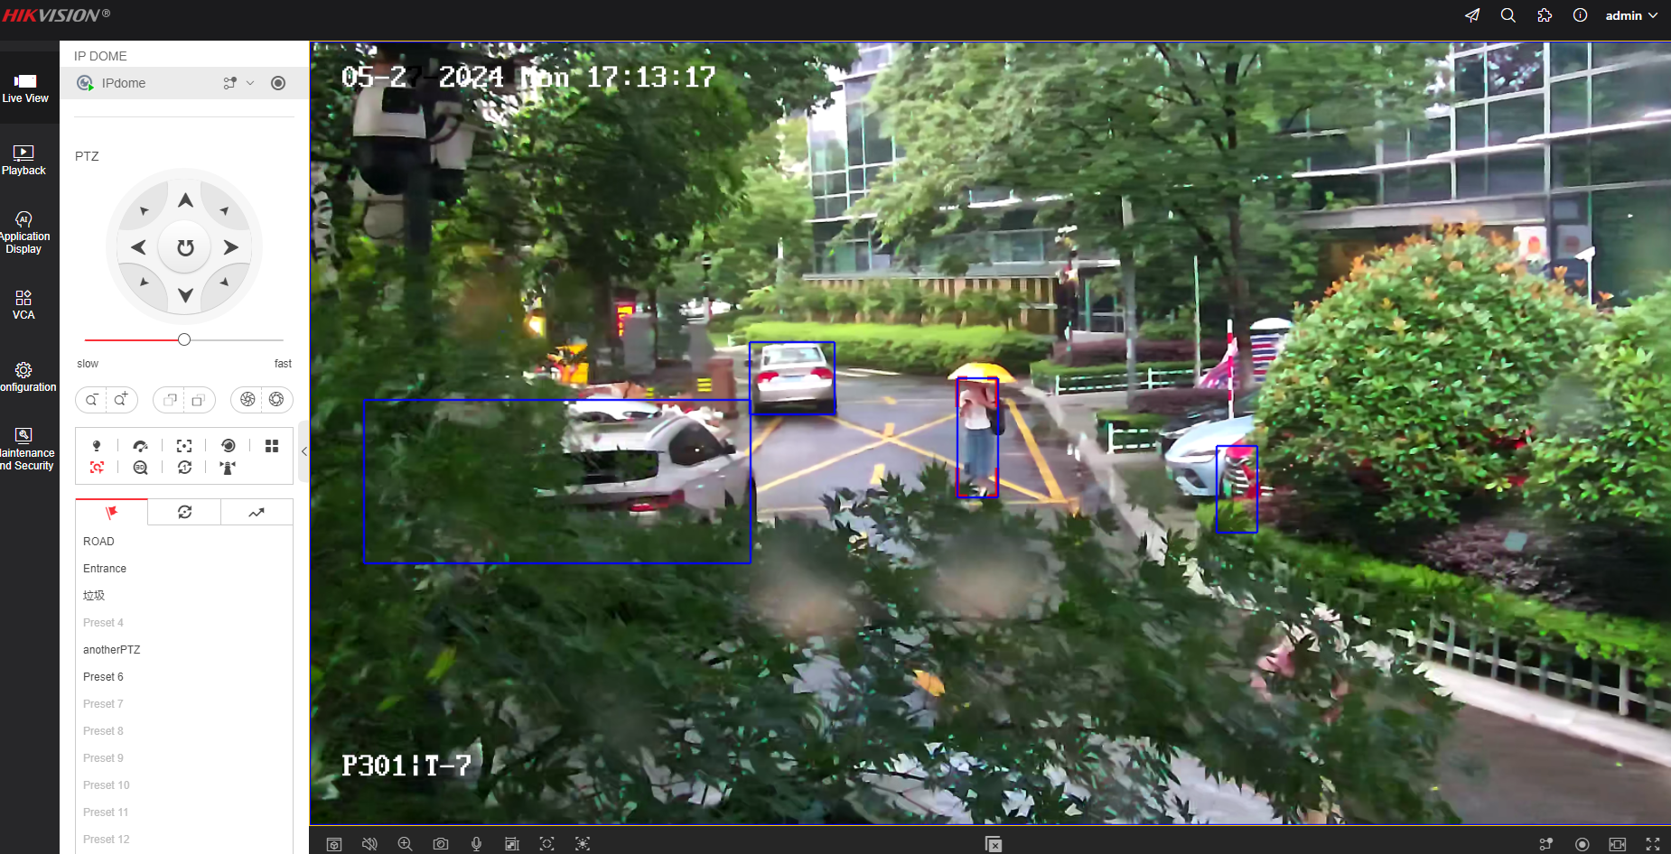
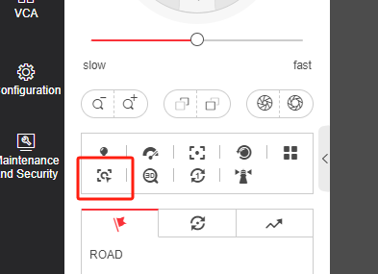
Configuration
1. Before you start: Enter the Smart Tracking settings interface and enable smart tracking first.
3. When there are multiple targets detected by the camera, select one target and left click its rule box, the PTZ camera will start to track that target automatically.
2. Click on the tool bar of live view interface.
Note: Not all the speed dome models support this function. Take the browser interface of the actual product as standard.

Slide 10
03
Panoramic Tracking

Slide 11
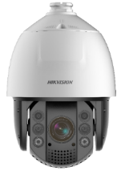
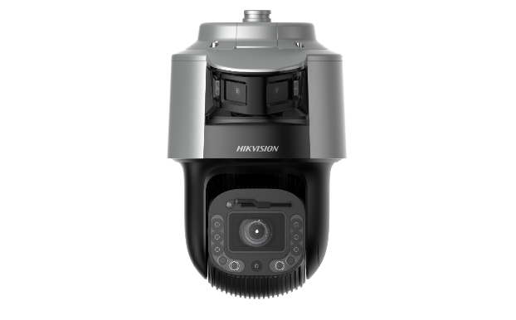
Introduction
Panoramic Tracking function
Panoramic tracking only equipped on TandemVu cameras, the bullet channel can make smart-linkage to PTZ channels. So that, the smart event triggered on bullet can linkage PTZ action.
When a target enters the specified monitoring area of the bullet lens, the bullet lens will link the PTZ lens to track the target. When the target leaves the area, the PTZ lens stops tracking the target.
Notes:
Which devices have this capability?
SF series:
G5H8 platform, only single lens bullet channel can support it;
G7H8 platform, both single lens and dual lens can support it;
SE series:
G5H8 platform support

Slide 12
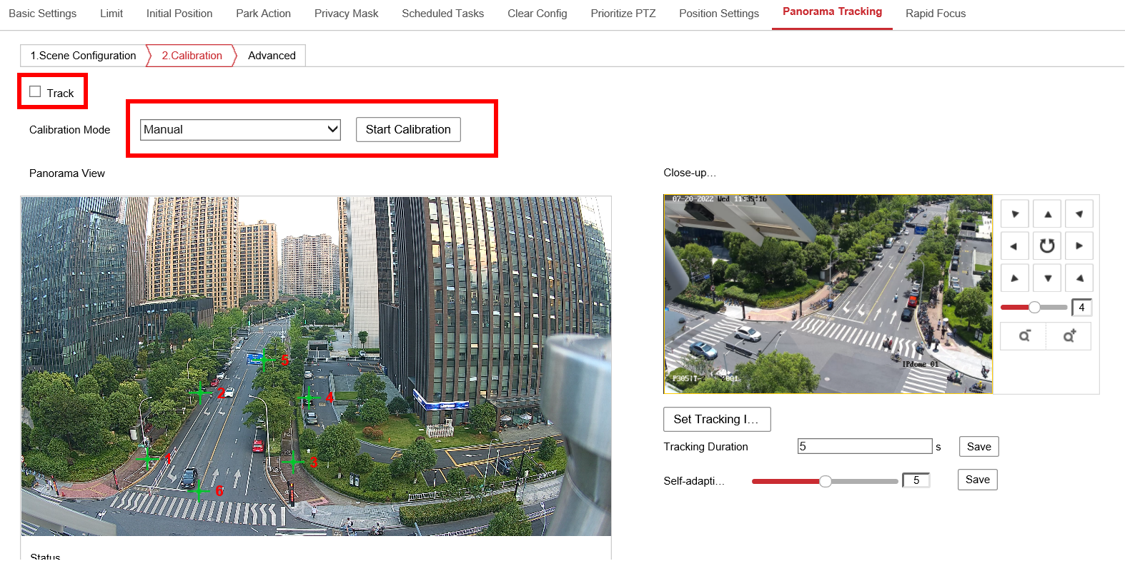
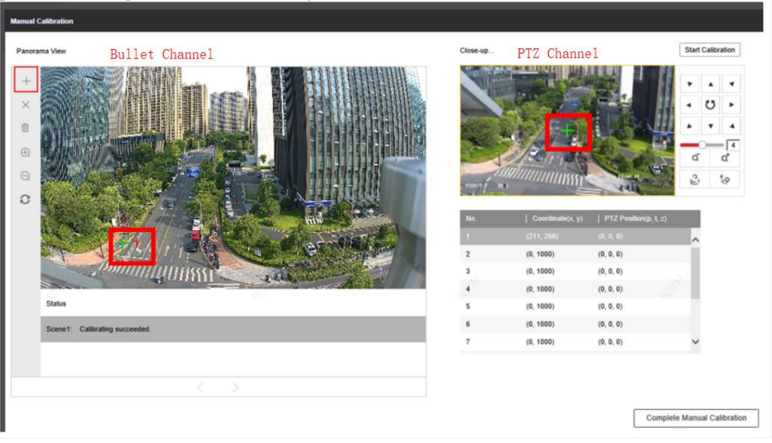
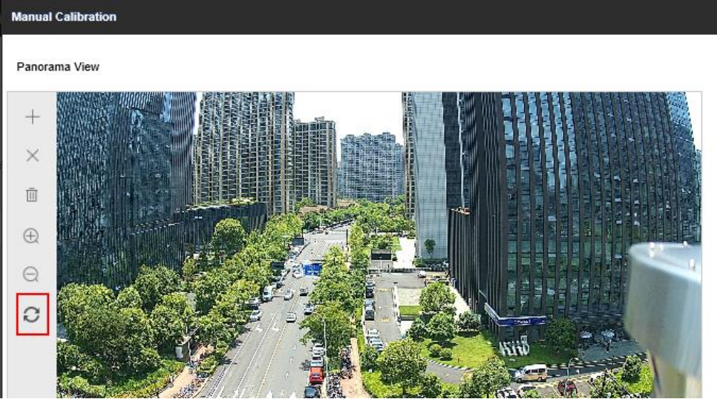
Configuration
1. Panoramic calibration
Before using panoramic tracking, we need to do the calibration for these two channels to unify the coordinate system of them.
We can use auto calibration concise when you have a concise and clean background. But for complex scenarios (like street, crossroads and plaza ), we need to use manual calibrate
(1). Old web interface
1. Uncheck “Track” first, to prevent the PTZ from moving around when doing the calibration. Then select “Manual” and Start Calibration
3. Select a coordinate on the right, click “Add” icon on the left toolbar, a green cross will appear on the bullet channel, move it to an appropriate location on the picture. Then on the PTZ channel, move the PTZ to make sure the green cross on the center of PTZ channel points at the same object/location on the bullet channel.
2. Click refresh icon to get the current bullet channel’s view
Notes:
Note: The recommended number of calibration points are 6 – 9 points. Please carefully choose the scene with appropriate reference, detailed environment and no obstacles in front of both channels, which can improve the accuracy of calibration.

Slide 13
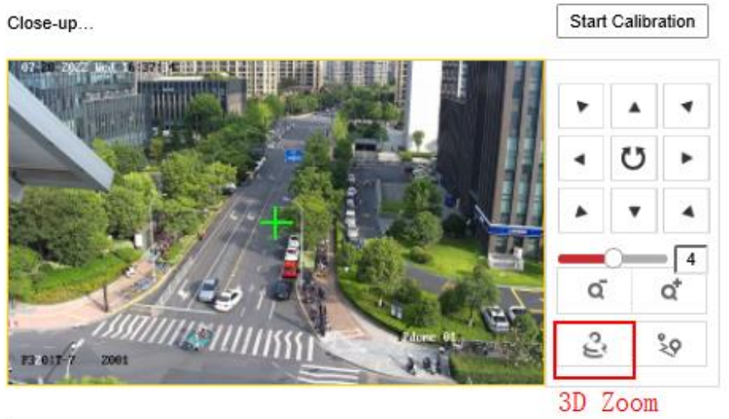
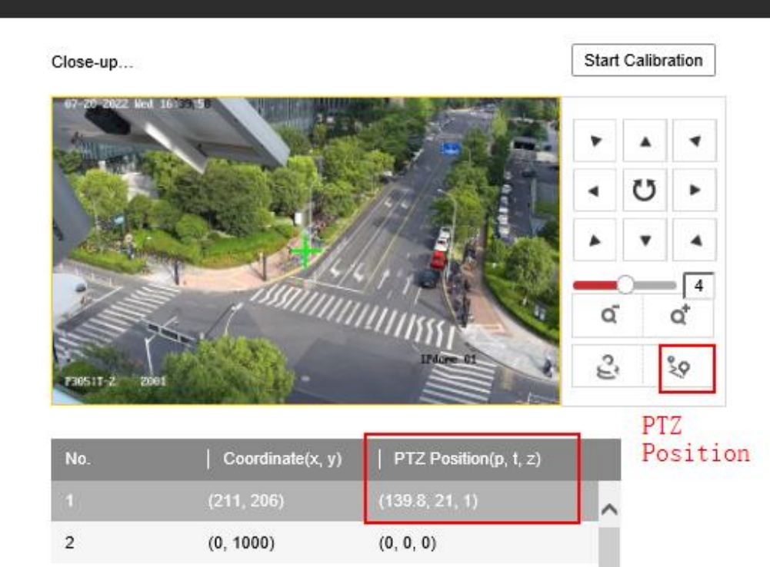
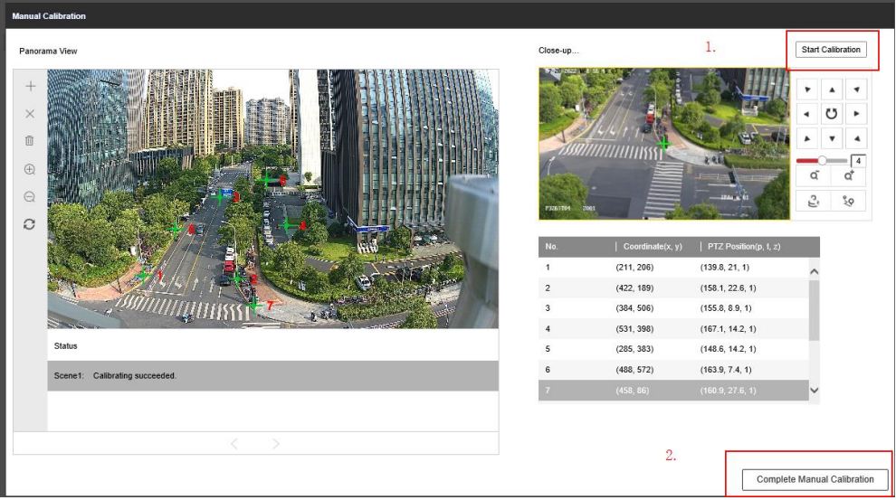
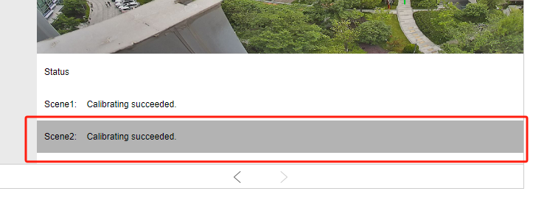
Configuration
4. After aligning the green cross on both bullet and PTZ channel, click PTZ Position icon to apply the coordination info to the points you just set, then the PTZ Position will be updated.
5. Select the second coordinate, add the second point on bullet channel, and repeat the operations above to calibrate each coordinate.
Note: You can also use 3D Zoom function to make the object on PTZ channel to become the center of the picture
6. After all the coordinates have been calibrated, click Start Calibration on the upper right corner, then click Complete Manual Calibration on the lower right corner. Then this calibration page will exit.
Note: For multi bullet channel product please calibrate under each Scene.

Slide 14
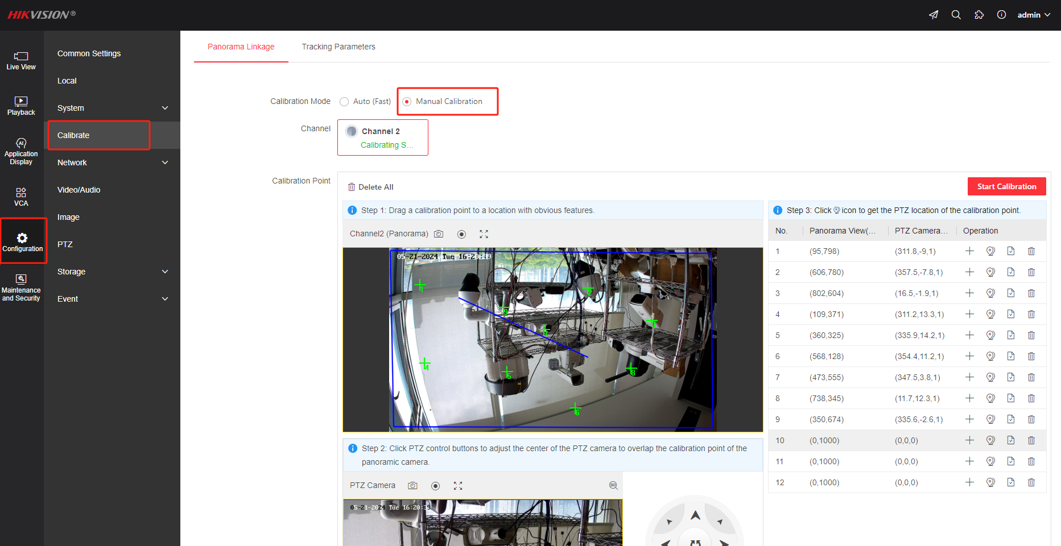
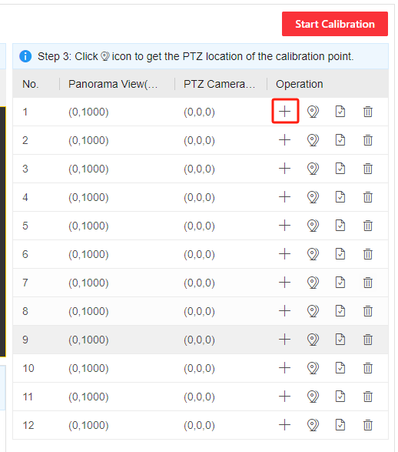
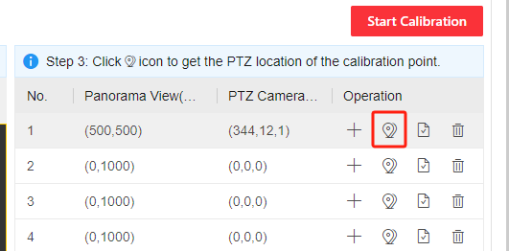
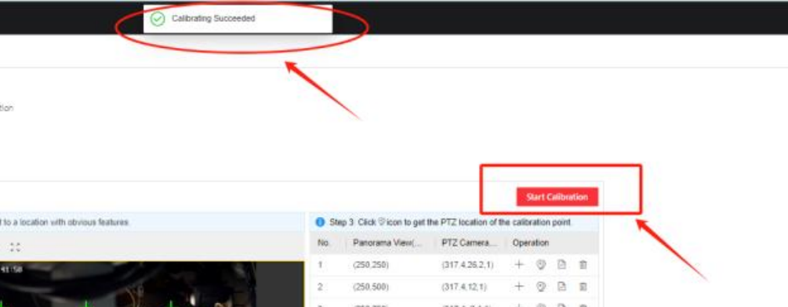
Configuration
(2). Web 5.0
The calibration method and logic of Web 5.0 are similar to those of older web interface, except that the calibration location and page have undergone some changes
Add new calibration points on interface(9~12 points are recommended )
Move the calibration point to a clear and fixed position on panoramic channel image, then control PTZ moving, please make sure two green crosses point to the same location in real scene
Note: Choose things that are fixed and clear, like buildings, avoid things that can move, like cars and pedestrians, and avoid things with complex textures, like bushes
After confirm the two cross point to the same location, click PTZ position button, then you can see their coordinate system values will be related.
After operated every points, click red button Start Calibration When note calibrating Succeed, which means the process finished

Slide 15
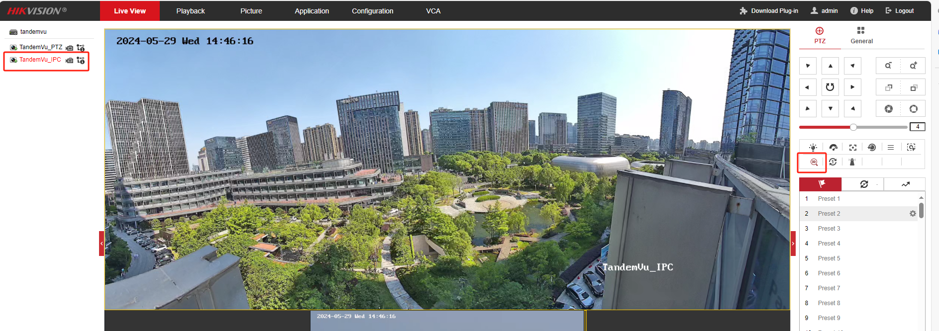
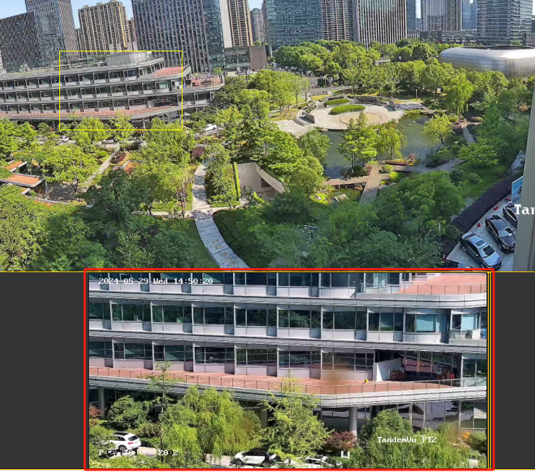
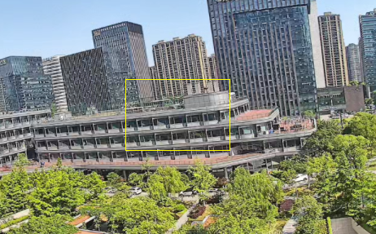
Configuration
2. Verify the calibration result
You can use 3D position to verify whether the calibration is accurate
(3) Check whether the PTZ channel can turns into the corresponding area，you can test multiple times with different area，if all works well，like the picture below，it means the calibration is succeed ，if there are some mismatch，you need to re-calibration for the calibration points nearby
(1) Click 3D position icon in panoramic channel
(2) Select a area in panoramic channel
Notes:
Note: The recommended number of calibration points are 6 – 9 points. Please carefully choose the scene with appropriate reference, detailed environment and no obstacles in front of both channels, which can improve the accuracy of calibration.

Slide 16
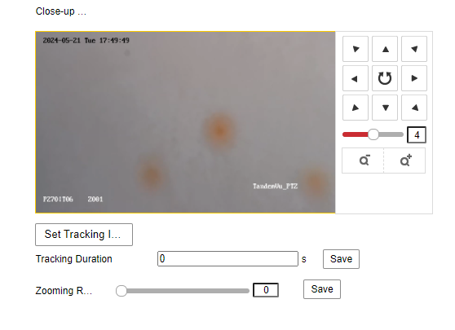
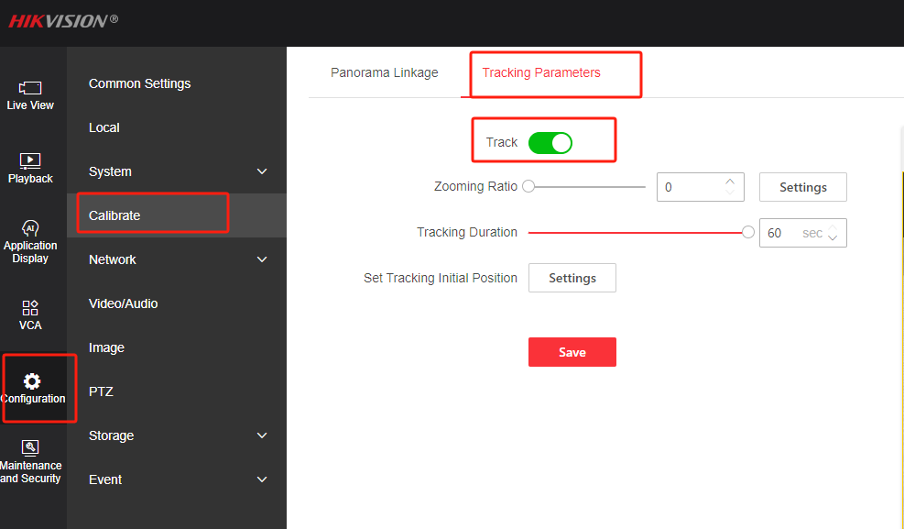
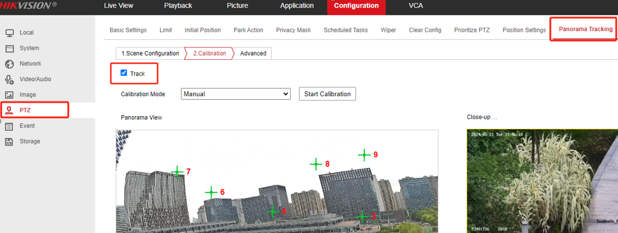
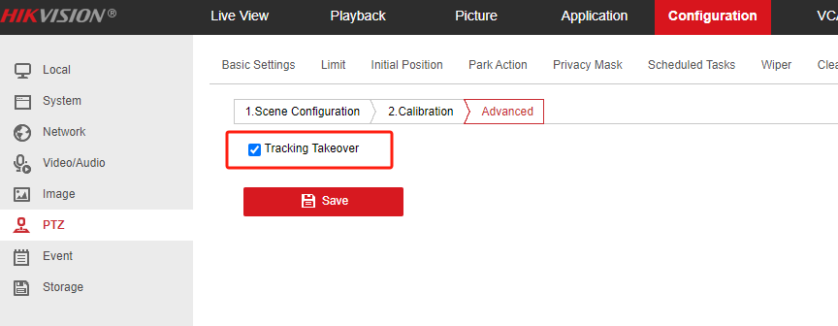
Configuration
3. Enable Panoramic Tracking
Old web interface
web 5.0
Click “Track” to enable Panoramic Tracking
Set tracking parameters
Set Tracking Initial: When the camera finish calibrating or has a calibration timeout, close-up view shall turn to a fixed position. Click the PTZ button to set a certain position, then click Set Tracking Initial to finish setting.
Tracking Duration: the PTZ camera channel stops tracking after the set duration.
zoom ratio: Set the zoom ratio of PTZ camera channel manually to ensure the certain scale of target in the PTZ view. The PTZ camera channel tracks the target by the scale once the tracking is triggered.
Tracking Takeover: keep tracking even the target is out of the view of the panoramic channel until out of the view of the PTZ channel
Notes:
Tracking Zoom Ratio: You can set to a desired value. Then the camera determines the actual zoom ratio dynamically according to the detected target size and the set value. Larger value means larger zoom ratio.
Set zoom ratio: you can set a fixed zoom ratio
Move the Tracking Zoom Ratio cursor to 0.
Select a target in the live image and adjust the PTZ buttons to see the target at desired size.
Click Set Zoom Ratio to set the current zoom ratio as the zoom ratio.

Slide 17
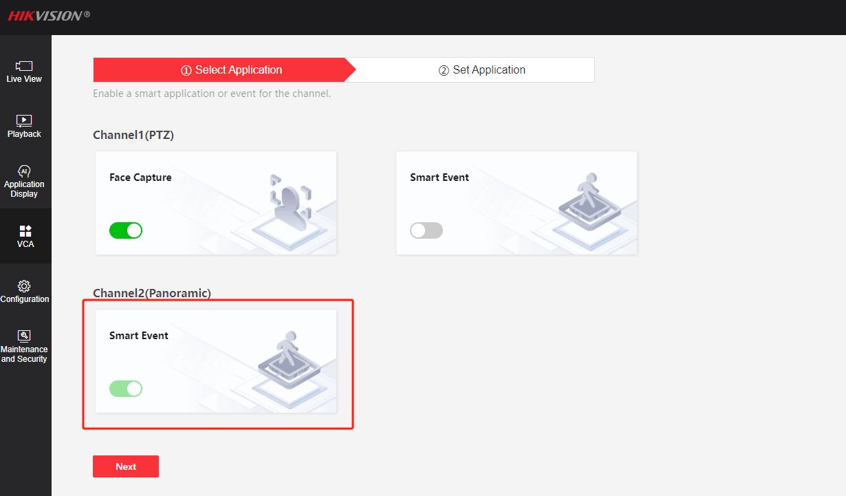
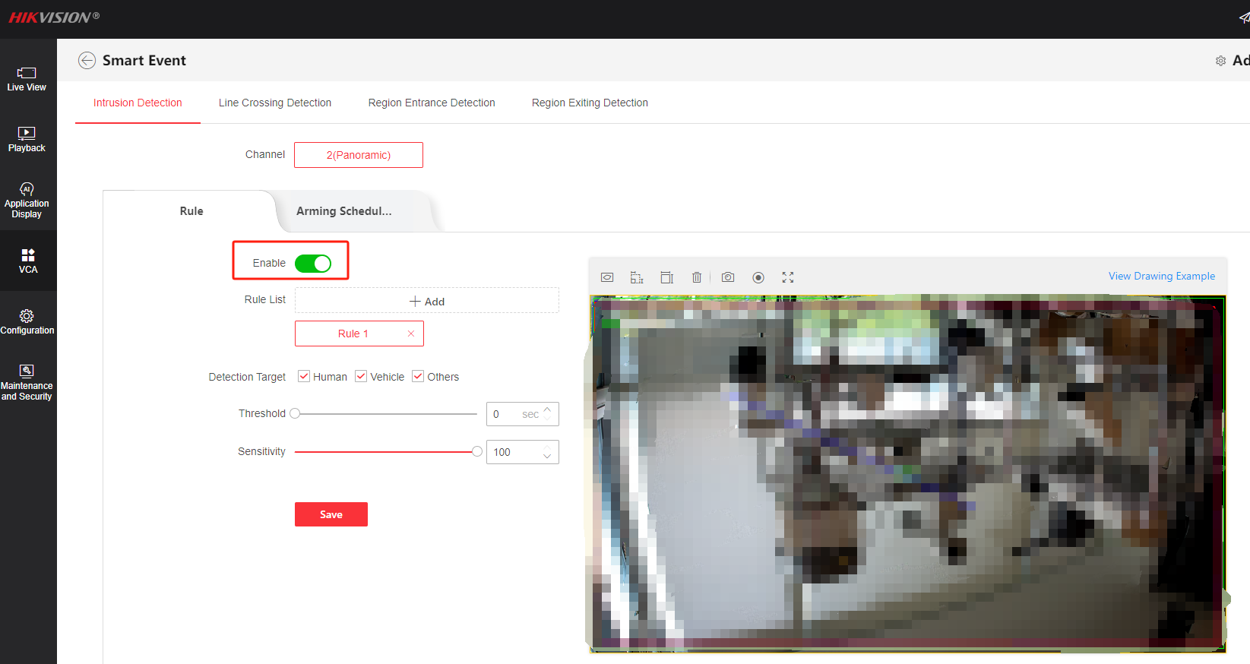
Configuration
4. Enable VCA Event for panoramic channel
Take intrusion detection as an example
Choose applicant as Smart Event
Enable intrusion detection
Set rule, detection target, threshold and sensitivity
Set the arming schedule

Slide 18
04
Person Arming

Slide 19
Introduction
When the device detects the armed person in the monitoring scene, it triggers alarms and tracks the target. During the tracking, the target location and other related information are uploaded.

Slide 20
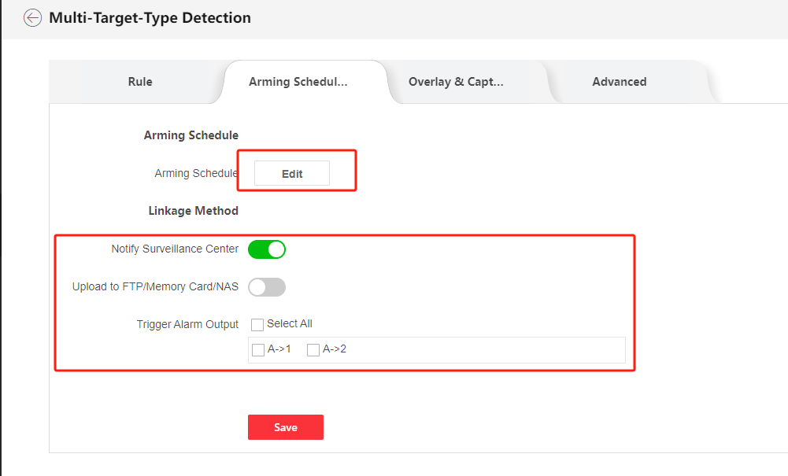
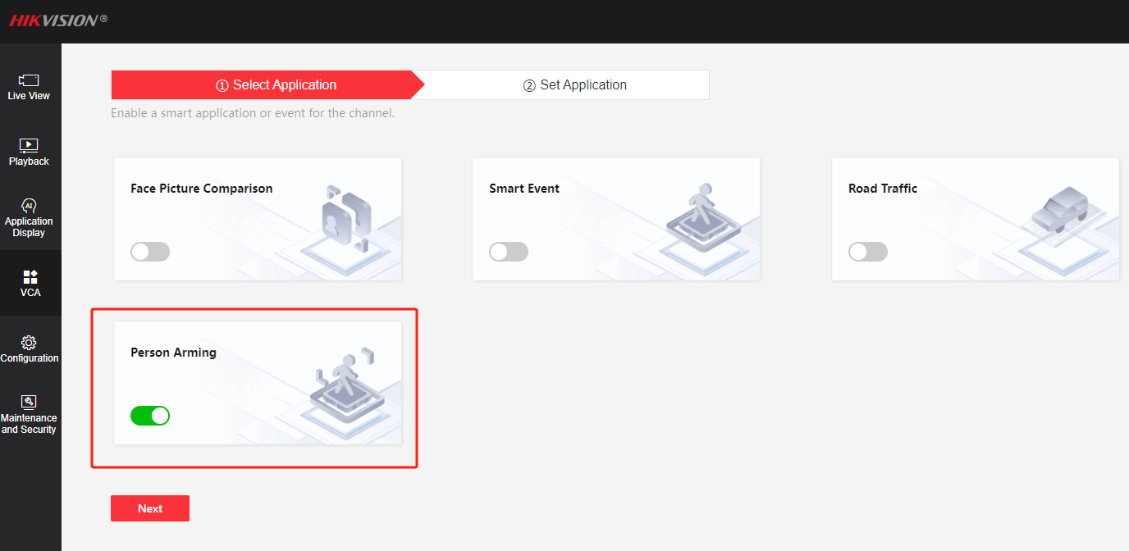
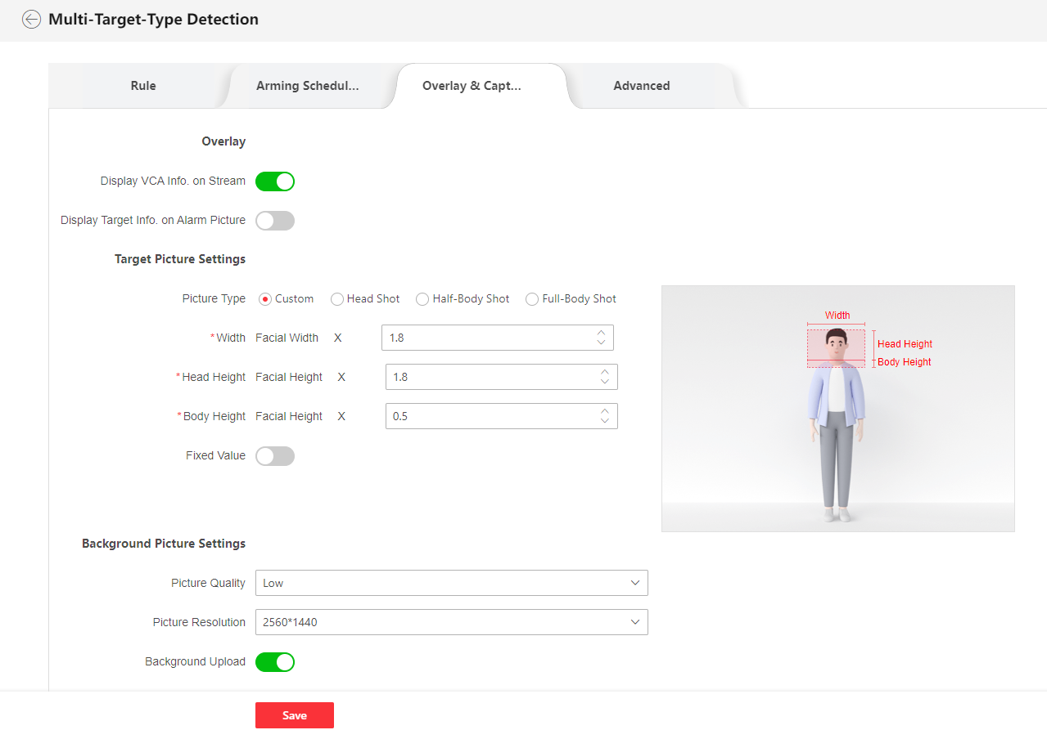
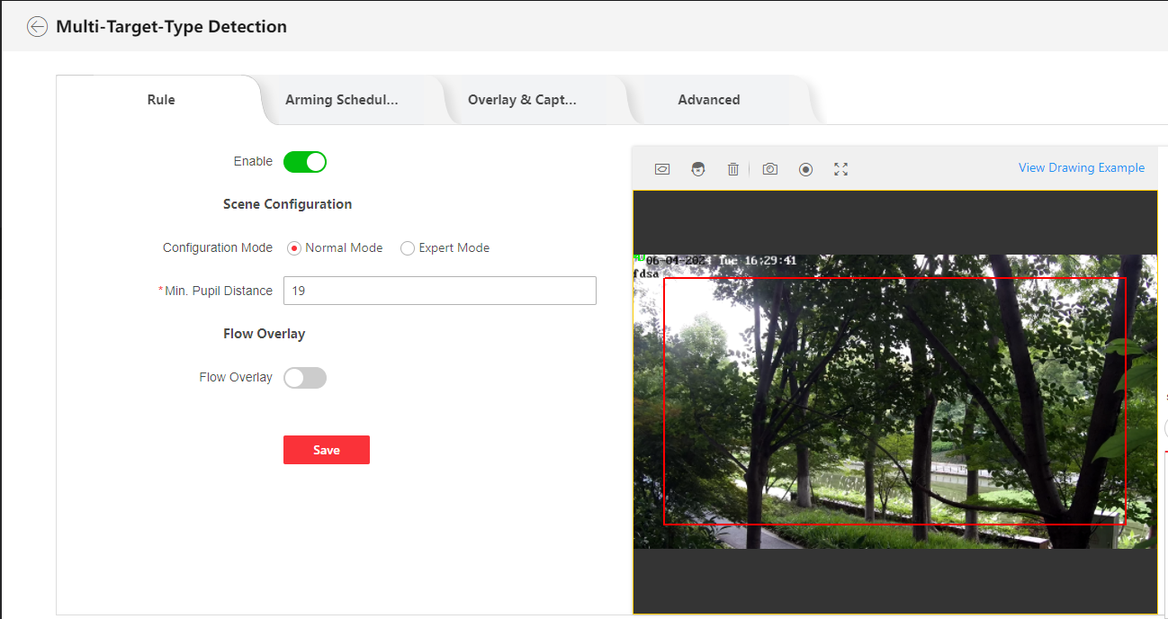
Configuration
1. Multi-Target-Type Detection
(3). Set the arming schedule and linkage method.
(1). Select VCA Resource as Person Arming
(2). Go to Multi-Target-Type Detection, Set the detection area and minimum pupil distance, and then enable it.
(4). Set the overlay &capture parameters.

Slide 21
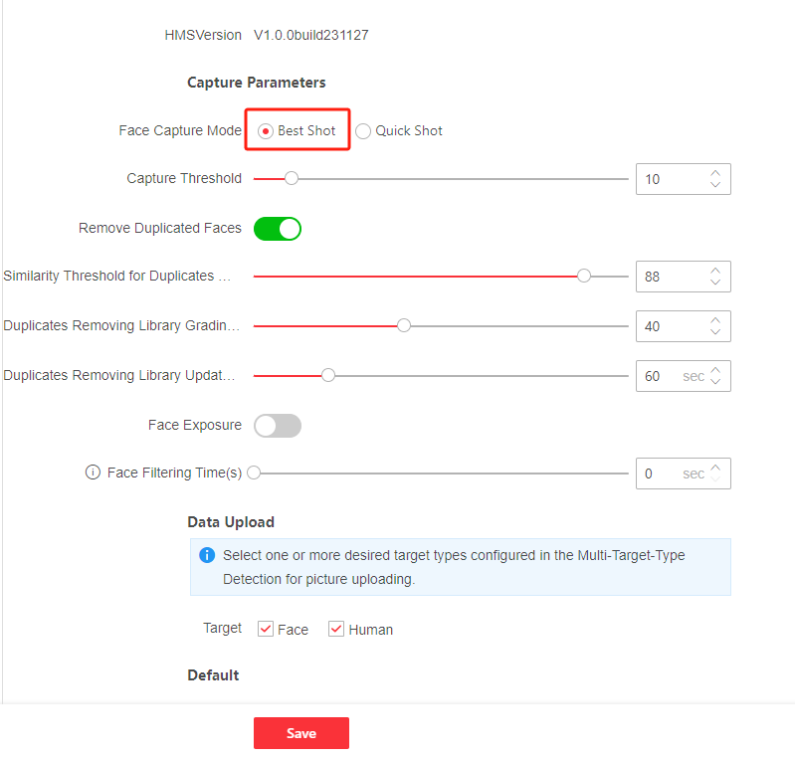
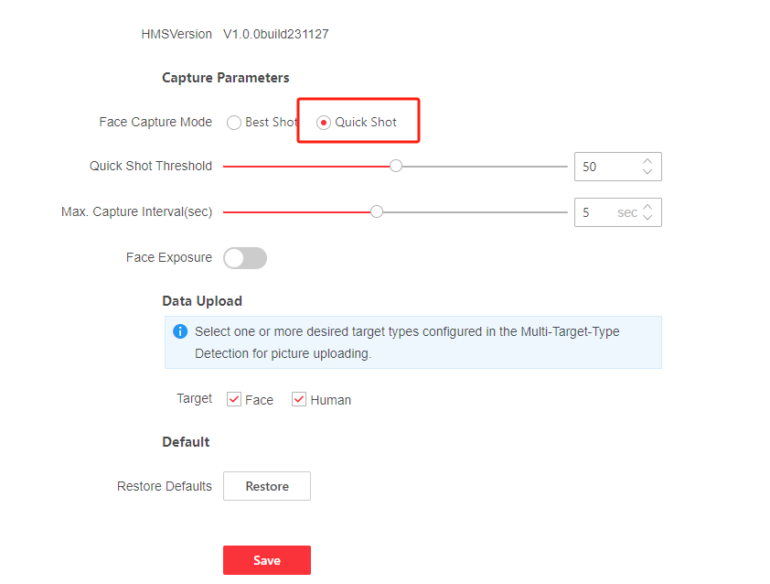
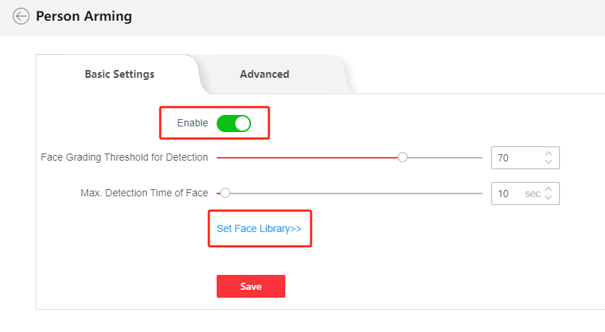
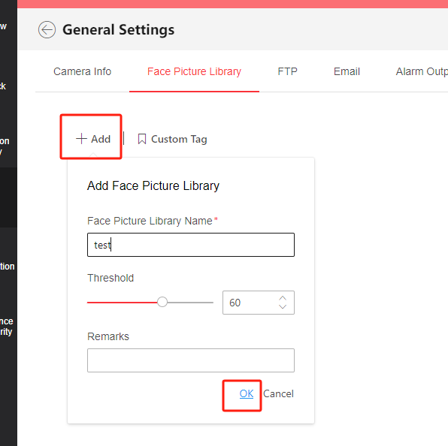
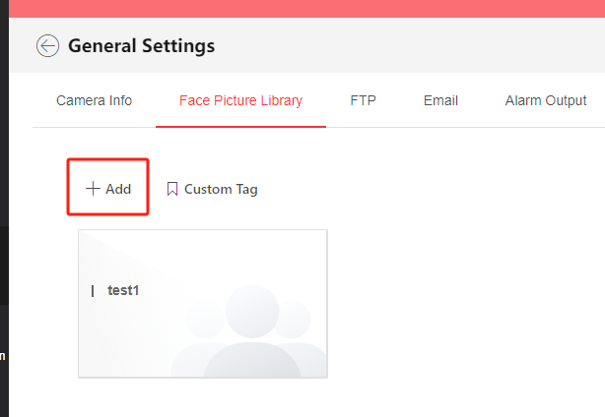
Configuration
(4). You can choose Best shot mode or Quick shot mode for face capture
Best shot：The device captures the target picture with the highest score after setting the parameters.
Quick shot：The device captures the target picture once the score of the captured face exceeds the Quick Shot Threshold during the Max. Capture Interval. Otherwise, the device selects and uploads the picture with the highest score during the Max. Capture Interval.
2. Person arming
(1). Go to person arming, set the Face Library
(2). Add face picture library
Face Grading Threshold for Detection: Every face entering the monitoring scene is graded by the device according to the quality. When a face with its grading exceeds the the set threshold, it triggers the comparison with the pictures in the selected face picture library.
Threshold: Face similarity higher than the set threshold triggers face picture comparison alarm uploading.
Notes:
Face Filtering Time(s): It means the time interval between the camera detecting a face and taking a capture action. If the detected face stays in the scene for less than the set filtering time, capture will not be triggered. For example, if the face filtering time is set as 5 seconds, the camera will capture the detected face when the face stays in the scene for 5 seconds.
Max. Detection Time of Face: If the face grading does not reach the set Face Grading Threshold for Detection during the set Max. Detection Time of Face, the device stops grading the target face.

Slide 22
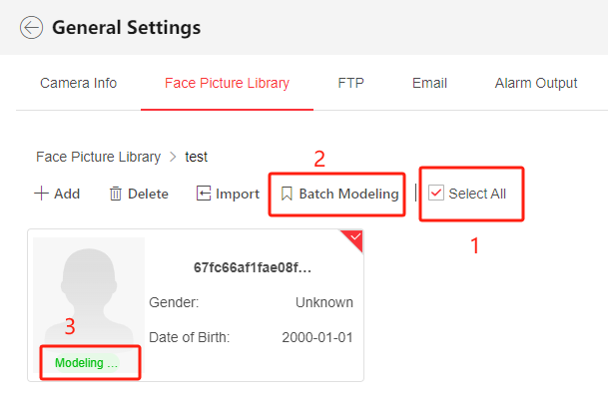
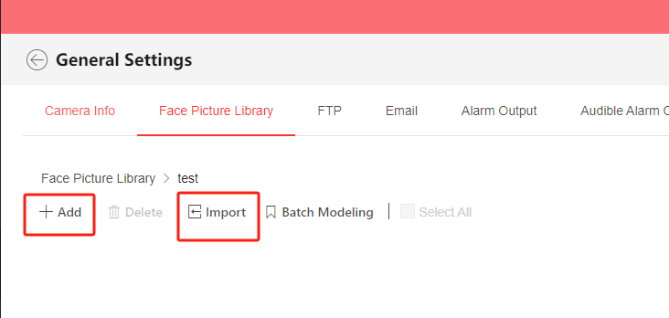
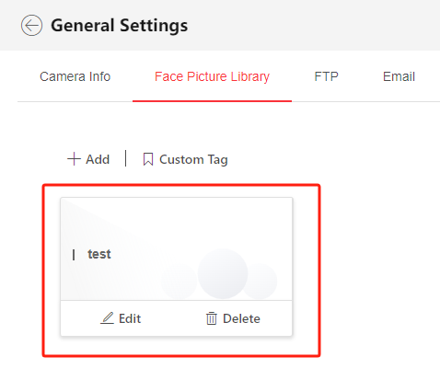
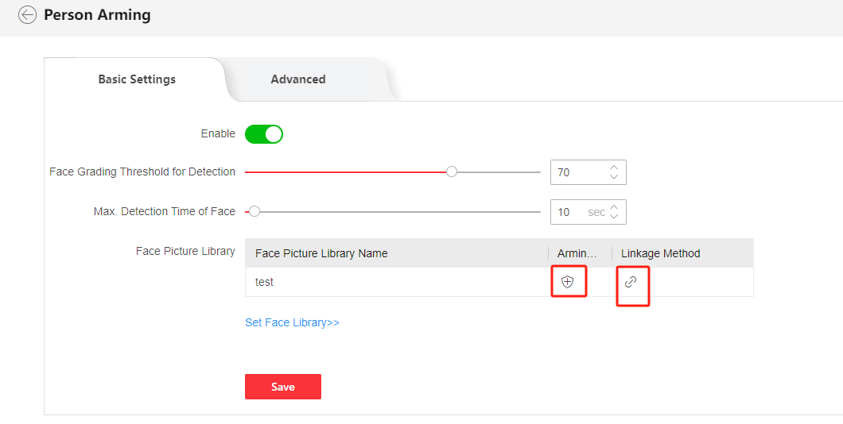
Configuration
(3). Upload face picture
You can upload face picture one by one or batch import
Select the pictures, click batch modeling until the status of all pictures become modeling succeed
(4). Set the arming schedule and linkage methods
(5). Check the result on Display Alarm

Slide 23
05
Vehicle Arming

Slide 24
Introduction
When the device detects the armed vehicle license in the monitoring scene, it triggers alarms and tracks the target. During the tracking, the target location and other related information are uploaded.

Slide 25
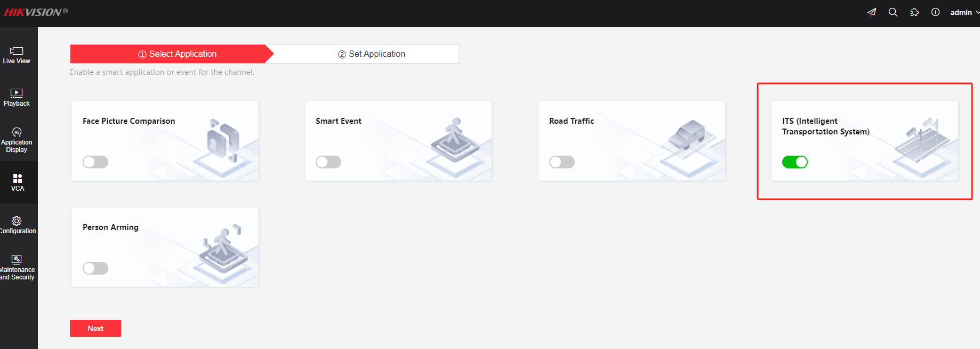
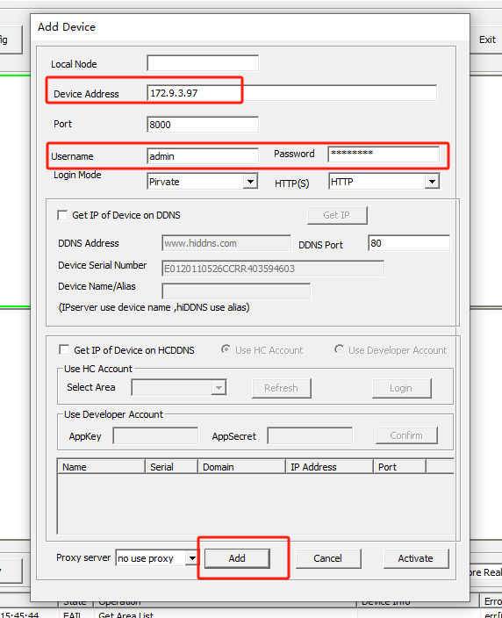
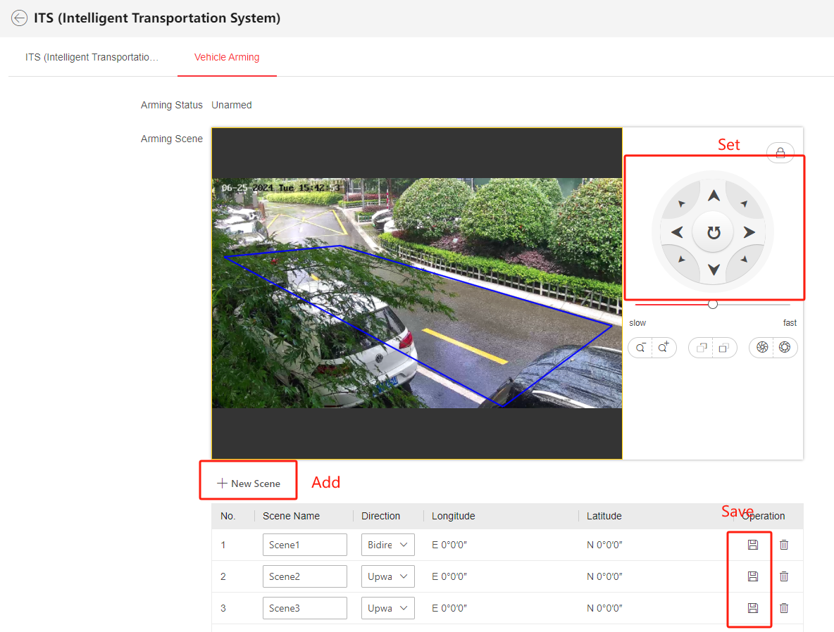
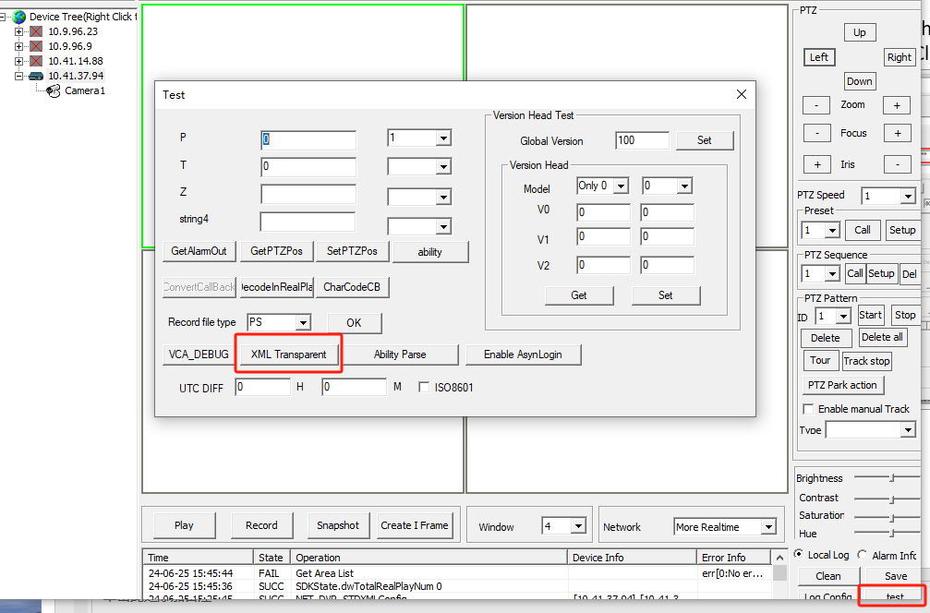
Configuration
1. Select VCA Resource as ITS
3. Arm the camera through Client Demo
(1). Add the camera into Client Demo.
(2). Select the camera, click test and select XML Transparent.
2. Set arming scene
NOTE: Only 1 scene can be armed simultaneously

Slide 26
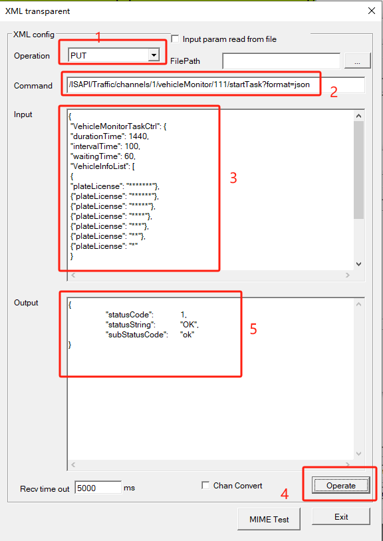
Configuration
Command:
/ISAPI/Traffic/channels/1/vehicleMonitor/111/startTask?format=json
Input:
{
"VehicleMonitorTaskCtrl":
{
"durationTime": 1440,
"intervalTime": 100,
"waitingTime": 60,
"VehicleInfoList":
[
{ "plateLicense": "*******"},
{"plateLicense": "******"},
{"plateLicense": "*****"},
{"plateLicense": "****"},
{"plateLicense": "***"},
{"plateLicense": "**"},
{"plateLicense": "*" }
],
"monitorType": "preset",
"presetID": 1,
"unarmedVehicleDetectionEnable": true
}
}
(3). Operate
Select Operation to PUT, input the following command into Command and Input, after that, click Operate, if the output displays ok, means the successful arming.
NOTE: The content highlighted in red can be changed according to actual arming needs

Slide 27
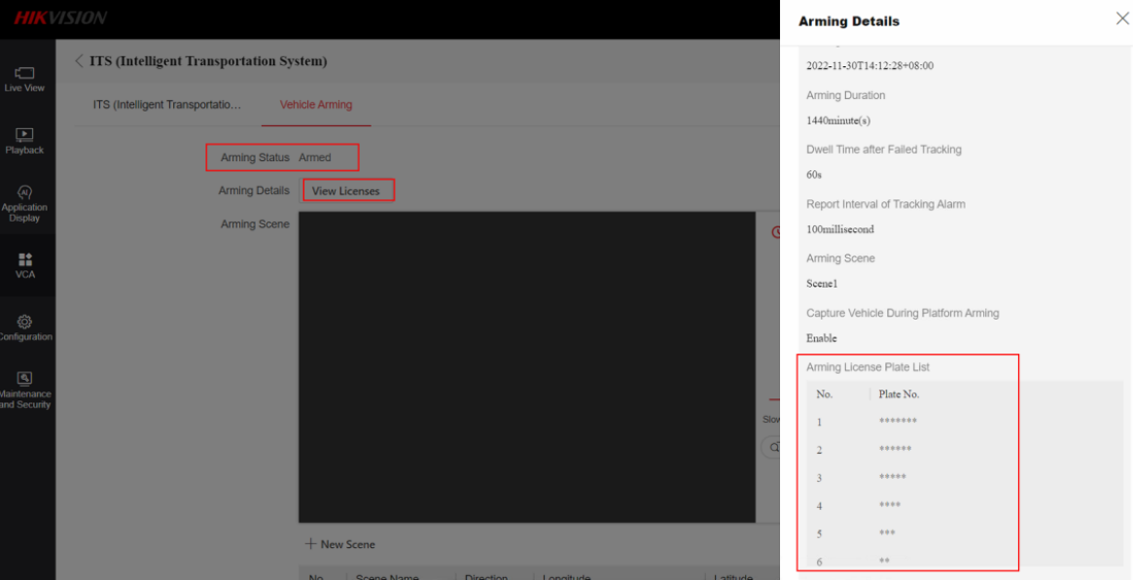
Configuration
(4). Check the arming status
If it is armed. By click the “view licenses” to click the arming license plate.
NOTE: Because the arming time it up to 1440mins which is 24hours, so need to mention that It is only valid for 24 hours, after 24 hours, you need to input command through the client demo again

Slide 28
Configuration
(5). Disarm
When exceeding the arming time, the device will be automatically disarmed. In addition, users can also manually disarm
Select Operation to PUT, input the following command into Command, after that, click Operate, if the output displays ok, means the successful disarming.
After the operation, go back to the camera web page and you can see the arming status back to unarmed.

Slide 29
05
Common Problems

Slide 30
Configuration problems
(1) Rule box problem
The edges of the rule box take into account the height of the target while avoiding areas such as bushes that are prone to false alarms

Slide 31
(2) Tracking Parameters
Please avoid to set too high zoom ratio value, it is easily to loss the target on zooming process, and if the target will lost in the image the device zoomed out too much;
Also set a proper tracking duration (The duration required for the target to normally move from entering to leaving the monitored area).
Note: Sometimes, you can test tracking state by set the zoom ratio value to 1
old version
Web5.0 version

Slide 32
06
Information collection

Slide 33
Videos
Record the videos with the tracking issues
NOTE：Please remember:
Use the manual recorder button on live view page
Enable POS and rule overlay
For Person Arming and ITS, enable tuning mode before manual recording videos
1. Enable POS info overplay
2. Enable tuning mode
(1) Through SDK demo
(1) Person arming
(2) ITS
(2) Through camera webpage

Slide 34
Diagnosis Info
Export diagnosis info from webpage
Normal webpage
Web5.0 webpage
NOTE：The diagnosis is especially valuable when the problem is just repeated

Slide 35
Thanks

